Slide 3
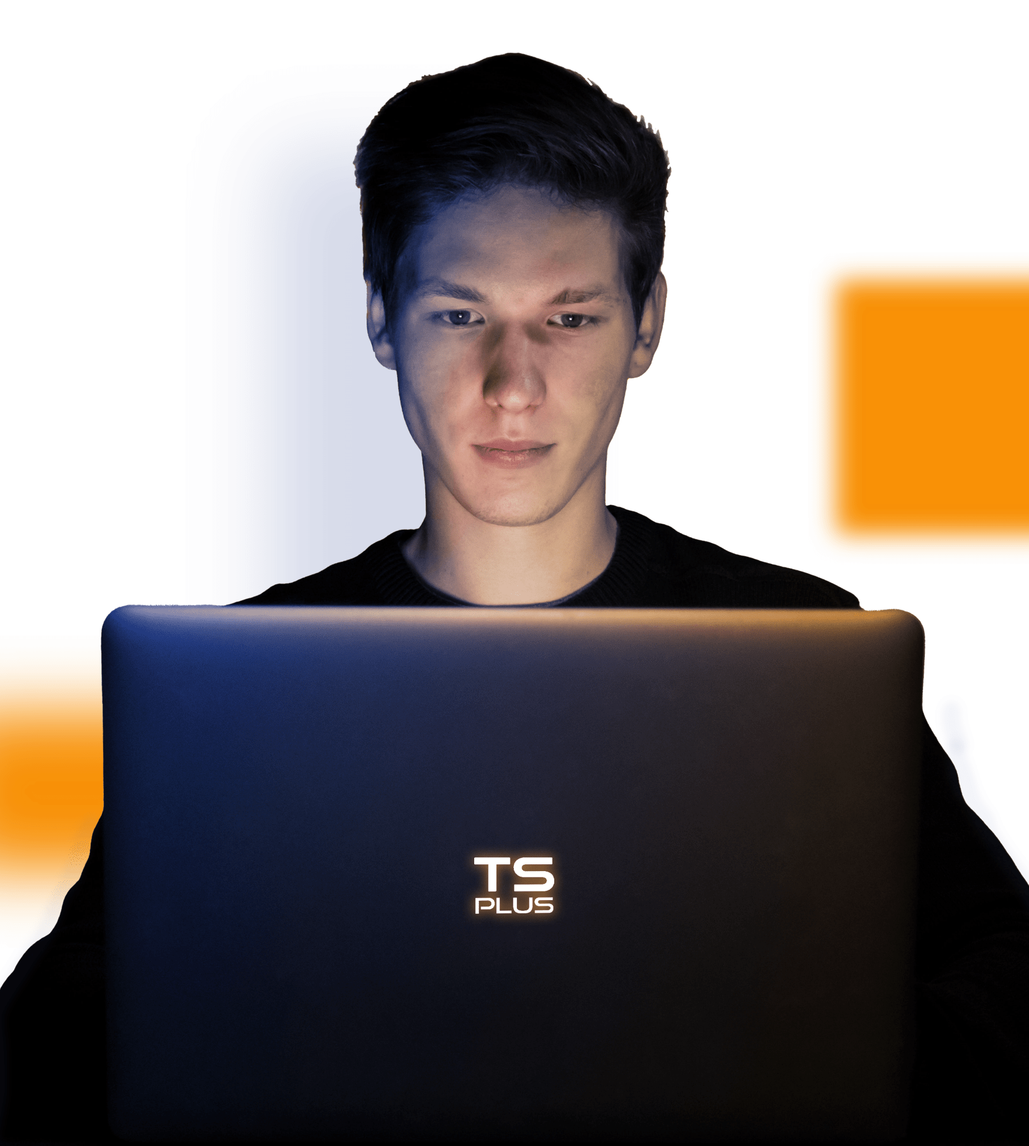
CONTEXT
A changing working environment

Slide 4
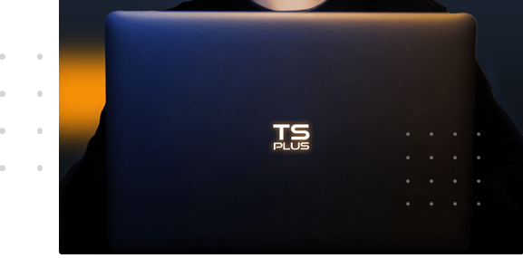
CONTEXT
A changing working environment
Increased demand for mobility over the
last decade.
Two years of forced Home Office
Development of instant communication tools
Emergence of wireless devices

Slide 5
Today, everyone expects to have access to their working tools from anywhere, at any time of day or night using the Internet on their personal device.

Slide 6
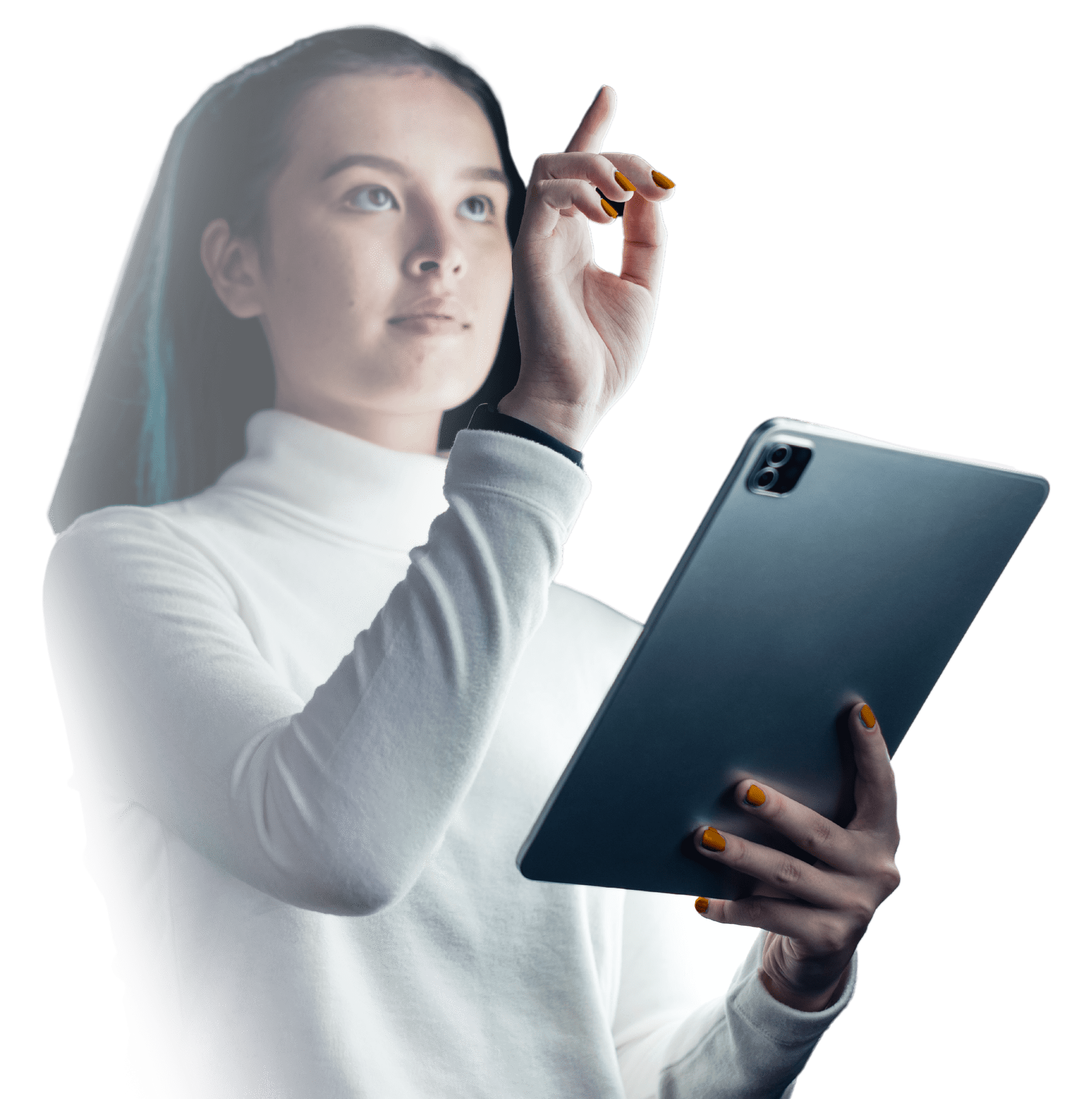
Today, everyone expects to have access to their working tools from anywhere, at any time of day or night using the Internet on their personal device.

Slide 7
Privately held Software Developer
Founded in France in 2007
Branch Offices in the USA, India and Czech Republic
More than 500, 000 customers worldwide
7000 resellers and partners

Slide 8
We are Expert in Remote Access Technologies
For 15 years, TSplus has expanded its experience to level up the ever-increasing capabilities of Cloud computing technologies and allow greater freedom of work.
Privately held Software Developer
Founded in France in 2007
Branch Offices in the USA, India and Czech Republic
More than 500 000 customers worldwide
7000 resellers and partners

Slide 10
CHALLENGE
How to quickly, securely and cost-effectively build remote work environments, given the following obstacles?
PC support and maintenance costs are higher than ever
Budgets allocated to IT (hardware and software) are being cut
Web App development is costly, long and complex to deploy
The use of the Internet increases insecurities and cyberthreats

Slide 11
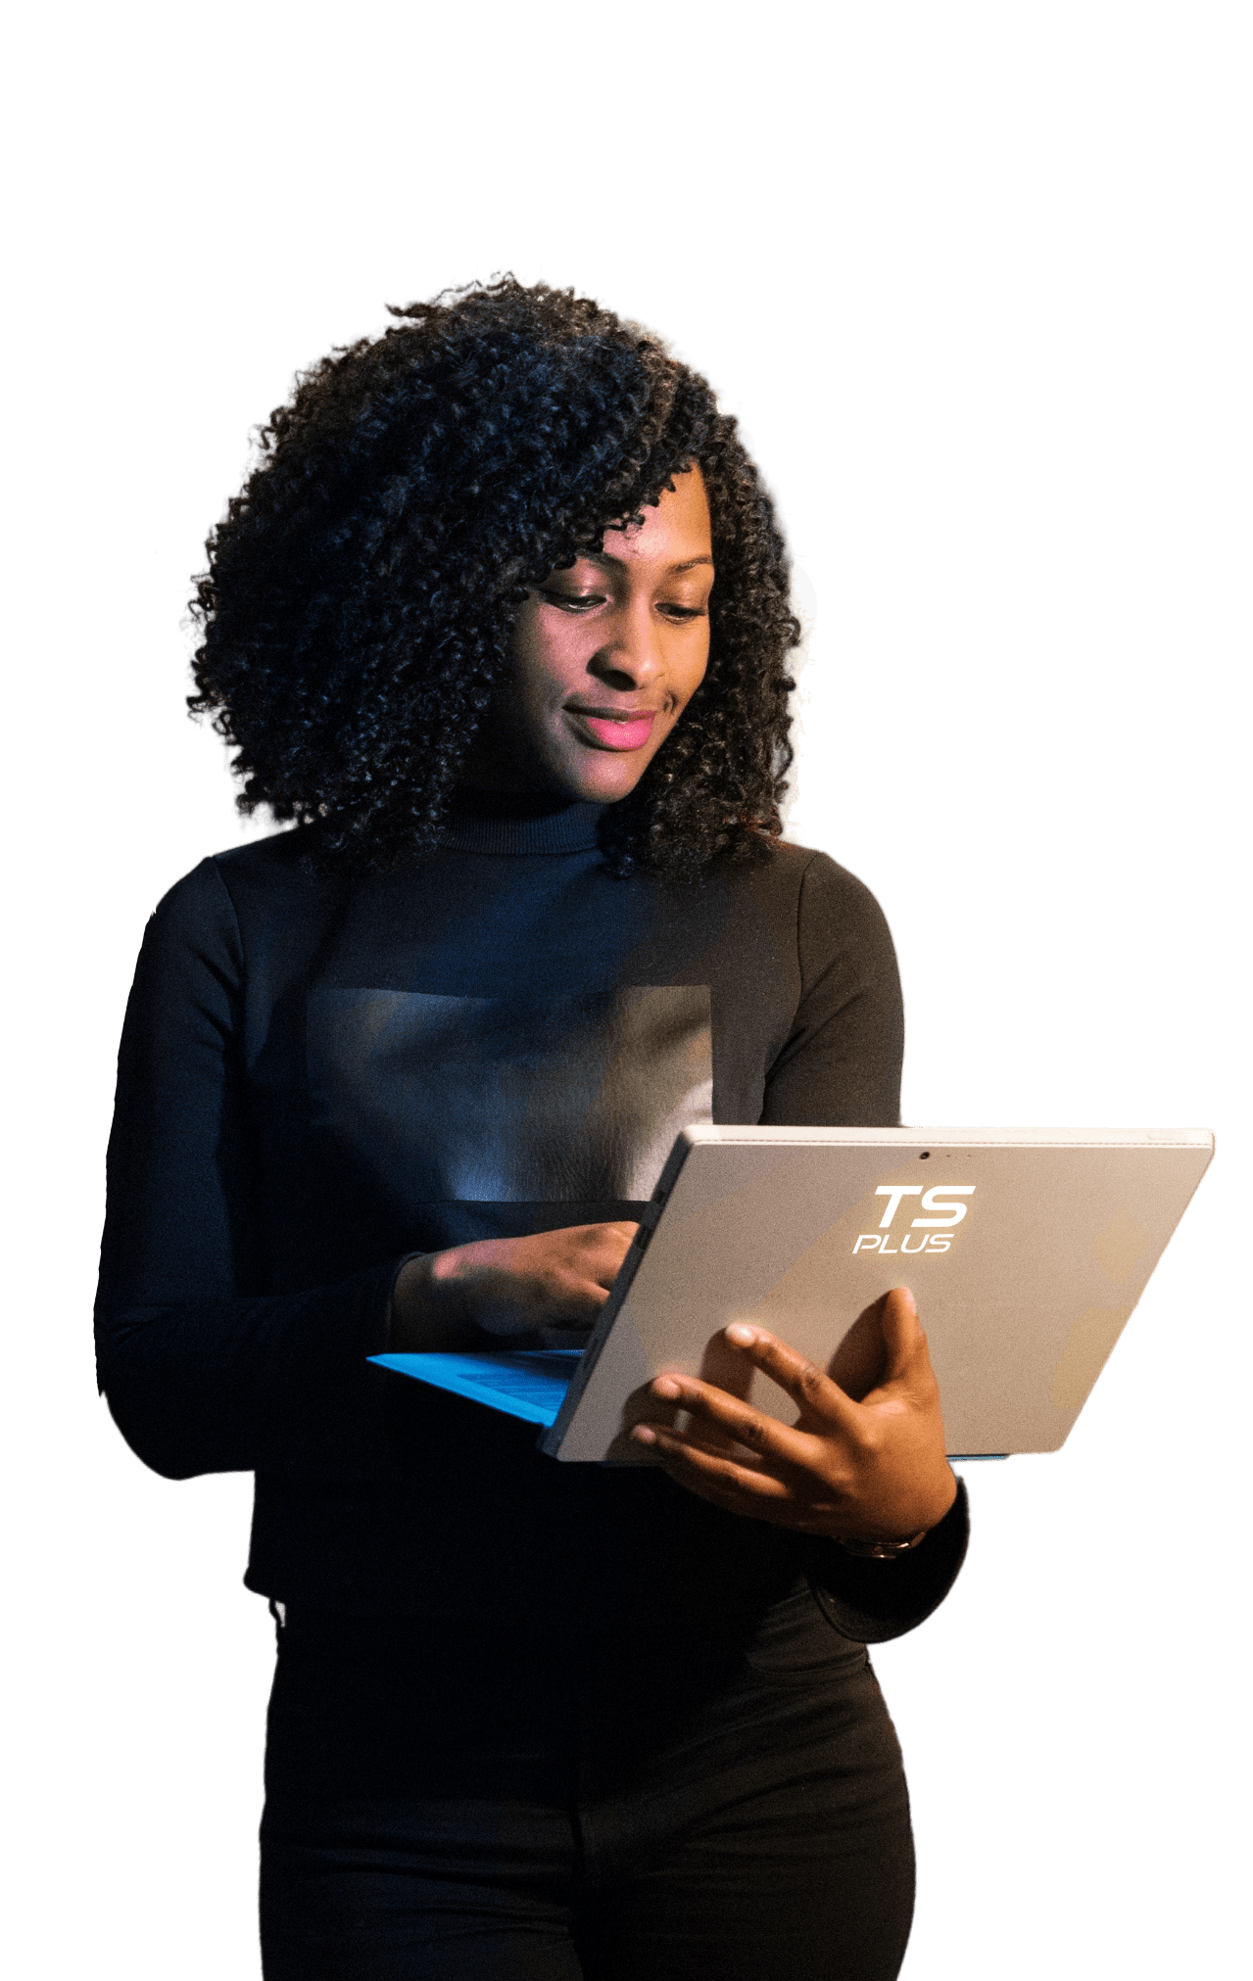
At TSplus, we integrate the most advanced technologies to enable organizations to deliver Windows applications and resources anywhere throughout the World:
Easy To Use
Secure
Cost-effective
Scalable

Slide 12
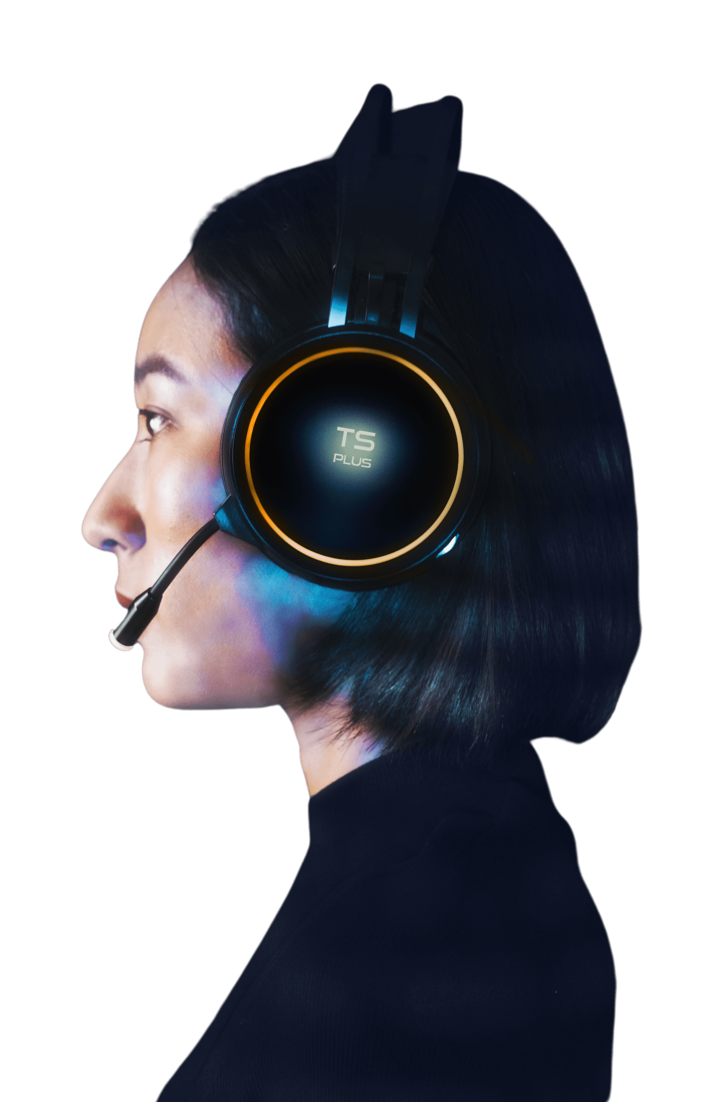
At TSplus, we integrate the most advanced technologies to enable organizations to deliver Windows applications and resources anywhere throughout the World:
Remote Desktop & Application Delivery
The best-value-for-money RDS and Citrix alternative
The cost-effective TeamViewer alternative
Server Security & Ransomware Protection
Server Administration & Session Monitoring
The secure gateway to redirect users to their own PC at work
The efficient tool to keep remote access infrastructures healthy
Screen Sharing & Remote Technical Support
The most comprehensive Remote Desktop security program

Slide 13
Remote access to windows applications from any browser and device
Improved management and control of IT equipment and budget
On premise installation: sensitive data stays secure on the corporate server
Remote Desktop & Application Delivery
Server Security & Ransomware Protection
Higher security: Brute-force bots and ransomware are blocked before they cause permanent damage
Reduced costs, including support travel time and related expenses
Zero or near-zero connection client footprint
Server Administration & Session Monitoring
Screen Sharing & Remote Technical Support

Slide 14
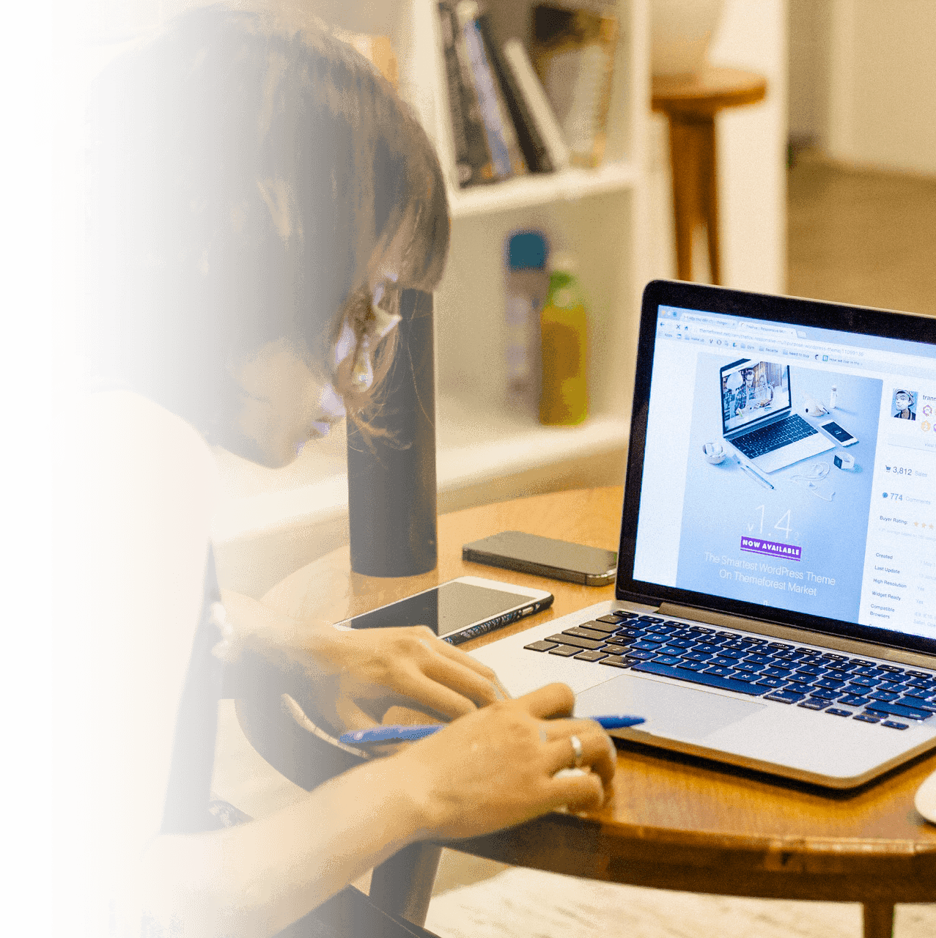
Every year, we invest time and money to design, develop and deliver new products, to enhance them and to offer excellent support to all of our customers, resellers and partners.
➔ TSplus products are used in businesses ranging SMBs with a single server to large corporations with hundreds of application servers and thousands of users

Slide 15
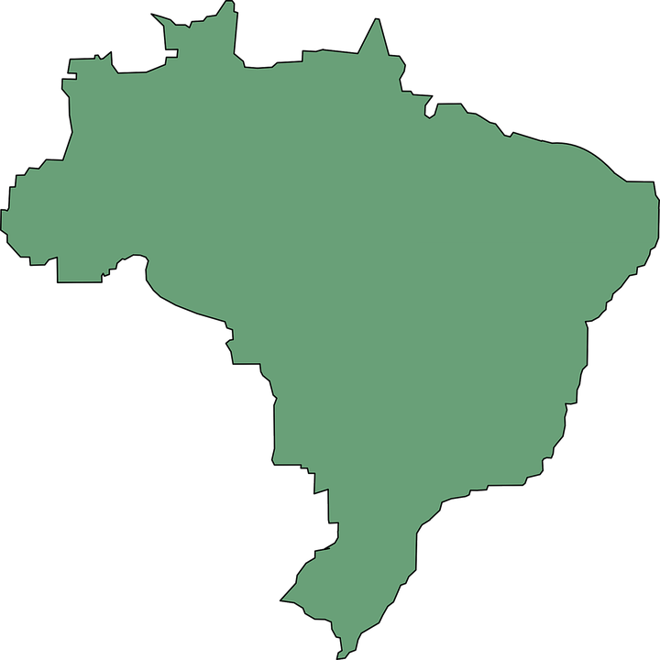
TSplus has subsidiaries and offices registered all over the world, covering 127 countries split in 12 Regions:
Every year, we invest time and money to design, develop and deliver new products, to enhance them and to offer excellent support to all of our customers, resellers and partners
Some large corporation owns hundreds of TSplus systems and many SMBs have deployed 1 to 10 Application Servers.
Western Europe/HQ:
ALEXANDRE BOKOR, France
Central Europe:
HENDRICK WENSCHUCH, Germany
South Europe:
CHRISTIAN PLATZER, Italy
Eastern Europe:
ANDRZEJ KRYSTASZEK, Poland
Middle-East: PATRICK LAWRENCE, Cyprus
Africa: MAURO FIORIN, South Africa
South America: LUIS PERES, Mexico
North America: JAY HOSSENIAN, California
Eastern-Asia:
ALAN YANG, Taiwan
Southeast Asia/China:
ADRIAN FOO, Malaysia
India Peninsula: RUKSHAN SANJEEWA, Sri Lanka
Brazil: GUILHERME FILIPPO, Brazil

Slide 16
Every year, we invest time and money to design, develop and deliver new products, to enhance them and to offer excellent support to all of our customers, resellers and partners
Some large corporation owns hundreds of TSplus systems and many SMBs have deployed 1 to 10 Application Servers.
Each region has its own culture, business requirements, language and spirit.
Our Directors make sure that TSplus provides the same quality and professionalism, no matter your location or needs.

Slide 17
contact@tsplus.net
www.tsplus.net

