Slide 1
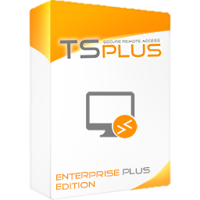
Remote Desktop, Web Portal and Windows Application Delivery
Multi-user Remote Desktop and Application Delivery
TSplus Remote Access is a technology that caters to the
requirements of both small and large businesses. Small
businesses need a rich set of capabilities to minimize the
cost of their IT efforts, while large businesses have complex
IT Infrastructure demands. TSplus Remote Access solves
these fundamental business problems by offering tailored
remote Desktop and Application Delivery solutions
designed for each of these business segments.
Remote Desktop Access
Remote Access provides your remote and local users access to centralized Windows applications on a full remote desktop. Remote Access supports concurrent Remote Desktop (RDS) connections using HTML5 or any RDP compatible clients.
Application Delivery
Publish Applications and enable users to remotely access them as if they were natively installed on their machine. Users access the remote apps from customizable launch menus or shortcuts on their desktops.
Assigning Applications
Once you have published your applications, you can assign them to one or more users or groups. Administrators can assign applications based on Active Directory, local accounts, Azure or AWS.
Multi-user Sessions
TSplus effectively enables from 3 to 50+ concurrent sessions to connect per server, allowing your server farm to scale up to thousands of users. Applications and connection modes can be customized for each user or group.
Connection modes: Customize the User Experience
RDP Client
TSplus Remote Access is compatible with any RDP client. Your concurrent users will have access to a standard Windows desktop with its shortcuts, start menu and task bar. Use the TSplus RDP client generator to enable a 1-click connection experience for your users.
RemoteAPP Client
Provide a launch menu on the local desktop of users to open applications hosted on your server. Applications will be displayed on the user’s local desktop as if they were running locally, not in a remote desktop standard session. You can also decide to publish one single application that will start automatically on the user’s local desktop.
HTML5 Client
The secure TSplus Web Portal enables delivery of a full remote desktop or application(s) on any device using any web browser. Users simply log in through the customizable HTML5 web portal to connect. The application(s) or the full desktop will be displayed within the browser.
Display Options:
RDP – Full Desktop with MSTSC or TSplus 1-click
RemoteApp - Floating Panel or Application Panel
RemoteApp – One-application launch
HTML5 - Full Desktop or One-application launch
HTML5 – Web Portal or Progressive Web App
https://tsplus.net/remote-access

Slide 2
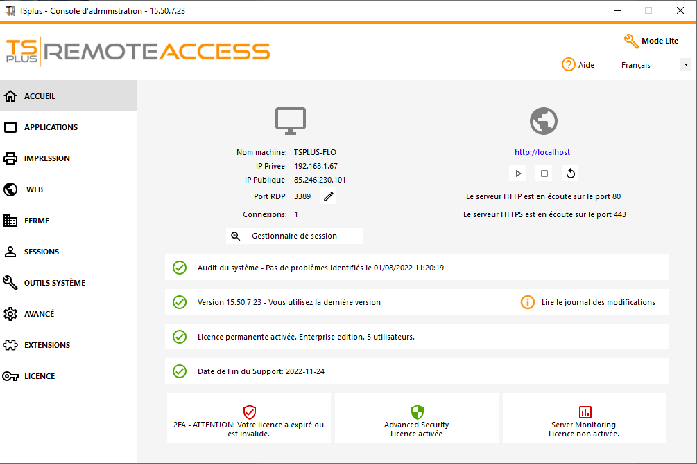
Pre-Requisites:
1) Hardware
TSplus Remote Access Server minimum requirements:
2) Operating system
Your server must use one of the following operating systems:
Windows 7 Service Pack 1, 8/8.1, 10 Pro, or 11 Pro
Windows Server 2008 R2 Service Pack 1, Server 2012 or 2012 R2, Server 2016, Server 2019 or Server 2022
Both 32 and 64 bit operating systems are supported.
The required framework is .NET version 4.5.2 for all supported Windows versions.
Make sure the RDS/Terminal Services and RDS/
Terminal Services Licensing server roles are not installed.
Windows Home/Family Editions are not supported.
3) Network parameters
The Remote Access Server must have a static private IP address
The TCP RDP port (by default 3389) must be opened both ways on your firewall.
The trial version of Remote Access is the fully-featured Enterprise Edition. It is licensed for up to 5 concurrent users for a period of 15 days.
Number of users | Windows Server2008 to 2022 or 7 to 11 Pro
3 - 5 | I5 or above 4 GB RAM One CPU 2 GHZ
10 | I5 or above 8 GB RAM One CPU 2 GHZ
25 | I7 or Xeon 16 GB RAM One CPU
50 and above | Dual CPU 32 GB RAM SSD Disk dedicated to the system
Admin Tool
Configure all Remote Access tools in one place.
User and Application Management
Active Directory Support
Client Generator
Customizable Web Portal
Remote Printing
Print from a remote session to a local printer.
Universal Printer (driverless remote printing with pdf)
Virtual Printer (fine-tuning and advanced printing)
Security
Maximize the security of your remote access infrastructure.
Secure encrypted connections (SSL/TLS)
TSplus Advanced Security (all-in-one security toolbox for remote access)
Two-factor Authentication (add-on to the Web Portal)
Frequent Security Updates
Lockout Feature (monitor and block IP after too many failed login attempts)
Farm Management
Scale up your remote access infrastructure.
TSplus Gateway Portal (access to multiple servers from one place)
Load Balancing
Reverse Proxy
…And More:
Web credentials
Session Pre-launch
File transfer and Clipboard
Open on Client
Customer and Partners Licensing Portal
Contact us TSplus corporation 300 Spectrum Center Drive, Irvine, CA 92618, USA +1 949-561-1771
https://tsplus.net/remote-access

