Slide 1
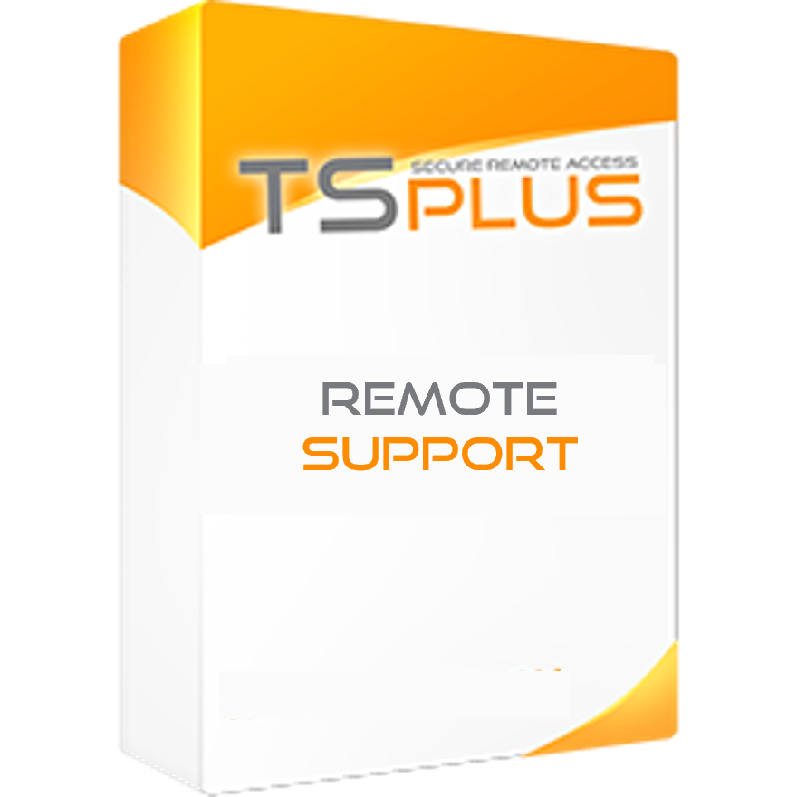
Provide instant attended or unattended remote assistance to your teams or clients anywhere, at any time.
Remote Desktop control and Screen Sharing Software for Remote Support and Maintenance Services
TSplus Remote Support is a technology designed for today’s flexible support teams and maintenance service providers. It offers a secure and simple process, convenient for both agents and end-users, allowing to access remote computers, files and applications in a click and take control to troubleshoot problems as quickly as possible.
Screen Sharing
Support agents can take control of the screen, mouse, and keyboard of remote clients. Agents and end-users simply download and run the same small program. The ultra-simple interface allows to take control of any PC in just a click, after entering the client's computer ID and a unique one-time password. As soon as the connection is made, the chat box appears, and the remote support session starts.
Multi-agent Support Session
An Agent can take control and troubleshoot independently or collaboratively: multiple Agents can connect to the same remote computer.
Chat Box
Both the one who shares and the one who controls the remote computer have a tailored chat box. In one case the box contains vital information and all the standard functionalities needed to run a support session.
The client's chat box is simpler for an ideal user experience.
Send Commands
Support Agents can send keyboard commands such as ctrl+alt+del or start the Task Manager on remote computers.
Support Features:
Support Agents have access to several features to provide the best help:
Change Interface Language
Multi-monitor Support
File Transfer
Enable/Disable Clipboard Synchronization
Remote Computer Information (OS, Hardware, etc)
Attended and Unattended Sessions Sharing
Enable quick and easy remote connections.
Computer ID and password: The end-user shares their ID and password with the agent to enable the connection. All access details can be shared at once with a Copy/Past button. The password can be manually refreshed in a click.
Unattended Access : Each agent can add remote machines to the list of available unattended computers and access them. Three actions are available on computers: connect, open a command prompt and remove. Unattended computers can be organized using groups and quickly found using the search bar.
End-to-End encrypted connections: TSplus Remote Support enables Windows desktop session sharing to create an encrypted connection between support agents and end-users. Every Remote Support connection is secured using modern TLS encryption. Remote Support connection servers are managed by TSplus experts, with server locations all around the world for the best customer experience.
https://tsplus.net/remote-support

Slide 2
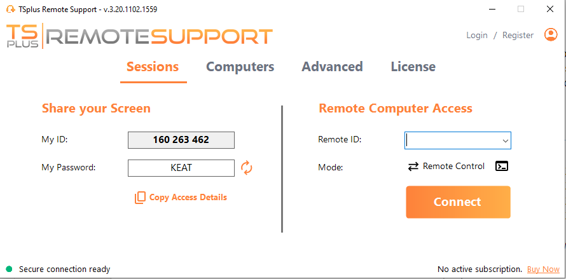
Pre-Requisites:
1) Hardware
TSplus Remote Support runs on both 32 and 64-bit editions of Windows computers.
2) Operating system
TSplus Remote Support is compatible with the following operating systems:
Windows 7 Service Pack 1
Windows 8/8.1
Windows 10 Pro
Windows 11 Pro
Windows Server 2008 R2 SP1
Windows Server 2012 or 2012 R2
Windows Server 2016
Windows Server 2019
Windows Server 2022
The required framework is .NET version 4.5.2 or higher.
There is no installation or configuration. TSplus Remote Support only requires an Internet connection.
Depending on the location of the agent and remote computers, and to ensure the best performance, multiple relay servers may be contacted by the Remote Support program. For networks with restrictive network policies, please allow outgoing connections to domain name *.tsplus-remotesupport.com from the agent and the remote computer.
The trial version of Remote Support is the fully-featured edition, valid for 15 days, 5 concurrent connections.
User Experience
Lite connection client: Simplified end-user interface.
Known Computers list: Each new connection is automatically added to a list of known PCs. Computers information can be edited at any time.
Advanced Settings: Useful management tools. Users can enable unattended access to their device, and agents can generate clients, customize the required client’s information, and access a helpful connections reporting.
Customization
The Admins console offers customization options to keep control of the support environment.
Use your Domain: Host your connection client download using your branded domain.
White Label: Add your branding to the Remote Support connection client.
Adapt video quality: Scales display quality to accommodate bandwidth limitations. This keeps the connection working smoothly and quickly.
Manage Agent Accounts
Registering allows agents to retrieve their configuration from different computers. Agents can create a personal login with a password to easily access their records of user information and PC IDs, including the list of unattended computers, from wherever they are regardless of the device they use to run Remote Support.
Two access modes are available:
"Remote Control" allows you to take control of the remote session using your mouse and keyboard, while displaying the screen of the distant session.
"Command Line" allows you to display a command prompt in the context of the remote session.
Contact us TSplus corporation 300 Spectrum Center Drive, Irvine, CA 92618, USA +1 949-561-1771
https://tsplus.net/remote-support

