Slide 1

The Simple Alternative to
TeamViewer
DISCOVER
2022

Slide 2



EFFICIENT
PROVIDE secure remote support faster than ever.
2
8
EFFORTLESS
Don’t spend time and money using Teamviewer.
just click, connect, and save on your budget!
ECONOMIC

Slide 3

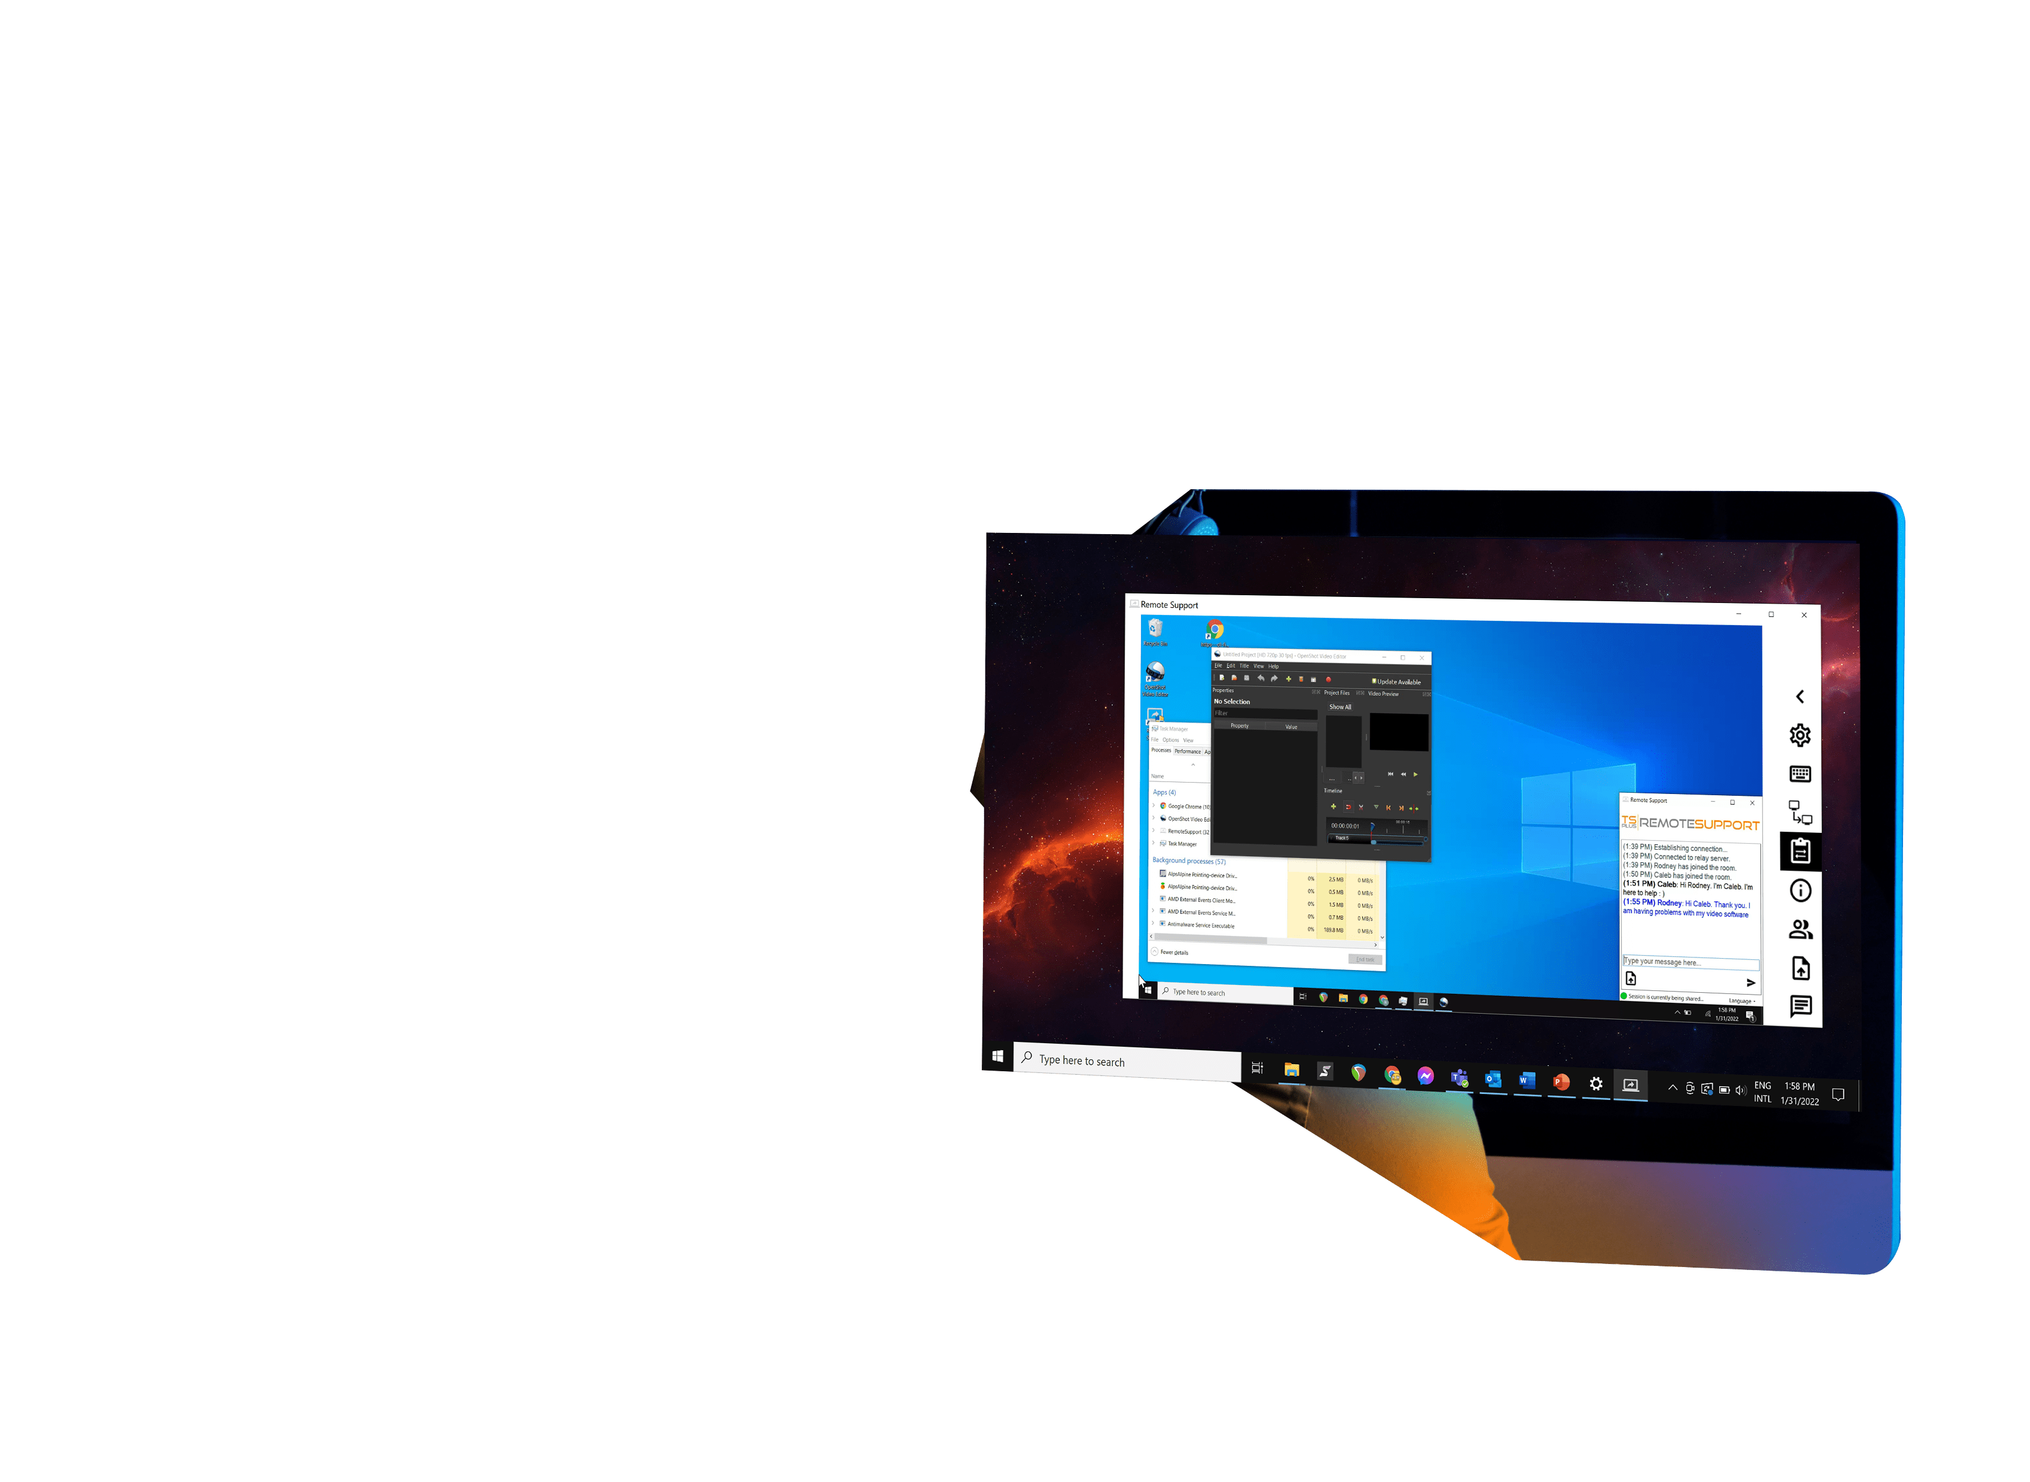


Instantly Access your Users’ Computers and Troubleshoot Problems in No Time
3
Deliver support services 24h/7
with a powerful solution
8
Remote Desktop Control
Screen & Keyboard Sharing
Unattended access
Execute Commands Remotely

Slide 4
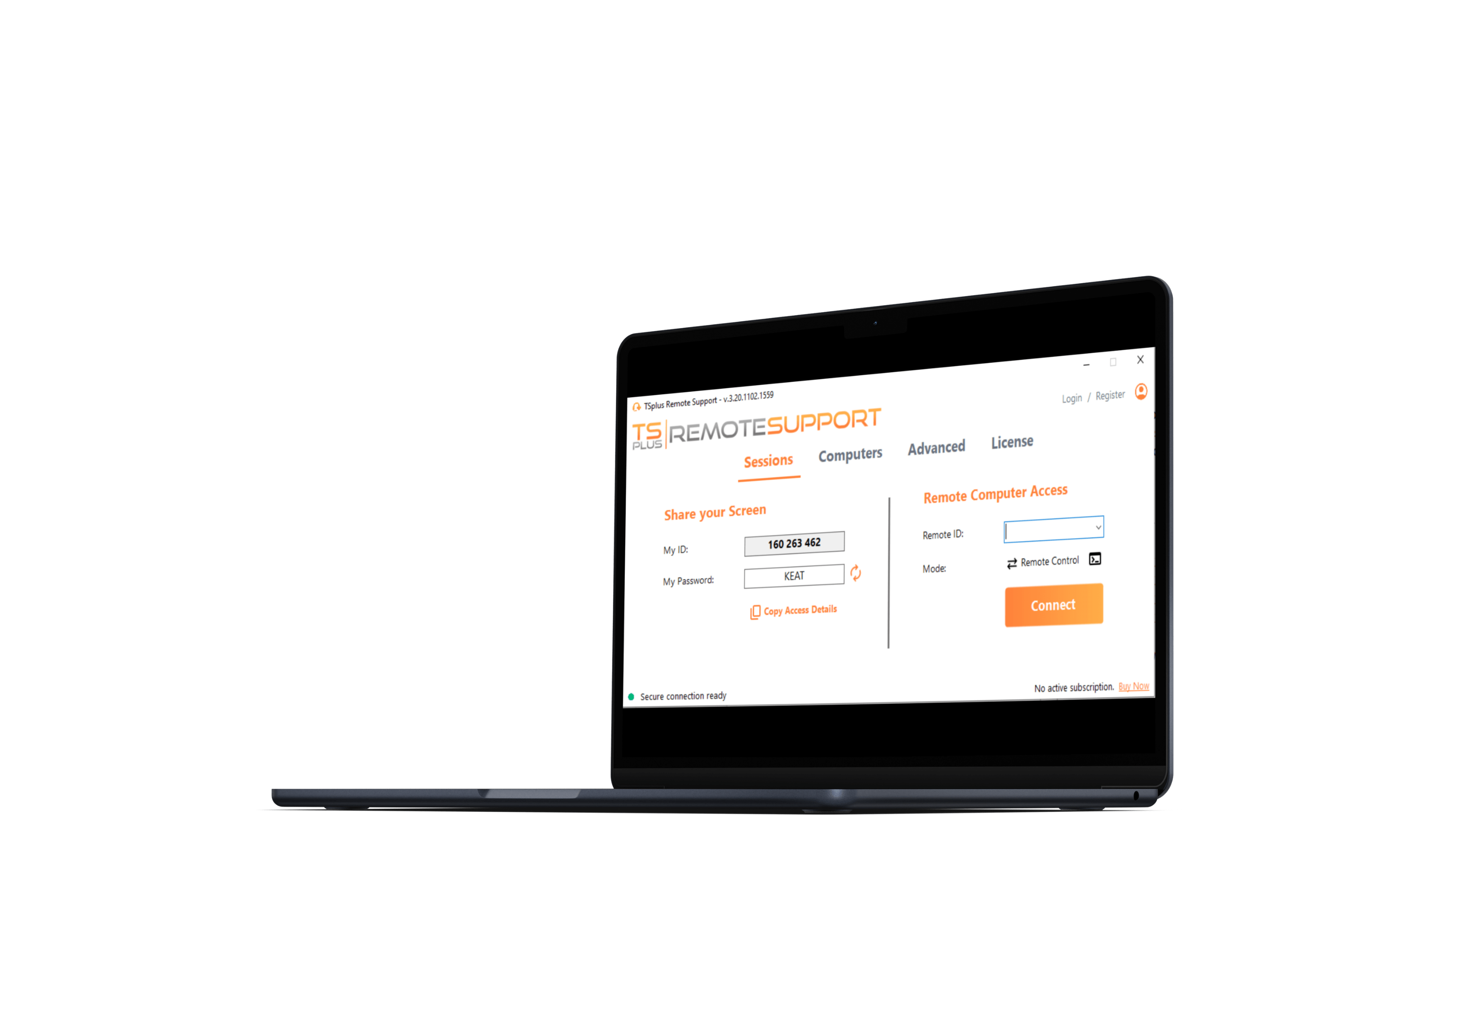
Give Your Support
Agents the Best Tools
for the Best Service
Quick installation
4
Single small program to share and control
Zero installation on the client side
Lite connection client (Client Generator)
8

Slide 5
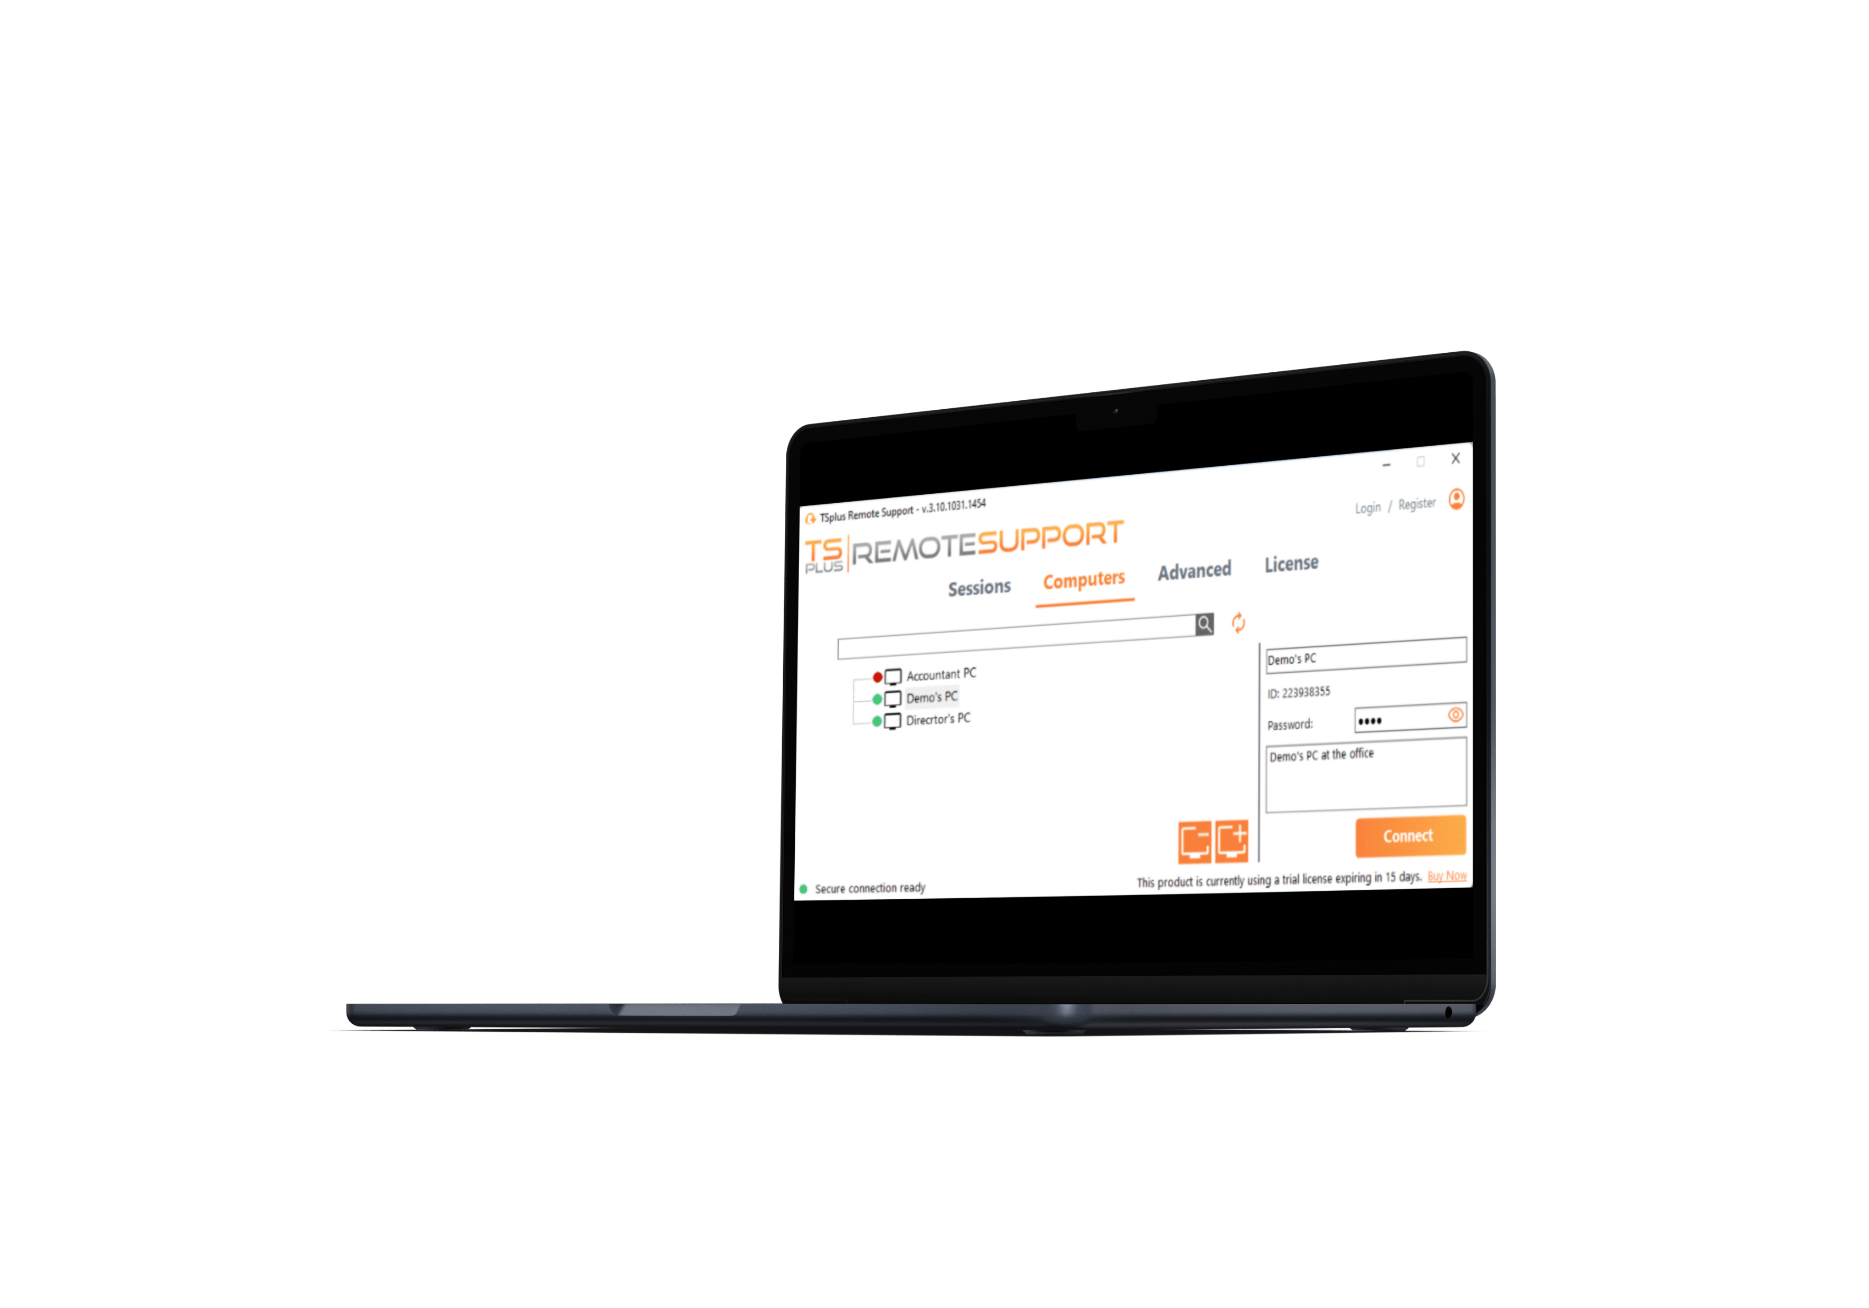
Give Your Support
Agents the Best Tools
for the Best Service
SMART MANAGEMENT
4
Automatic list of known computers
Access to client system information
Create Agent account & login
8

Slide 6
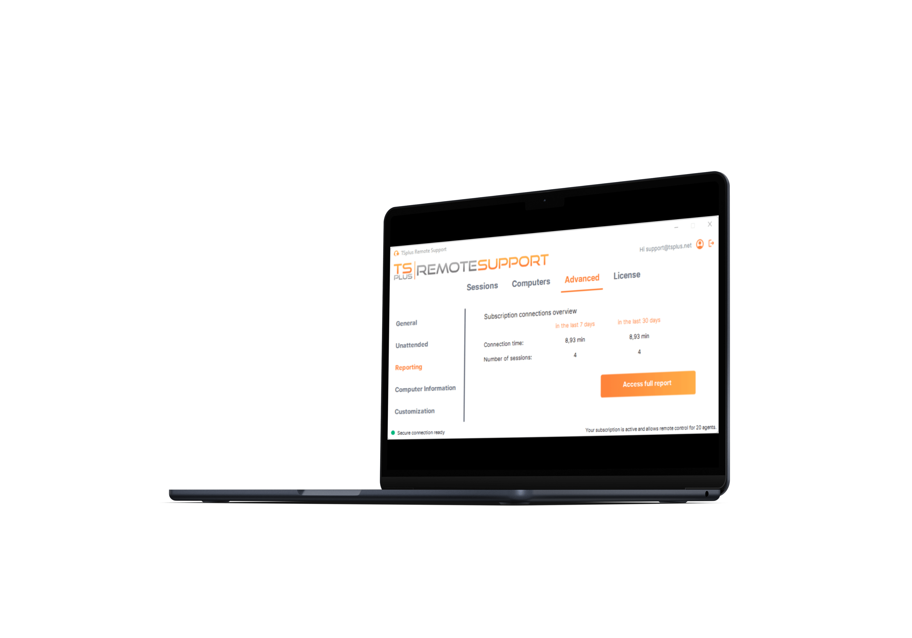
Give Your Support
Agents the Best Tools
for the Best Service
EASY COLLABORATION
4
Connections reporting
Multi-session support
File sharing
8

Slide 7
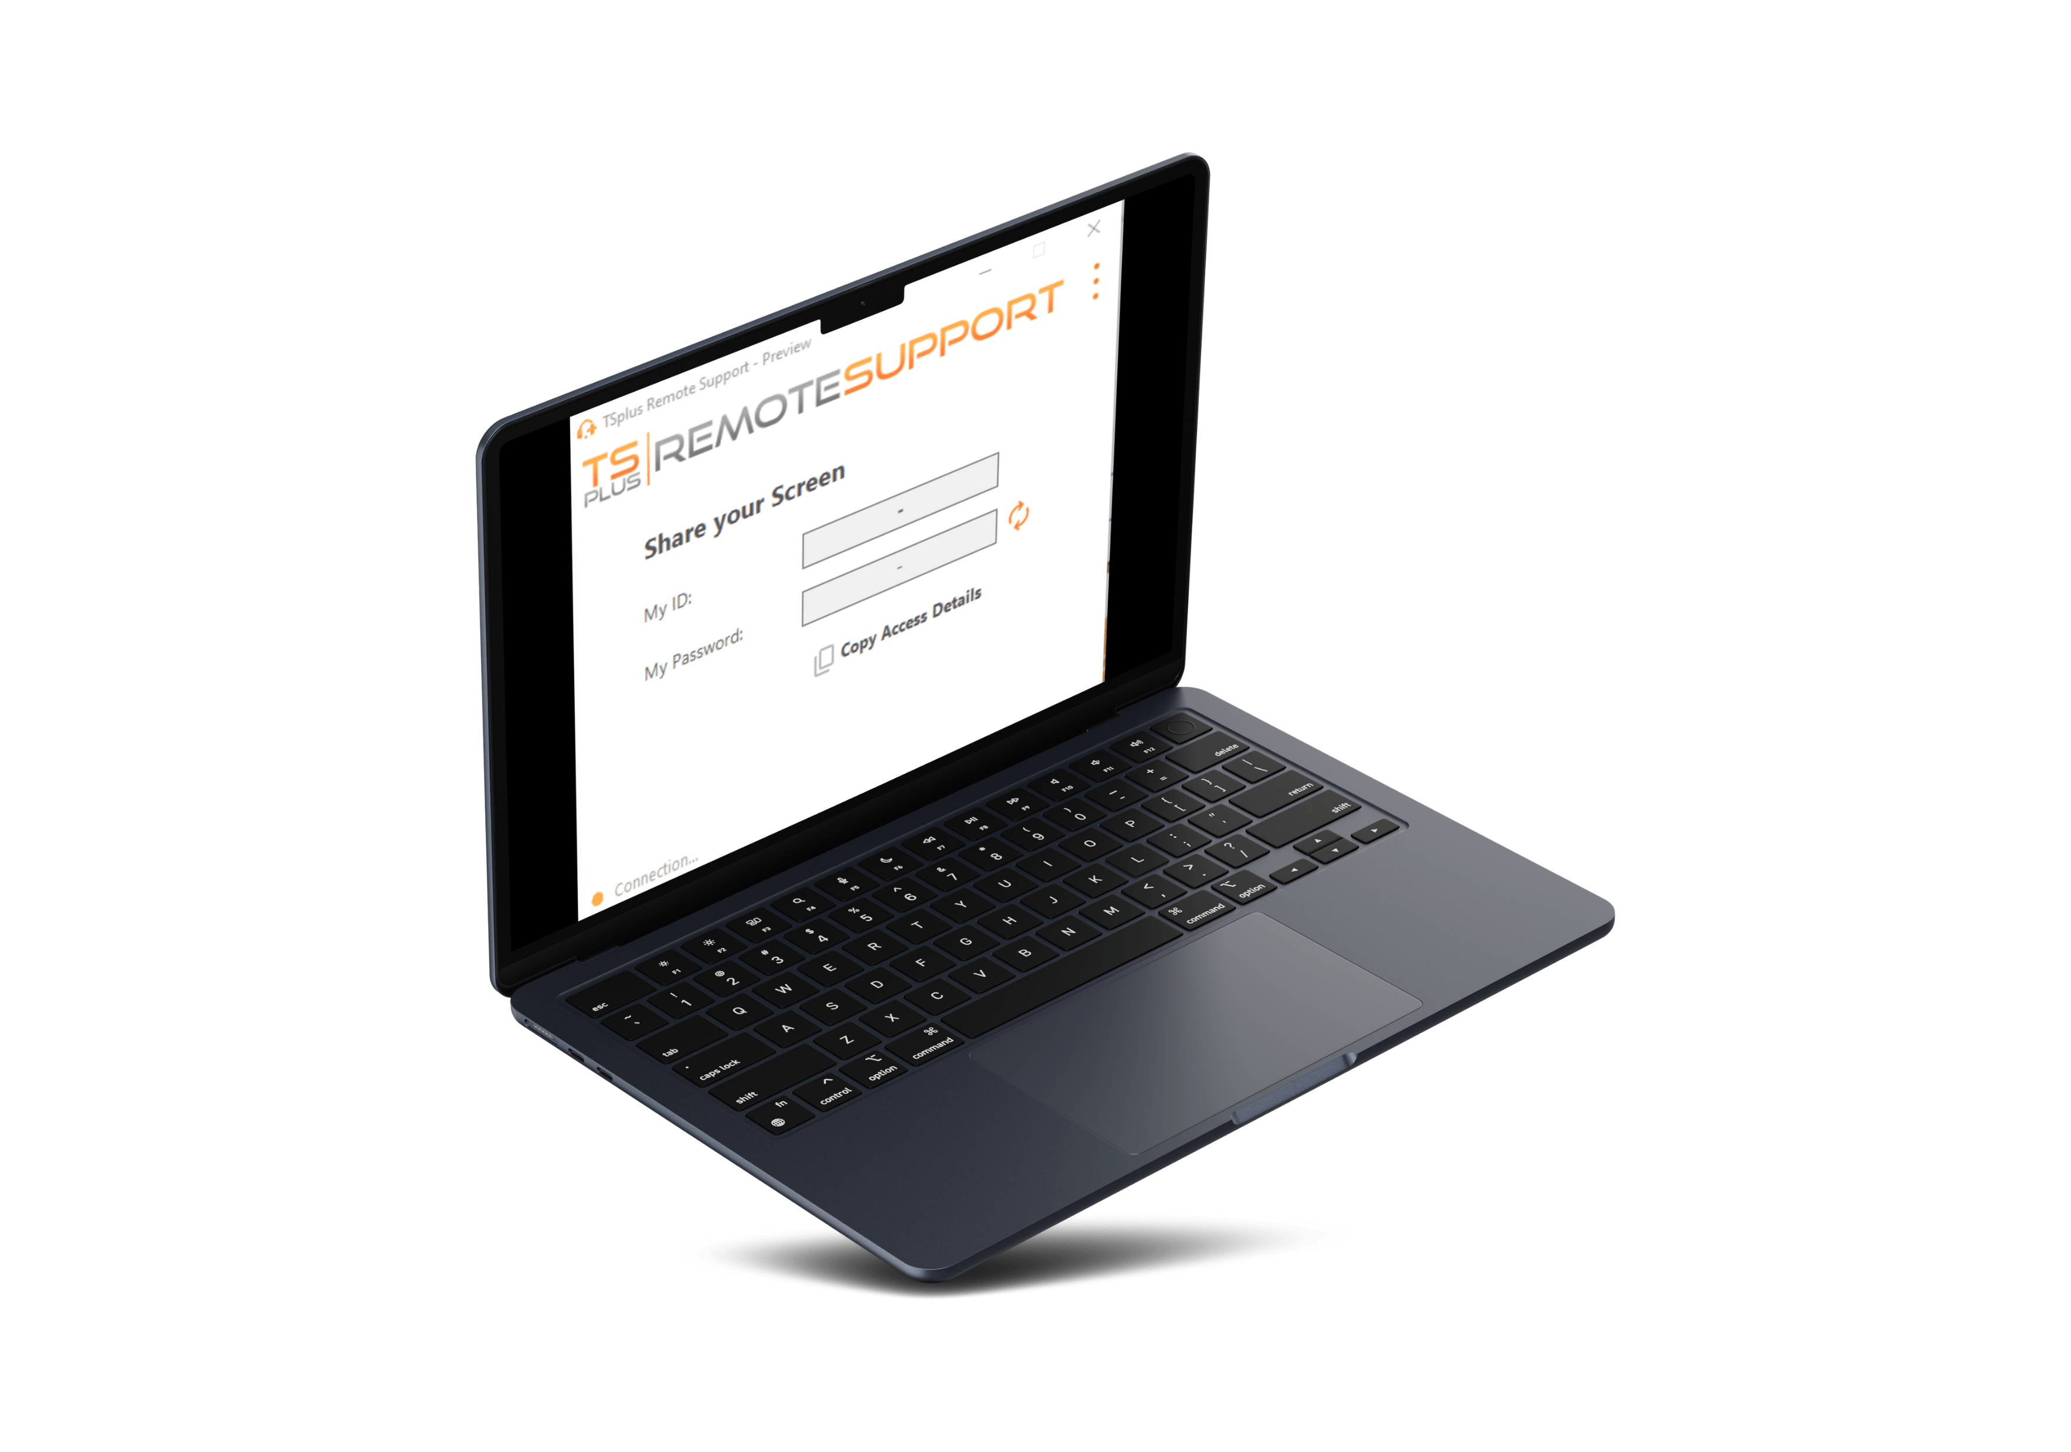
Help Your Customers
Without Struggle. Connect in a Click and Take Control!
SIMPLE CONNECTION
5
Simplified end-user interface
Universal sharing system: ID and password
One click to connect
8

Slide 8
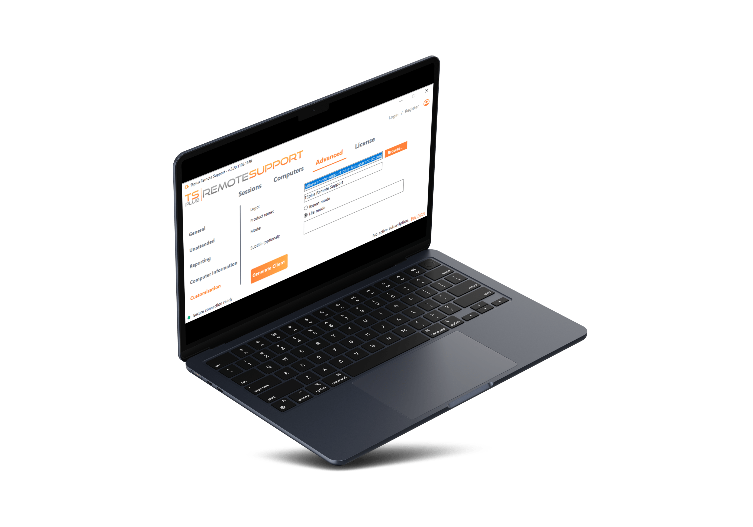
Help Your Customers
Without Struggle. Connect in a Click and Take Control!
CUSTOM SOLUTION
5
Use your own domain name
White label client logon
One-time client password
8

Slide 9
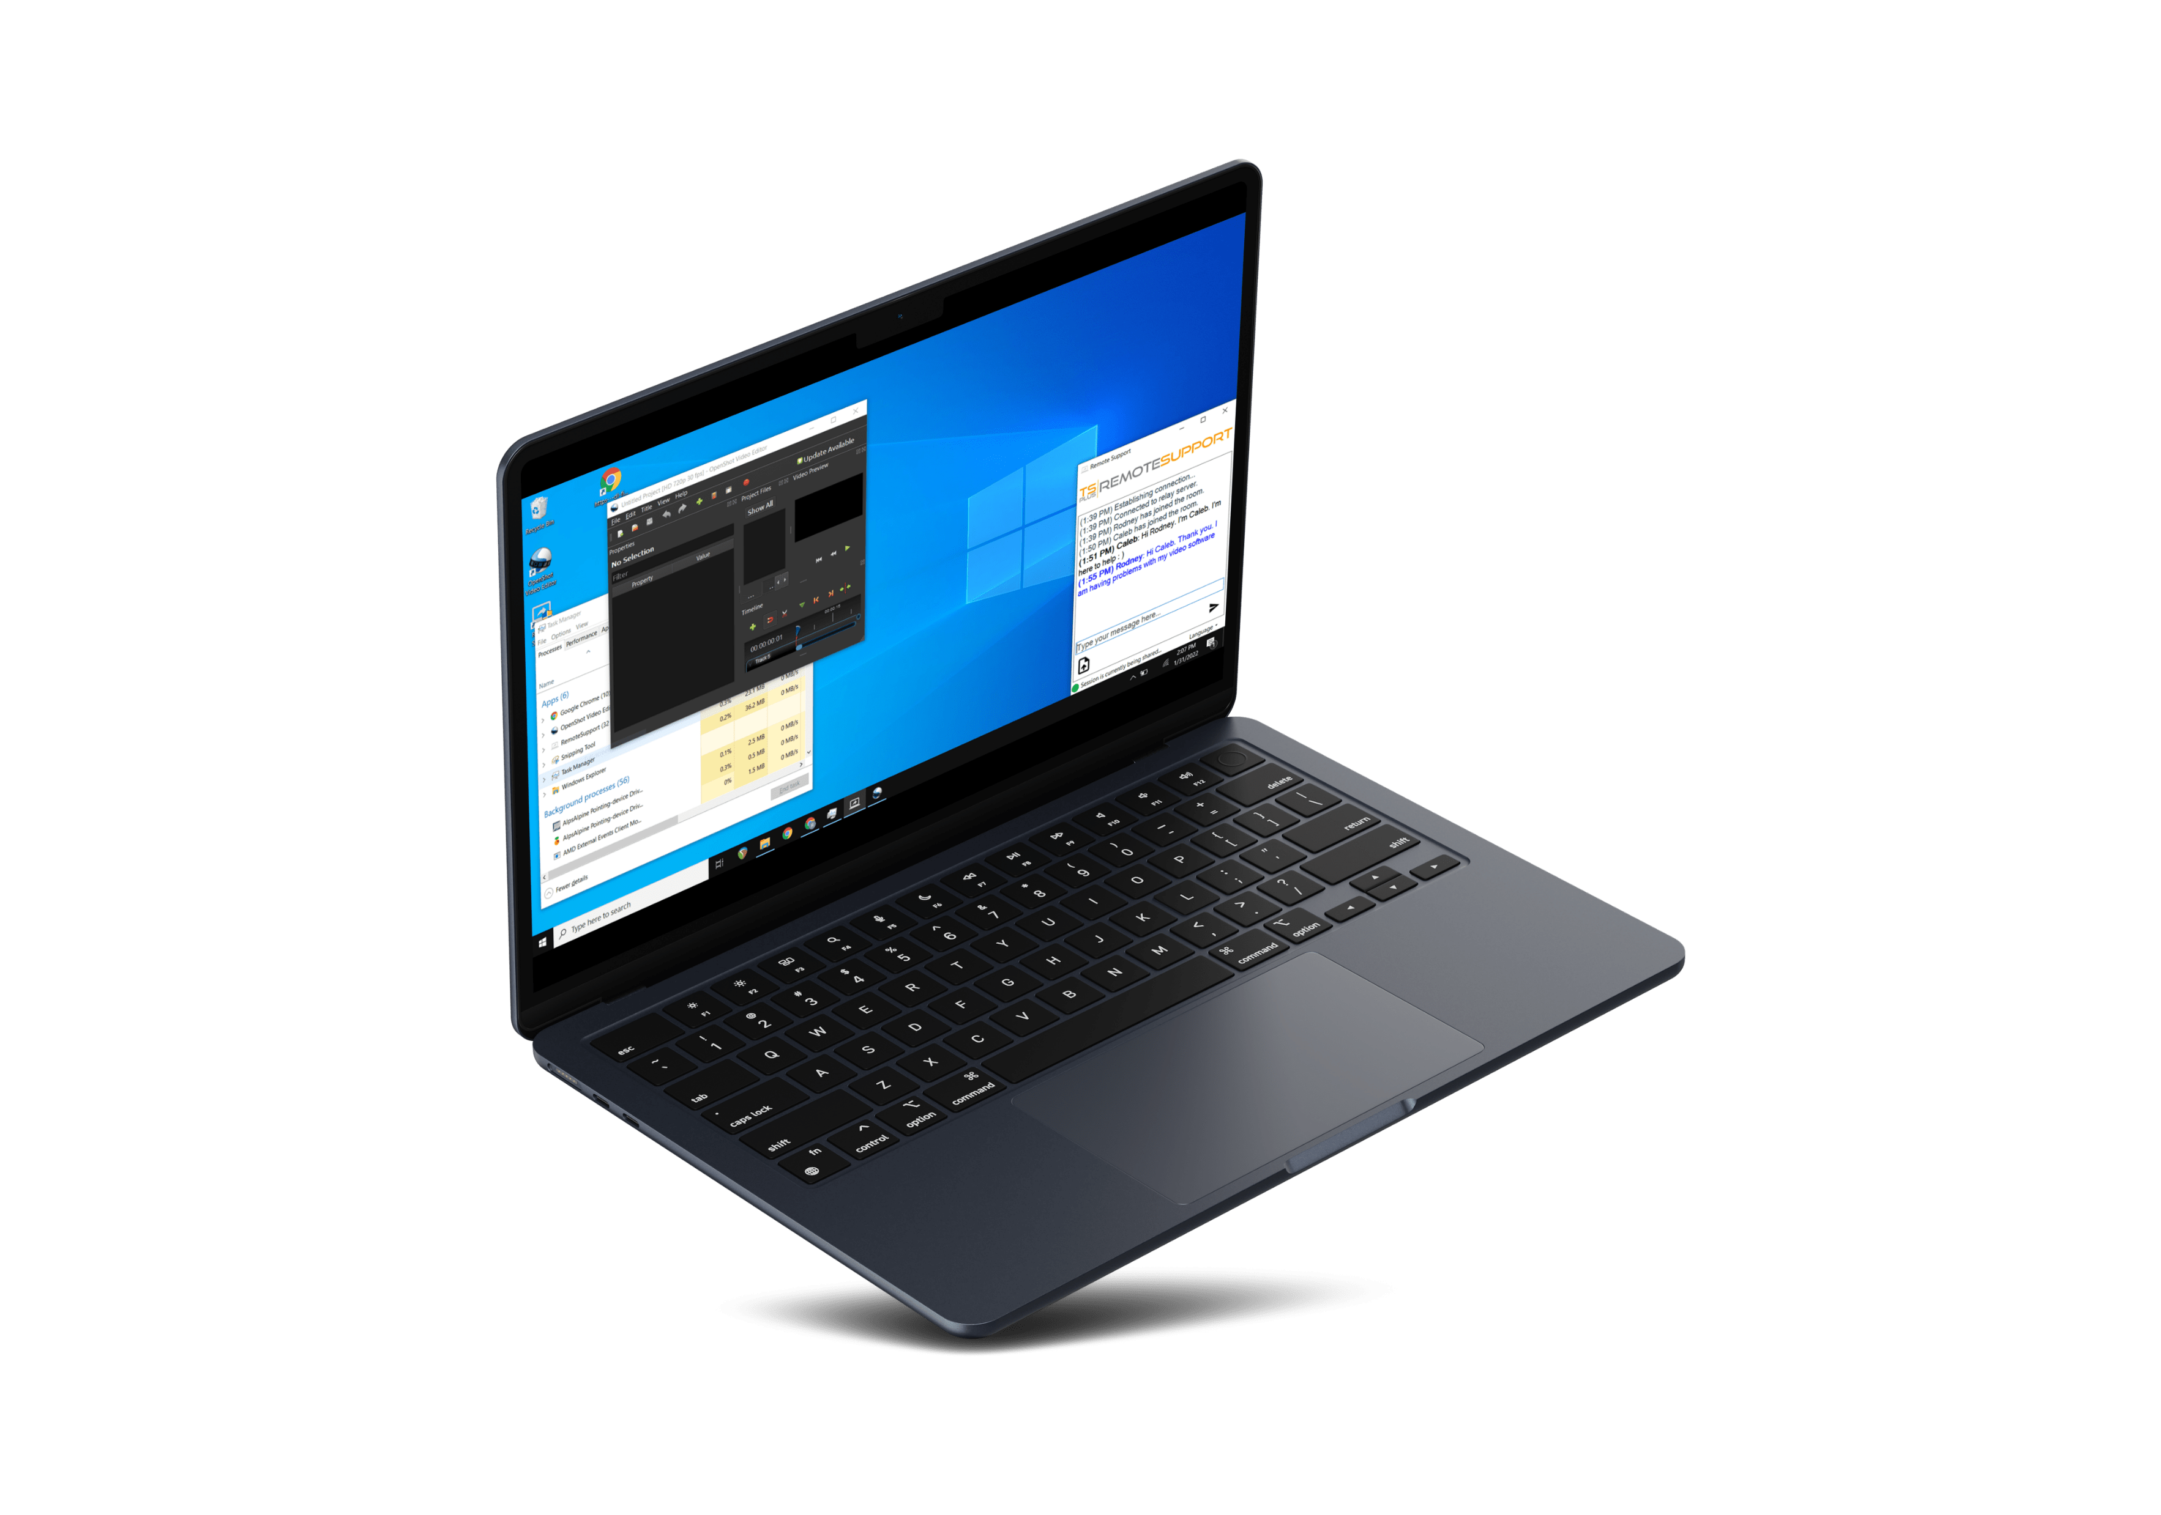
Help Your Customers
Without Struggle. Connect in a Click and Take Control!
INTERACTIVE SUPPORT
5
Communicate via chatbox
Copy/paste & clipboard sync
Language selection
8

Slide 10


Build The Trust: Ensure Session Sharing Stay Safe for Everyone
6
No third party server.
We offer a full Saas Solution!
8
Full back-end management
Regular updates and maintenance
End to end TLS encryption

Slide 11


Connection relay
The TSplus Difference: relay servers all around the globe.
Connection via
Client logon
7
8
And, Remote Support scales display quality to accommodate bandwidth limitations.
control your co-workers or clients’ pcs from anywhere
Share your user screen, mouse and keyboard in a click

Slide 12

A Great Product Should not Come at a Great Cost. Be Smart and Take the Leap!
8
Our very attractive monthly subscription starts at:
Saas
solution
PER CONNECTION PRICING
FREE TRIAL DOWNLOAD
8
$8
for 1 connection
Pay monthly.
Unlimited Clients
15 days
Stop whenever you want
Pay per concurrent connections
5 connections
Test it today!
Visit our website
Control your IT budget
Access from 50 unattended PCs

