Slide 1




Server Monitoring
Get historical and real-time data about your servers, websites, applications and users.
Comprehensive server and website monitoring software.
TSplus Server Monitoring is a technology designed for remote access and remote work infrastructures, to get a clear understanding of usage and performance. It monitors servers and websites on a single interface and provides relevant reports and alerts to IT Administrators can understand, predict and avoid any issue that could harm the production.
Server Features
Real-time Monitoring
Performance Monitoring: Display an overview of the server performance (CPU, Memory, Disk read and Disk write) over the last 10 minutes.
Process Usage: Show the processes currently used on the selected server, and other key indicators.
Bandwidth: Monitor the bandwidth usage (up and down) of the selected server.
Users: Display users currently connected to the selected server
Server Report Features
Customizable Reports: Both standard reports or customized can be used to view, export, print or email servers’ performance indicators.
Concurrent Sessions Report: Display, export, print or email the number of concurrent sessions for the specified server(s) and period of time.
Performance Report: The Server average performance Report displays the average performance (CPU, Memory, and Disk usage) for the specified server(s) and period of time.
Network Usage Report: The Network Usage Report displays the network usage for the specified server(s) and period of time.
User Presence Report: The User Presence Report displays the user presence for the specified server(s) and period of time.
User Attendance Report: The User Attendance Report displays the user attendance for the specified server(s) and period of time.
Application Usage Reports: The Application usage per server and user Report displays the application usage per user for the specified server(s) and period of time.
Website Features
Real Time Monitoring: All websites have been running properly over the last 30 days, or the selected period of time. This simple real-time report includes an overview as well as the possibility to deep dive into specific machines, further into the past.
Availability Report: The Website Availability Report displays the uptime in percentage for the specified website and period of time.
Response Code Report: The Website Response Report displays the responses codes for the specified website and period of time.
Response-time Report: The Website Response Time Report displays the maximum, average and minimum response time in milliseconds for the specified website and period of time.
https://tsplus.net/server-monitoring

Slide 2

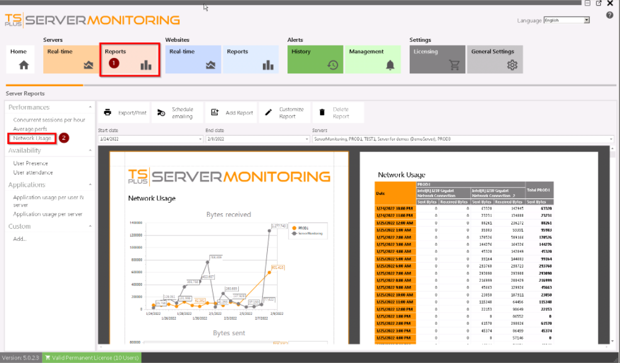
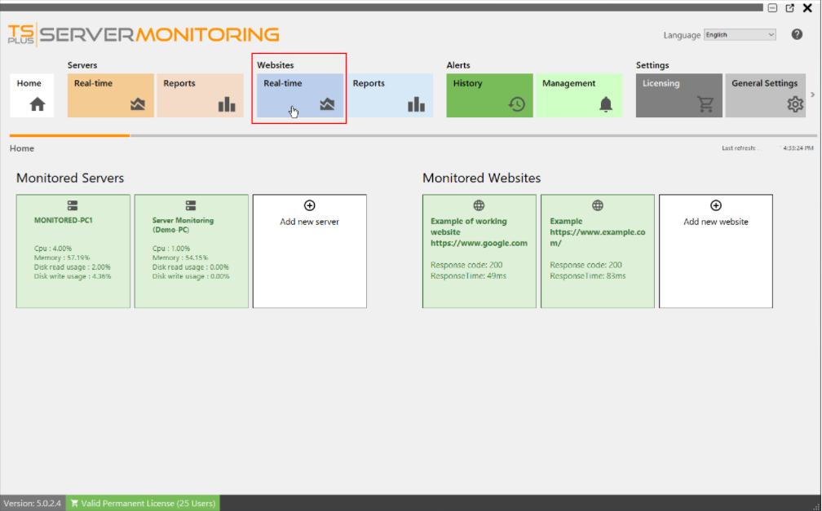
Alerts Management
Server and Website Alerts: The software automatically creates standard alerts sent by email when certain metrics’ thresholds are passed and come back to normal. Servers alerts include key metrics; processor, memory, disk read/write usage, disk used space, active users and downtime duration. Website alerts include Response Time, Downtime Duration and incidentally Availability.
Alert Customization: Server or website alerts can be created by defining specific thresholds for the metrics which need to be monitored closely. When a threshold is passed or when the situation returns to normal, the system sends email notifications.
Alert Notifications: An email is sent as soon as the targeted threshold is reached or exceeded, as well as when the metric is back to normal. Emails can be set to be sent to several recipients. Additionally, the dashboard allows to easily check the alerts history.
Admin Tool and Customization
All-in-one Dashboard: All the previously outlined features are accessible from an easy-to-use dashboard.
Server and Website Management: To add, edit and remove the servers and websites to be monitored. Parameters of the reports and alerts can be configured from the different tabs.
Settings: Server Monitoring can be easily customized, notably by configuring the SMTP server for email notifications, as well as the subject and content of those emails.
Report Customization: Logo, colors and chart types can be easily changed. This feature allows to filter data in different ways, hide some elements, brand the reports and customize them to better reflect the context.
1) Hardware
Make sure to respect the Processor and Memory requirements based on the number of monitored servers:
1-2 servers to monitor: CPU Cores = 2, RAM = 8
3-4 servers to monitor: CPU Cores = 4, RAM = 16
5+ servers to monitor: CPU Cores = 8, RAM = 32
Ideally:
Install it on an SSD disk drive
Allocate enough disk space for data collected and the SQL database
Run Server Monitoring on a dedicated server
2) Operating Systems
Server Monitoring is compatible with the following OS: Windows 7 SP1, 8.1, 10, Server 2008 R2 SP1, 2012 / 2012 R2, 2016, 2019 and 2022.
Both 32 and 64 bit architectures are supported.
The installation process is easy and configuration is straightforward. For the purposes of your trial, we recommend choosing the “recommended” setup type.
The trial version of Server Monitring is the fully-featured edition, valid for 15 days.
Contact us TSplus corporation 300 Spectrum Center Drive, Irvine, CA 92618, USA +1 949-561-1771
https://tsplus.net/server-monitoring

