Slide 1
The OnLY Security Program Designed for Remote Access
DISCOVER
2022

Slide 2
SECURE
Protect your Remote Connections and Keep
your Servers Secure
2
9
USER FRIENDLY
Don’t Spend Time and Money Using different technologies.
Advanced Security has it all in one Tool !
ECONOMIC

Slide 3
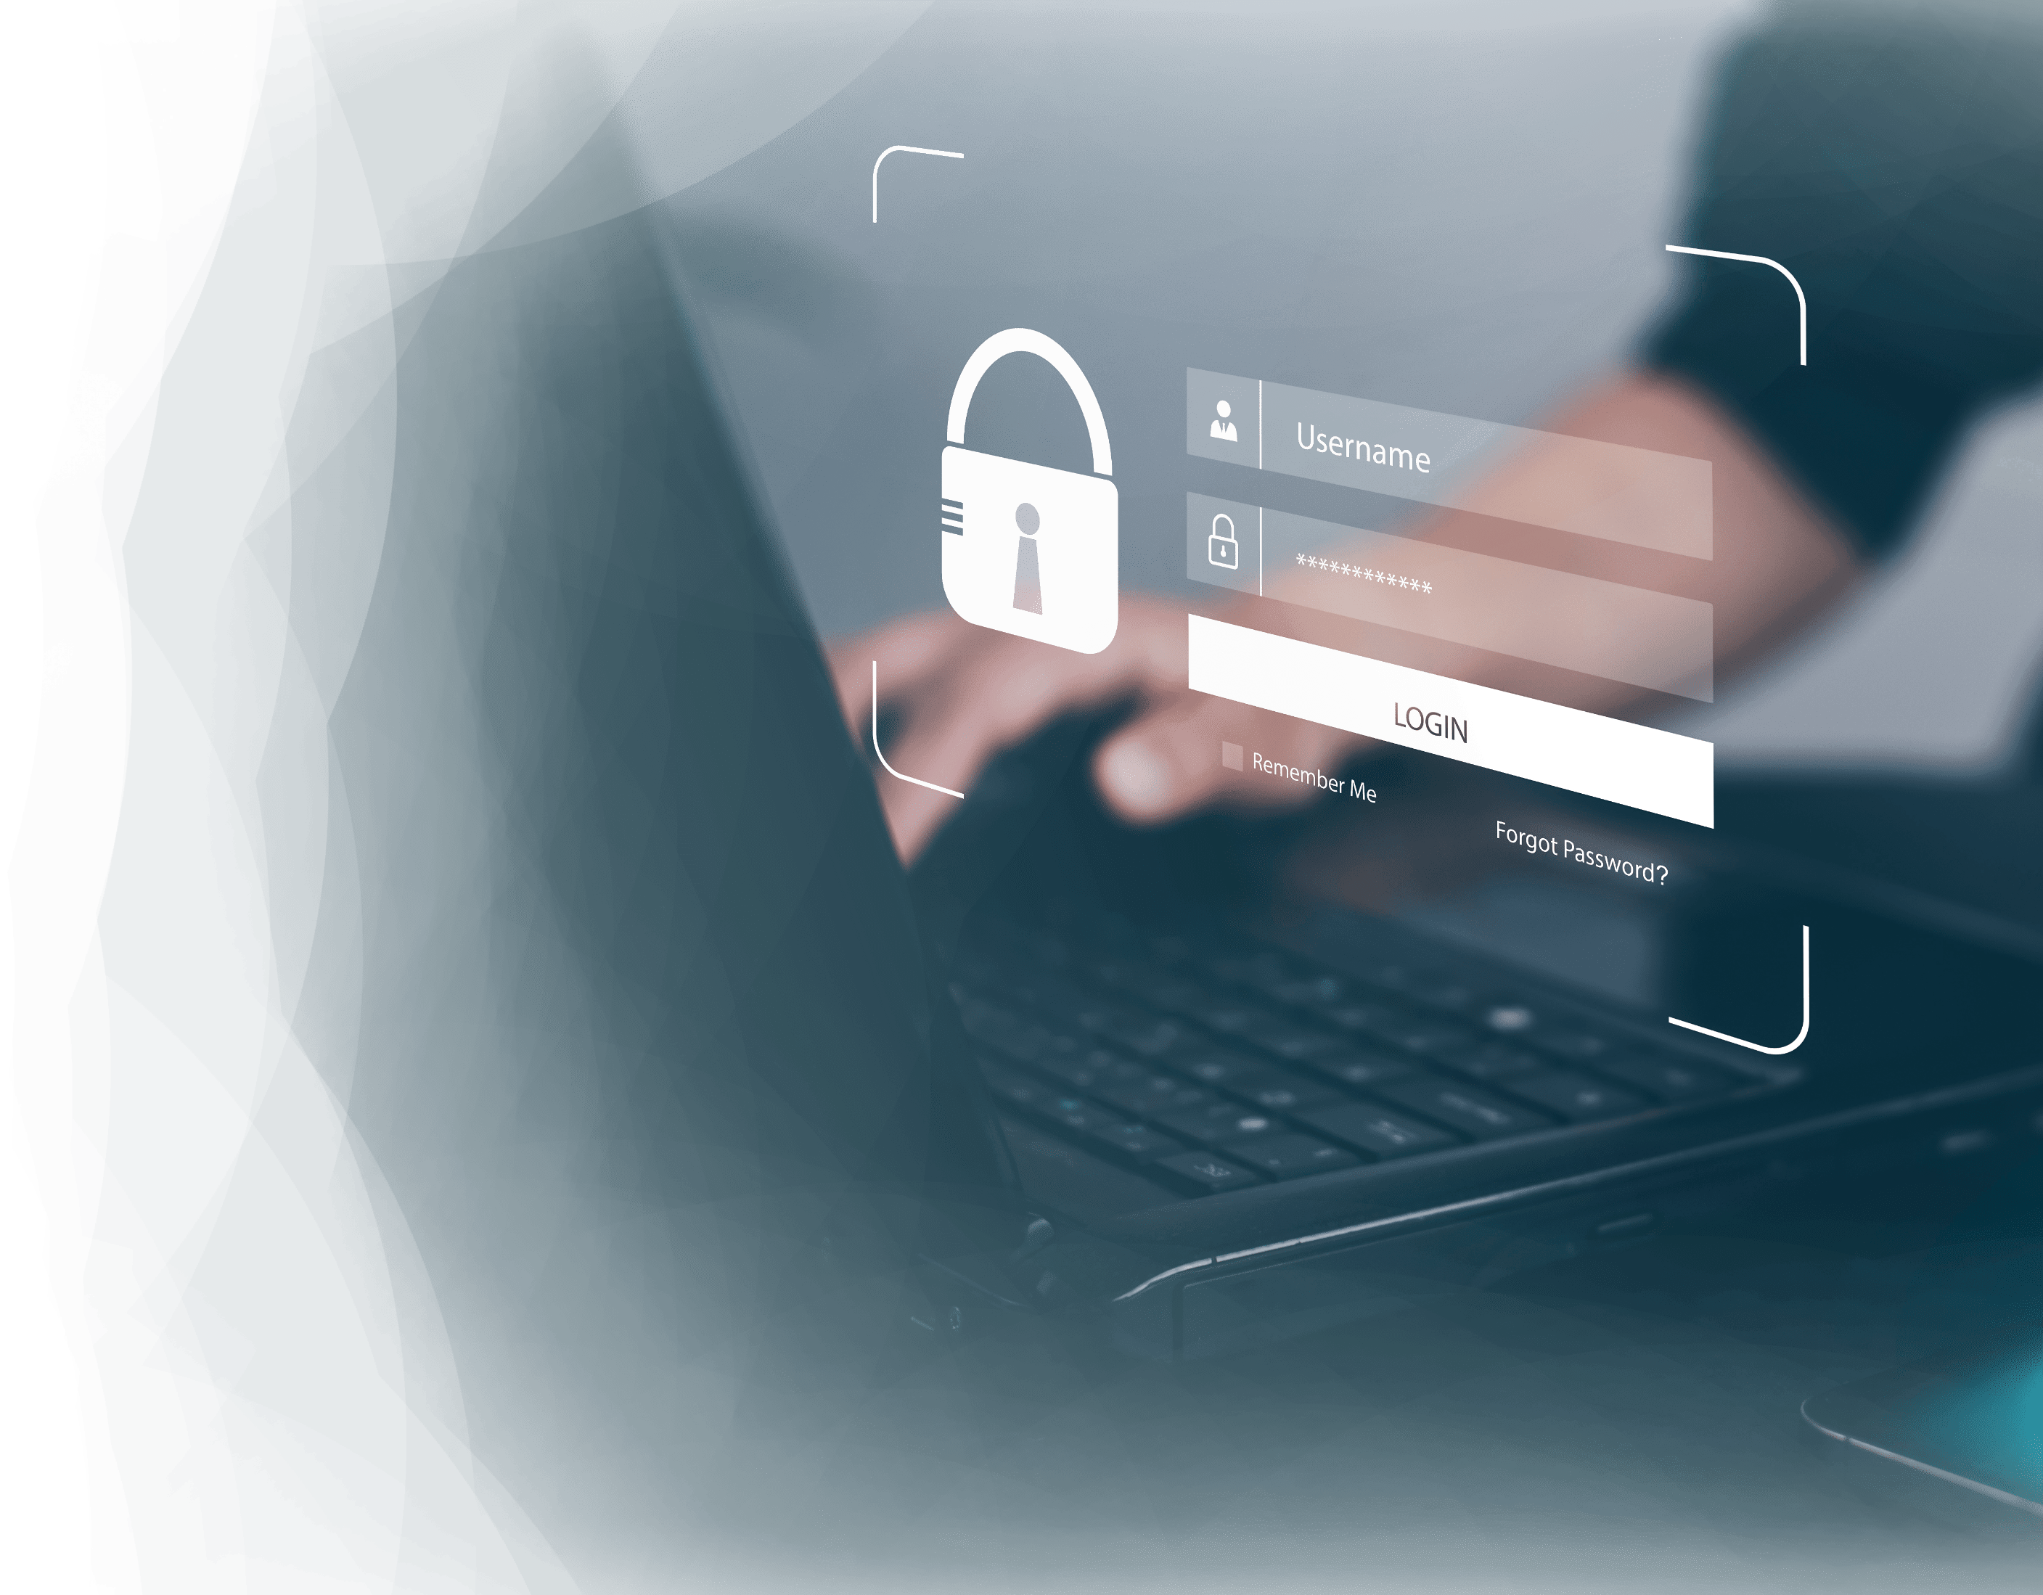
A Unique Tool for Remote Access Security
3
Total protection for Remote Access infrastructures
9
Access Restriction based on Time,
Location and Device
Protections Against Bots and Malware
Set Windows Security Policies in One Click

Slide 4
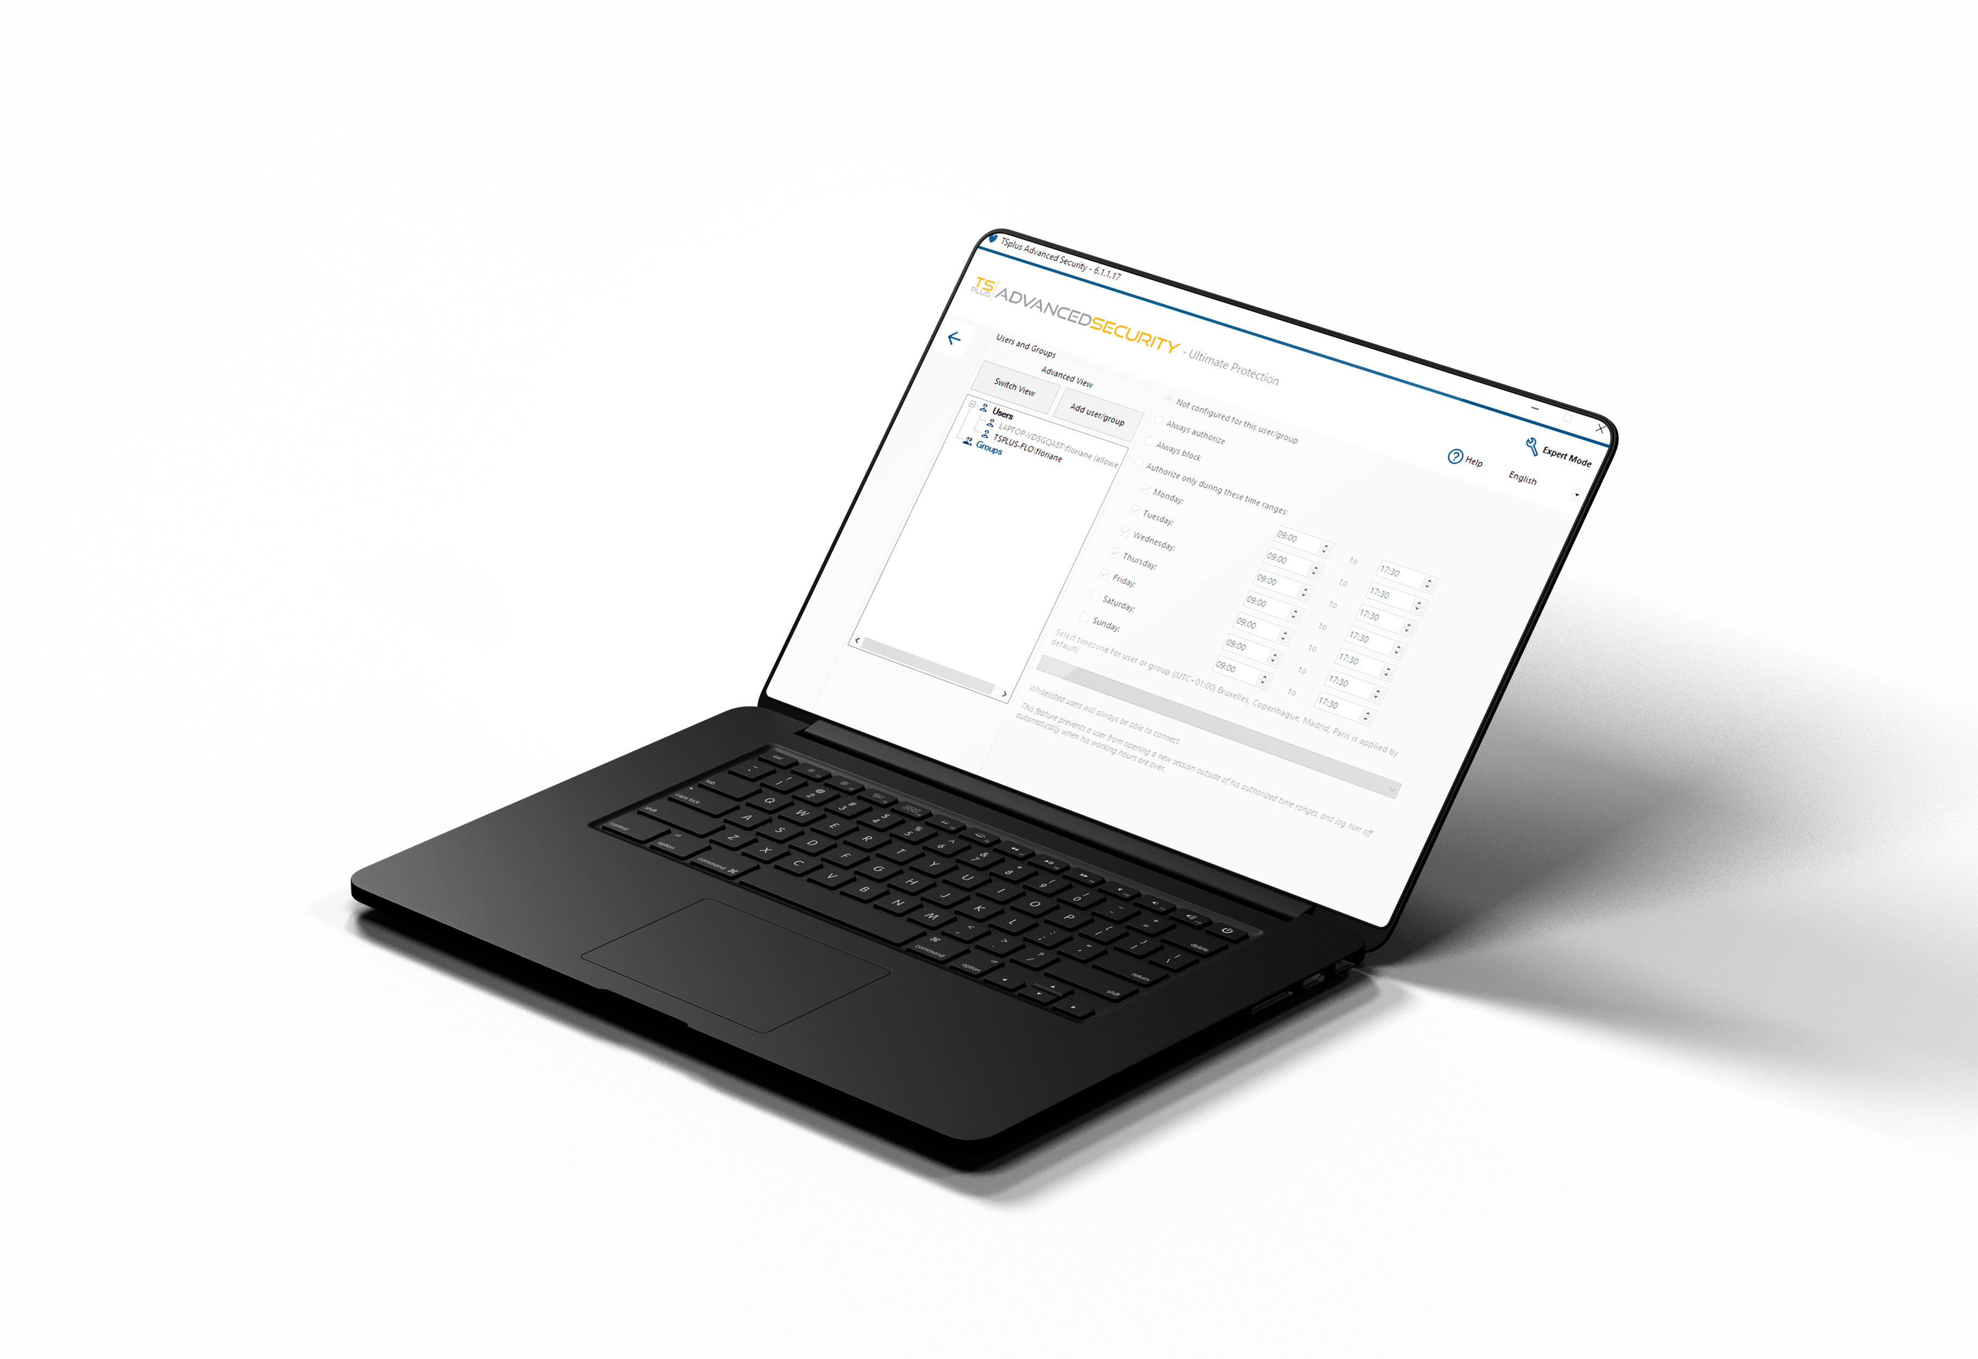
At Home or At the Office, Keep Your Data Safe
Get All the ESSENTIAL Protections for Your Remote Server!
4
WORKING HOURS
9
Set Working Hours per User/Group
Automatically close sessions and block logins outside of working hours

Slide 5
At Home or At the Office, Keep Your Data Safe
Get All the ESSENTIAL Protections for Your Remote Server!
4
HOMELAND PROTECTION
9
Allow Connections Based on Location
Block Connections from Elsewhere

Slide 6
At Home or At the Office, Keep Your Data Safe
Get All the ESSENTIAL Protections for Your Remote Server!
4
BRUTE-FORCE DEFENDER
9
Detect Failed Connection Attempts
Block IP Addresses after failed attempts

Slide 7
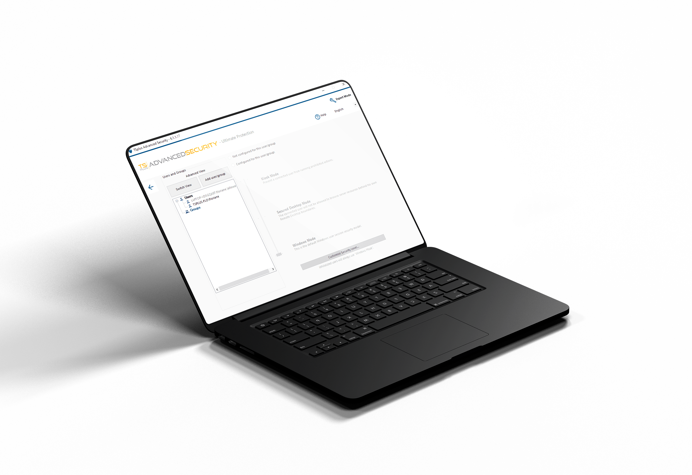
Reduce your Attack Surface and Increase your Peace of Mind
Apply The ULTIMATE Security Rules to Protect Your Remote Environment
5
9
CLICK SECURE DESKTOP
Set RDS Group Policy in One Click
Choose from 3 Standard Security Levels

Slide 8
Reduce your Attack Surface and Increase your Peace of Mind
Apply The ULTIMATE Security Rules to Protect Your Remote Environment
5
9
RANSOMWARE PROTECTION
Detect and Stop Ransomware
Quarantine and Recover Files and Programs

Slide 9
Reduce your Attack Surface and Increase your Peace of Mind
Apply The ULTIMATE Security Rules to Protect Your Remote Environment
5
9
WINDOWS PERMISSIONS
Inspect Users Windows Permissions
Edit Permissions per User or Group

Slide 10
All-in-One Cybersecurity Toolbox
Easily Manage The Level of Protection for Your Servers
6
9
Easy-To-Use AdminTool
Central IP Address Management
Central Programs Whitelist
Real-Time Events Log
Advanced or Lite Mode GUI

Slide 11
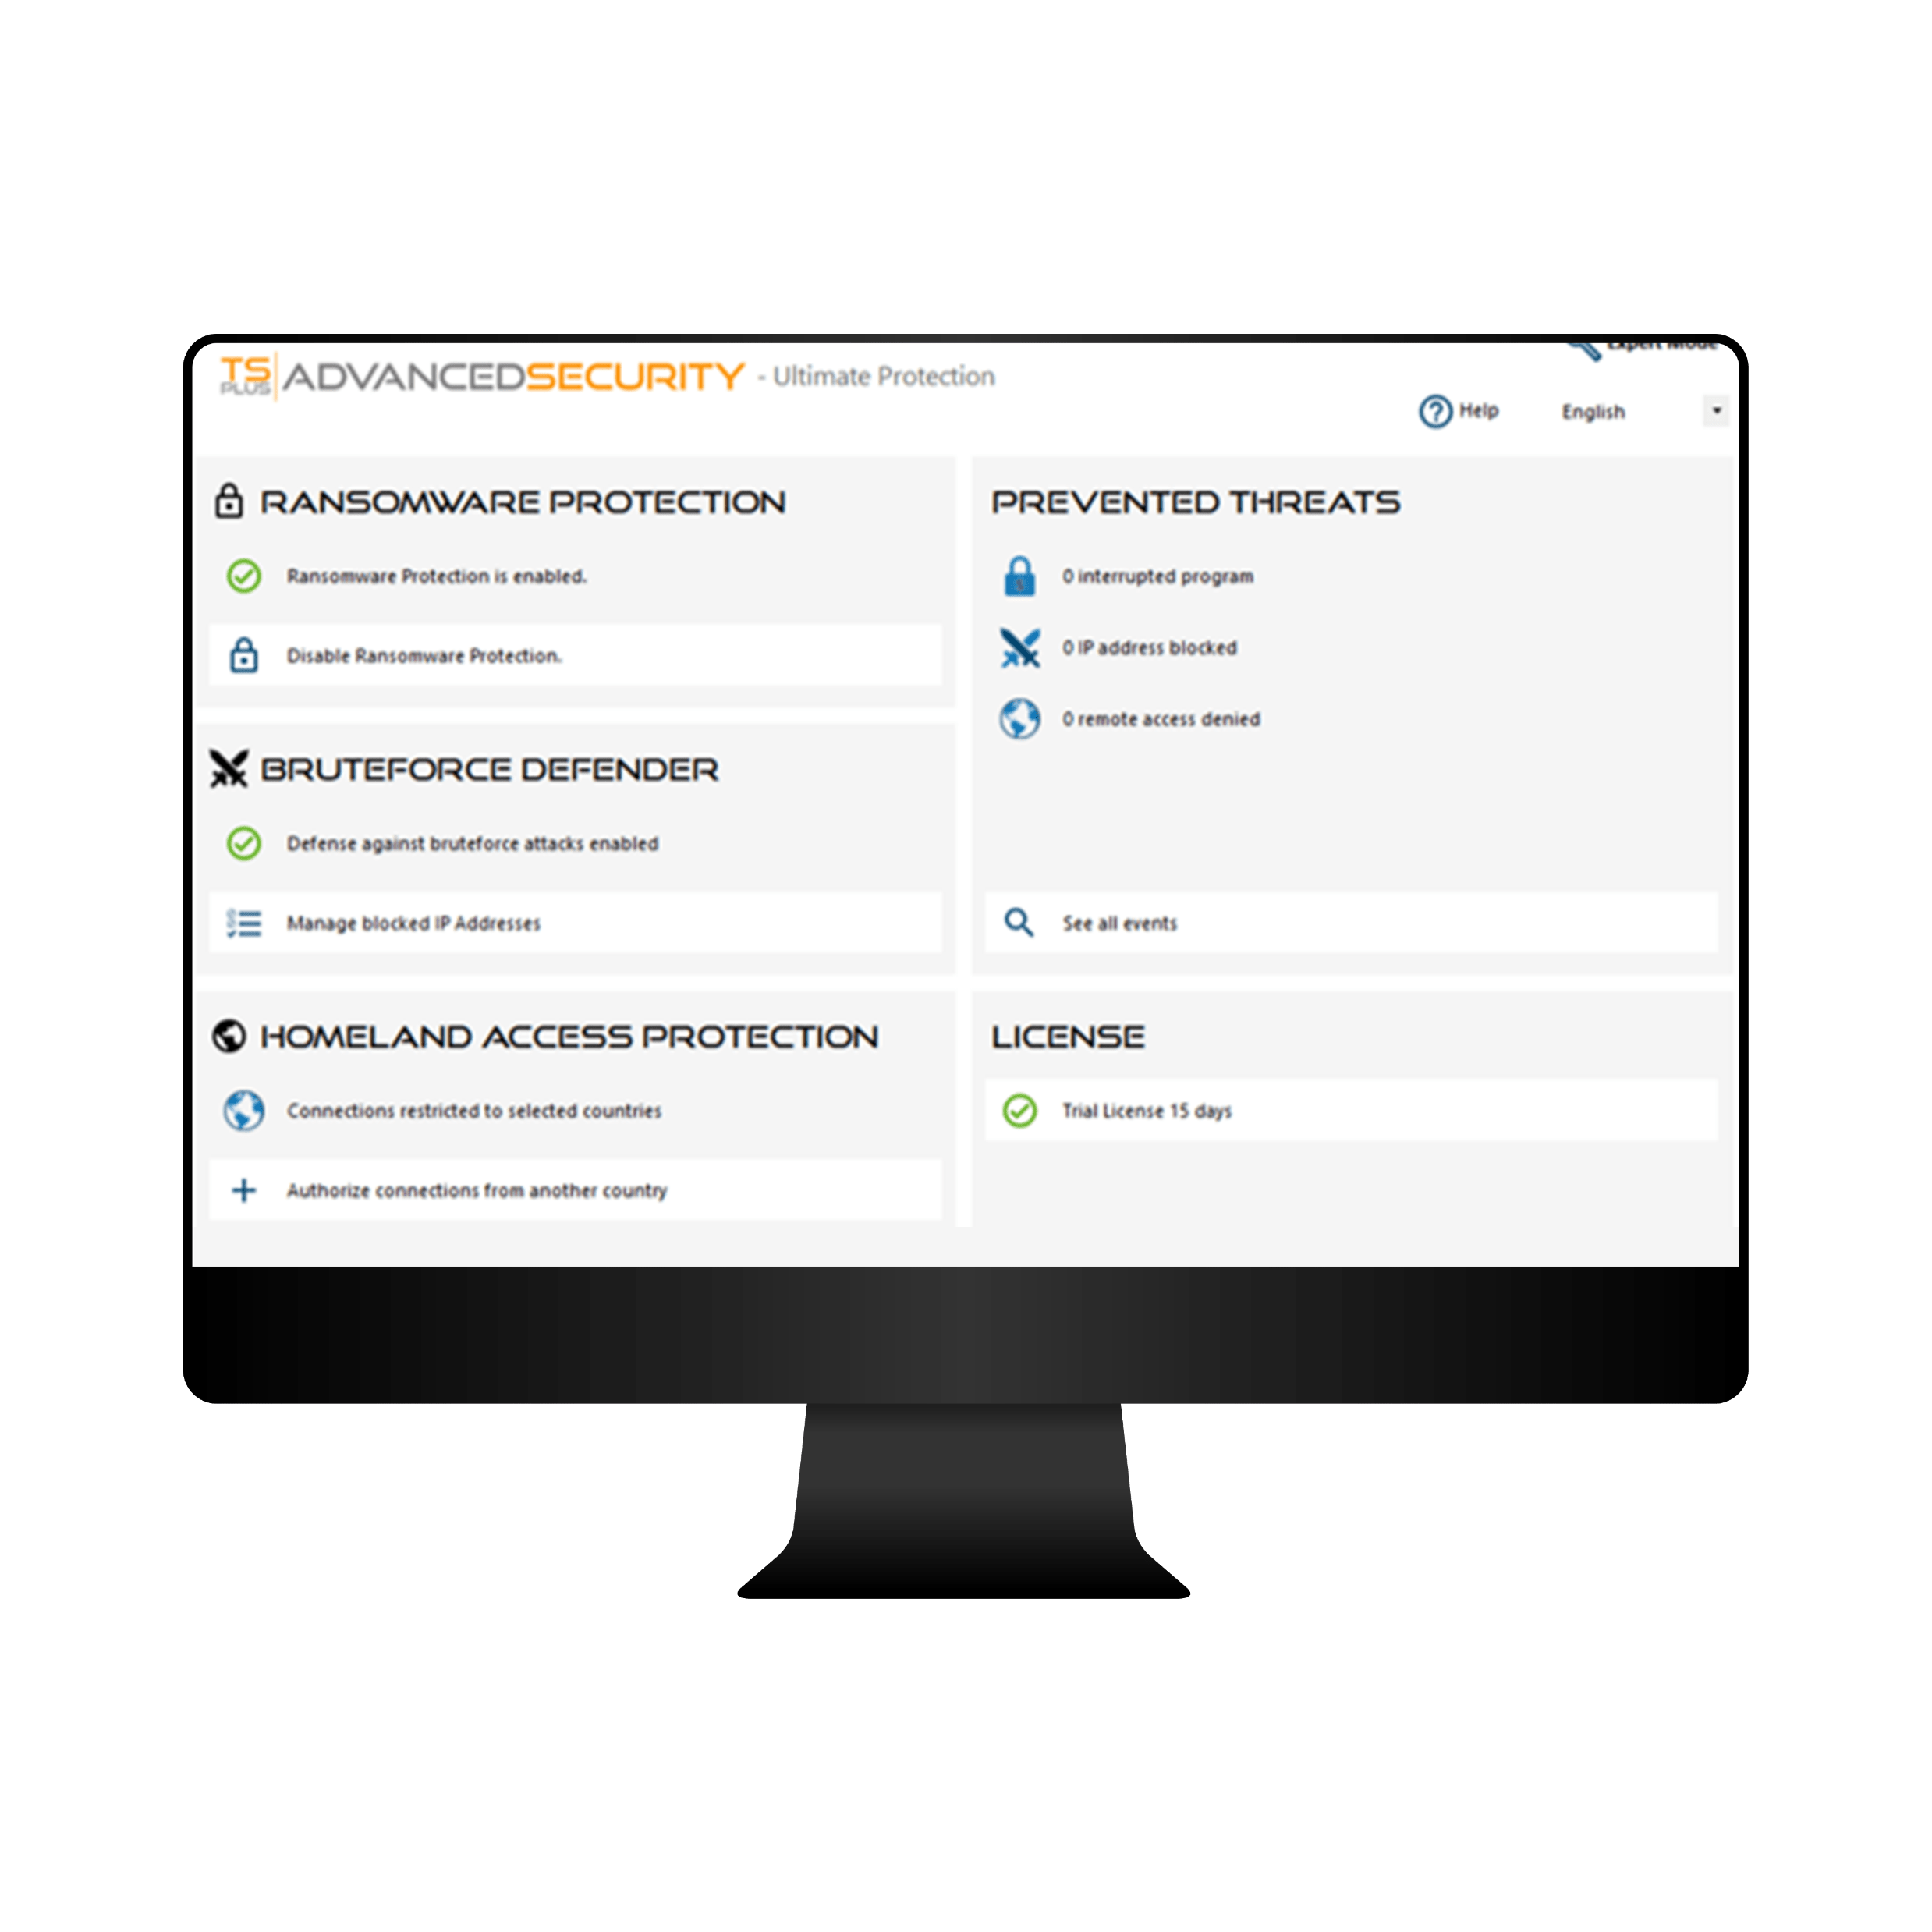
Advanced Security is New For You? Get a Quick Start with Our Lite Mode
All our best features, right where you need them
7
1
STOP RANSOMWARE
Enable in One Click
9
2
Block brute force Attacks
Check Blocked IPs
3
RESTRICT ACCESS
Add Countries to your Whitelist
4
CHECK YOUR SECURITY
See Advanced Security Action

Slide 12
Prevent foreign spies
Stop
Ransomware
The TSplus Difference: A 360 degrees Approach to Security
8
Prevent, protect, defend
9
Advanced Security Prevents, Protects and Defends against all kinds of threats
Corporate Applications server
Employees
at the office
Remote
Workers

Slide 13
A Great Product Should not Come at a Great Cost. Be Smart and Take the Leap!
9
Our very attractive licensing model starts at:
Perpetual
licensing
Per server
pricing
FREE TRIAL DOWNLOAD
9
$50
for the Essential Edition
Pay only once.
Protect Unlimited
15 days
Own the Licenses Forever!
Number of Clients!
Test it today!
Visit our website

