Slide 1

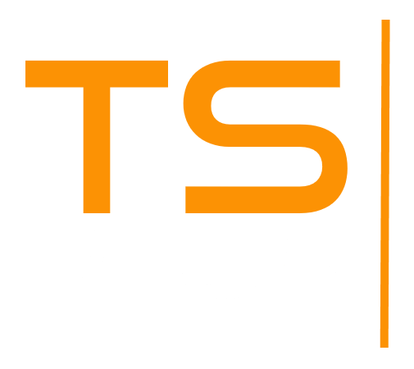
The Only Security Program Designed for Remote Access
DISCOVER
2025

Slide 2



SECURE
Protect your Remote Connections and Keep
your Servers Secure
2
15
USER FRIENDLY
Don’t spend time and money using
different technologies.
Advanced Security has it all in one tool!
ECONOMIC

Slide 3
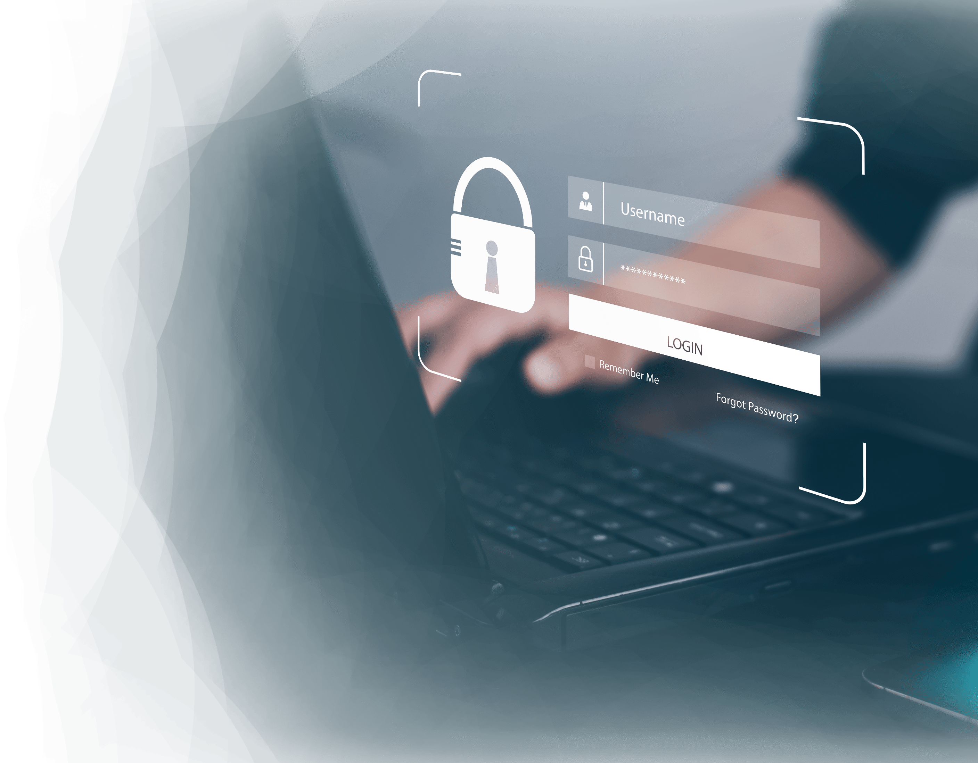

A Unique Tool for Remote Access Security
3
Full protection for Remote Desktop
infrastructures
15
FIREWALL: Protect your network from external threats
SESSION SECURITY: Control user access
RANSOMWARE PROTECTION: Protect corporate data

Slide 4
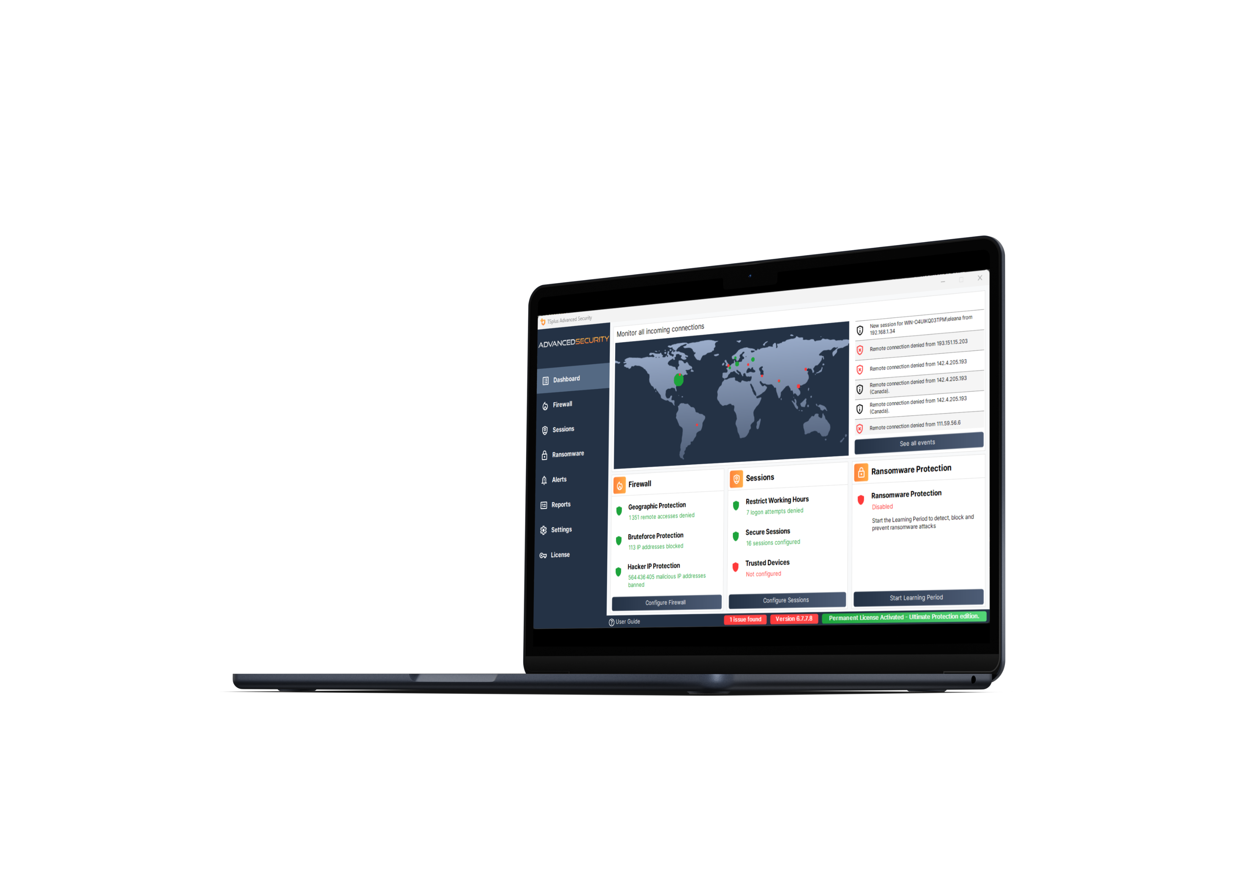
At Home or At the Office, Keep Your server Safe
Get all the ESSENTIAL protections
for your Remote Desktop servers!
4
GEOGRAPHIC PROTECTION
15
Enable connections based on location
Block connections from anywhere else

Slide 5
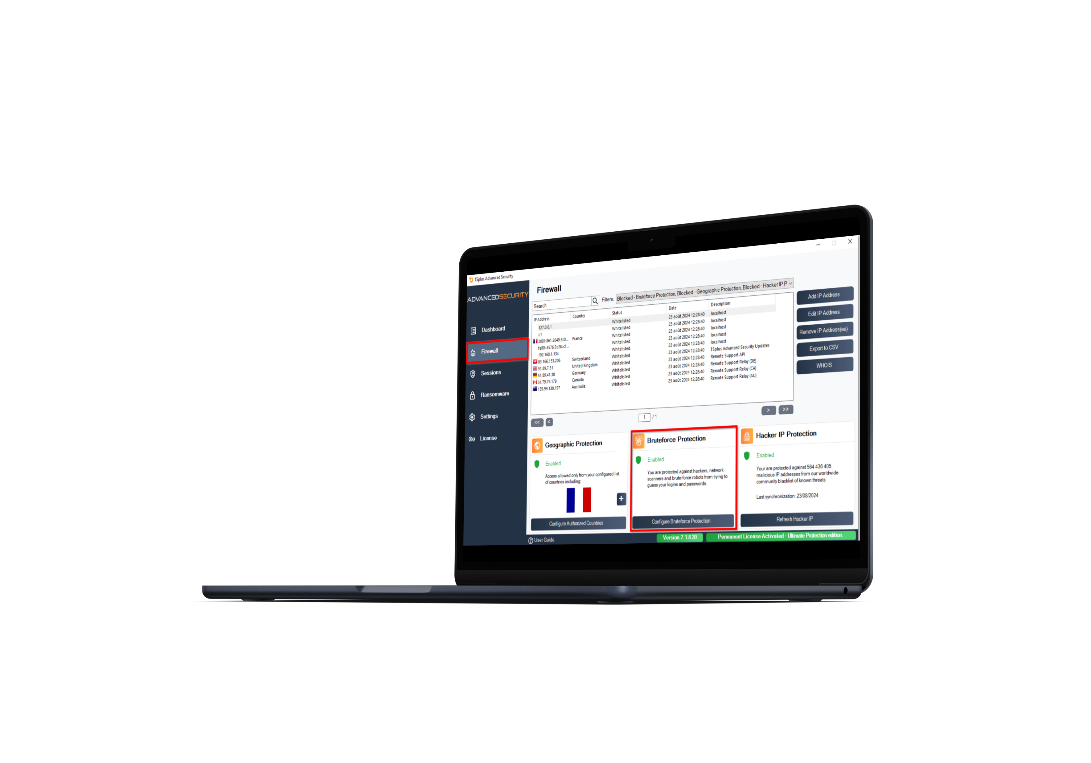
At Home or At the Office, Keep Your server Safe
Get all the ESSENTIAL protections
for your Remote Desktop Servers!
5
BRUTE-FORCE PROTECTION
15
Detect failed connection attempts
Block IP addresses after failed attempts

Slide 6
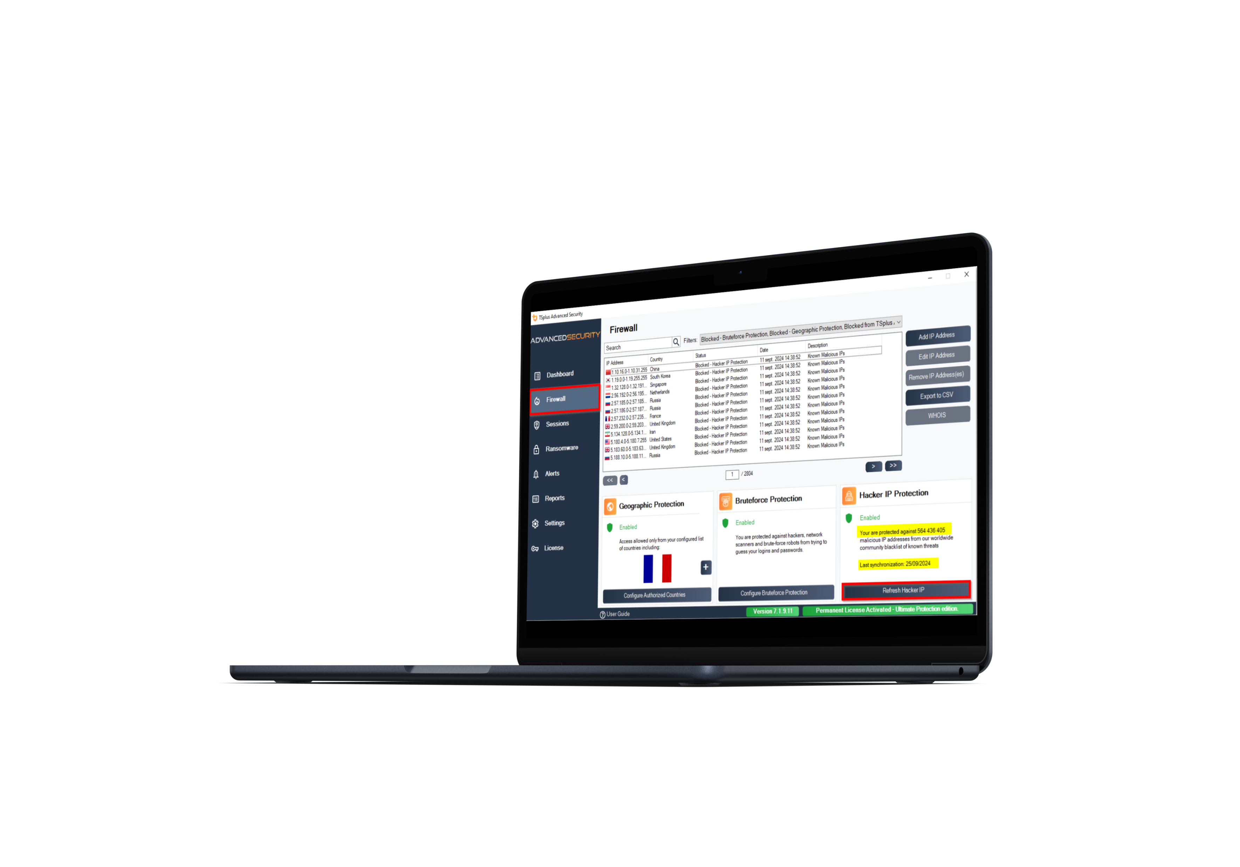
At Home or At the Office, Keep Your server Safe
Get all the ESSENTIAL protections
for your Remote Desktop Servers!
6
Hacker IP PROTECTION
15
Protect servers against hacker attacks
Automatically block more than 564 million malicious IPs from day 1

Slide 7
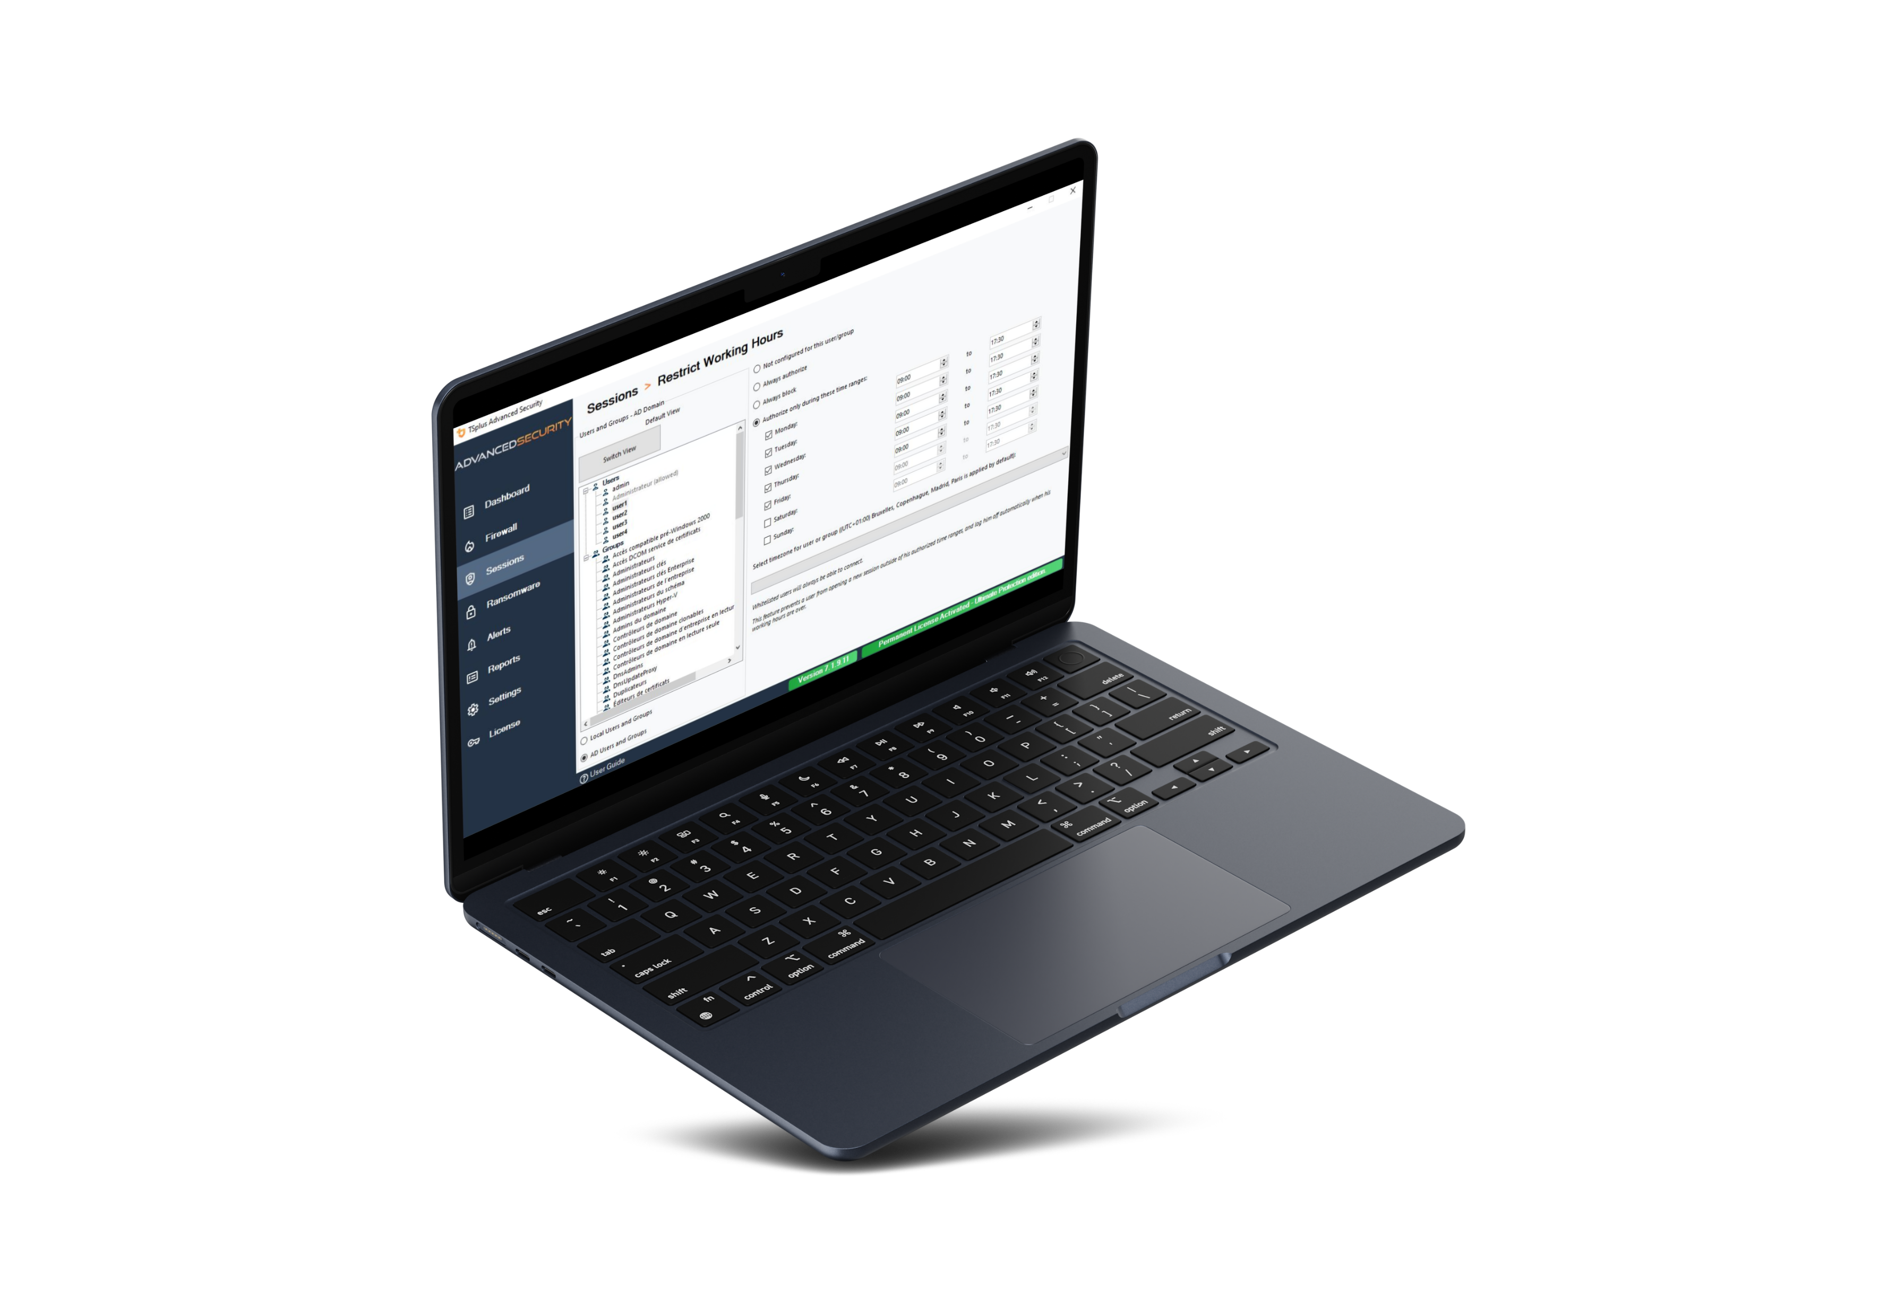
Lock down remote sessions and Increase your Peace of Mind
Get all the ESSENTIAL protections
for your Remote Desktop Servers!
7
15
Restrict Working hours
Set working hours per user/group
Automatically close sessions and prevent logins outside of working hours

Slide 8

Lock down remote sessions and Increase your Peace of Mind
Apply the ULTIMATE security rules
to protect your remote environment
8
15
SECURE sessions
Set RDS group policy in one click
Select from 3 standard security levels

Slide 9

Lock down remote sessions and Increase your Peace of Mind
Apply the ULTIMATE security rules
to protect your remote environment
9
15
PERMISSIONS MANAGEMENT
Inspect Windows user permissions
Edit permissions per user or group

Slide 10
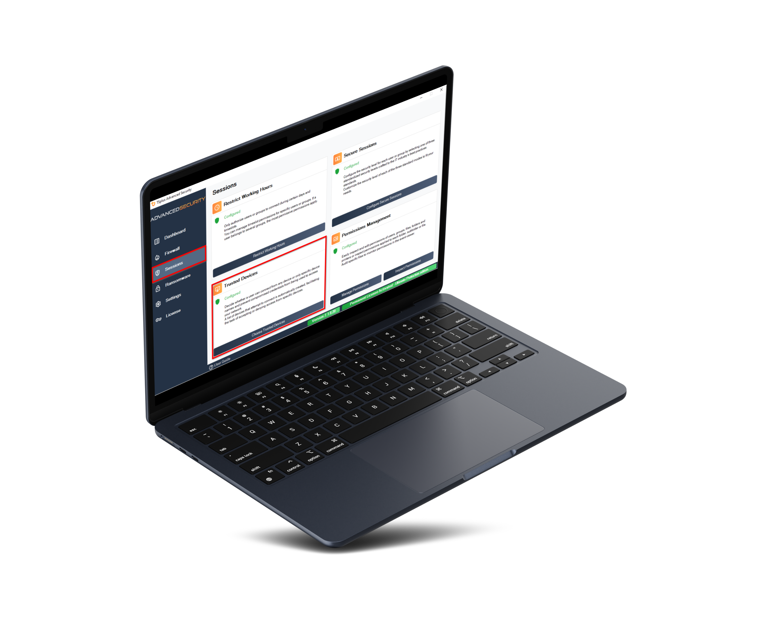
Lock down remote sessions and Increase your Peace of Mind
Apply the ULTIMATE security rules
to protect your remote environment
10
15
Trusted devices
Control and register connecting devices
Deny access to unauthorized devices and get a list of failed attempts

Slide 11

PROTECT YOUR SERVERS AND CORPORATE DATA
Apply the ULTIMATE security rules
to protect your remote environment: RANSOMWARE PROTECTION
11
15
DETECT ransomware attacks
BLOCK compromised files
PREVENT by analyzing snapshots & reports

Slide 12

All-in-One
Cybersecurity Toolbox
Easily Manage The Level
of Protection for Your Servers
12
15
Easy-to-use administration tool
Central IP address management
Interactive world map of connections
Real-time event log
Alerts, notifications and reporting

Slide 13





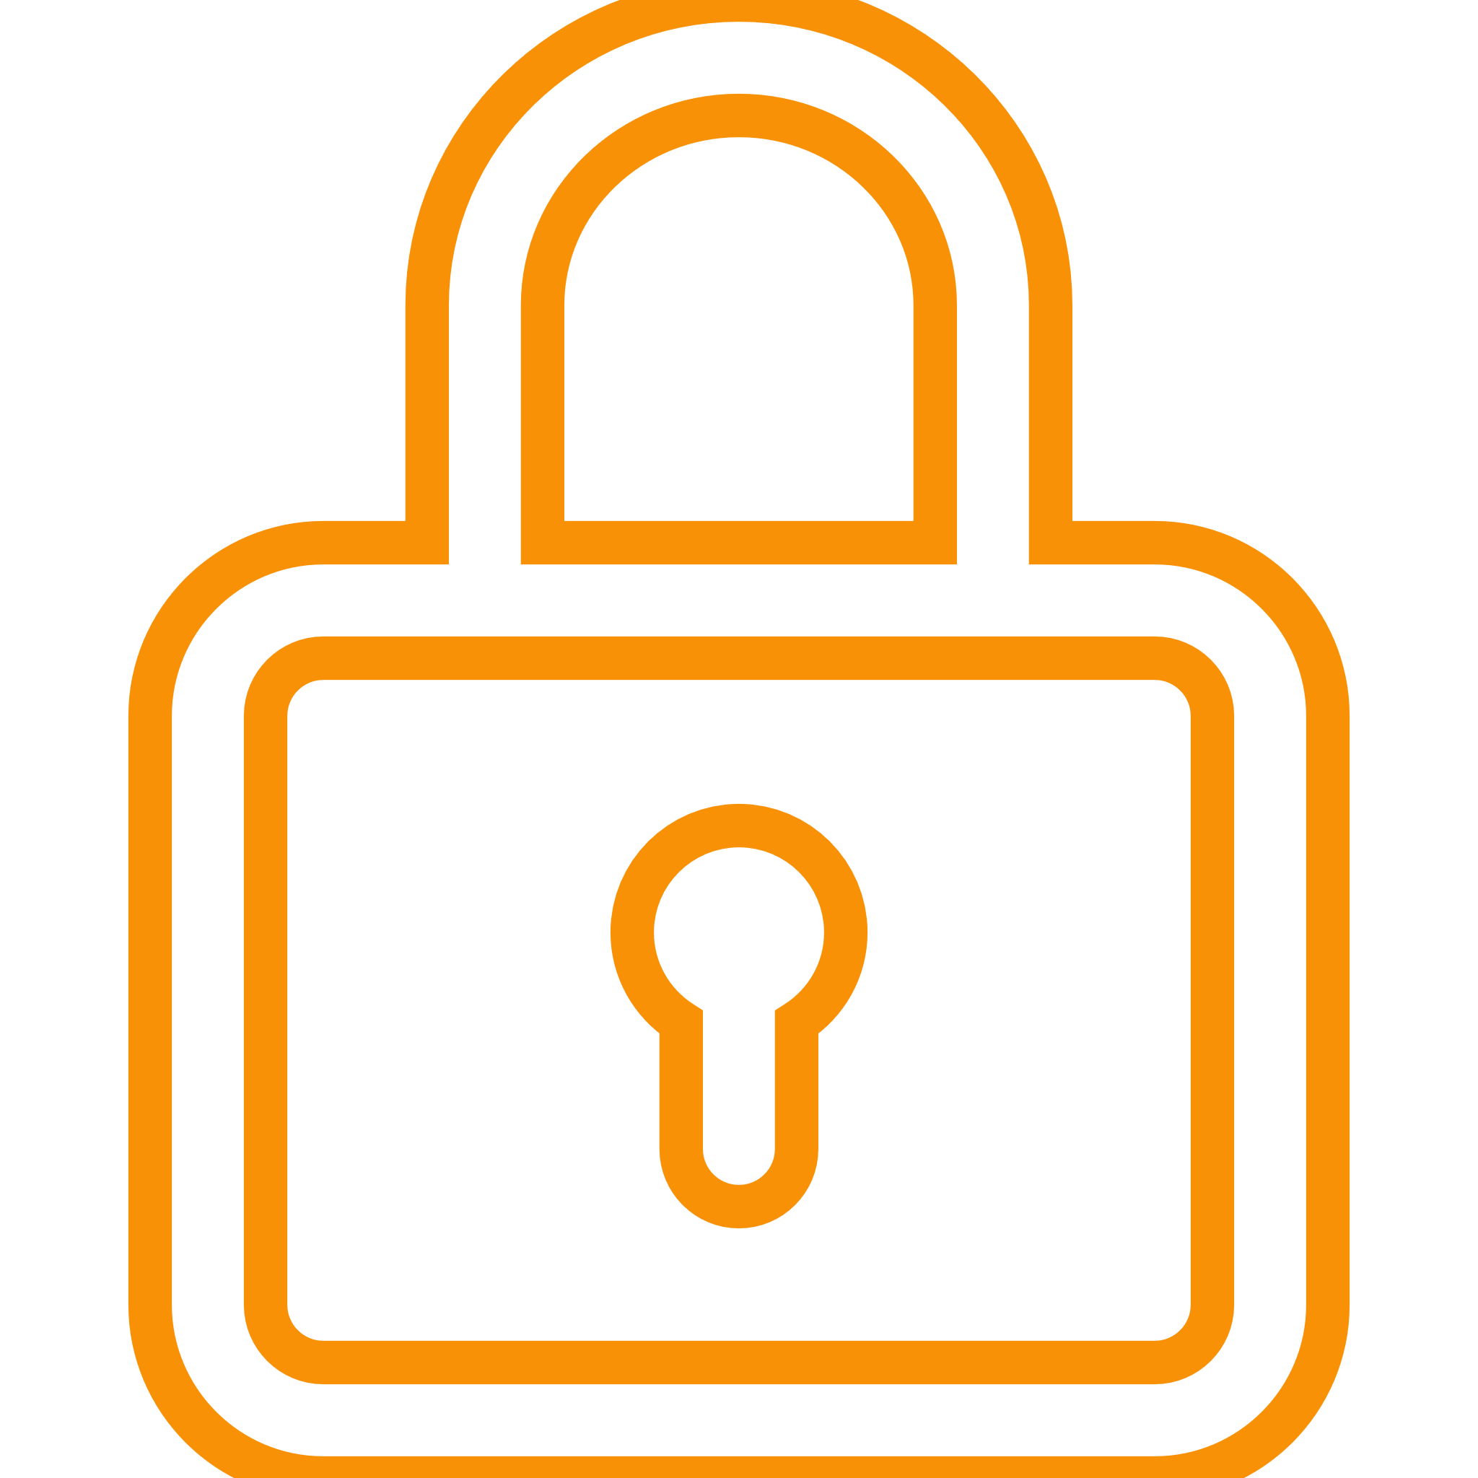
Prevent foreign spies
Stop
Ransomware
The TSplus Difference: A 360 degrees Approach to Security
13
Prevent, protect, defend
15
Advanced Security prevents, protects and defends against
all kinds of threats
Corporate
Applications server
CONTROL ACCESS
SAFEGUARD YOUR DATA

Slide 14

A Great Product Should not Come at a Great Cost. Be Smart and Take the Leap!
14
Our very attractive licensing model starts at:
Perpetual
licensing
Per server
pricing
FREE TRIAL DOWNLOAD
15
$180
for the Essential Edition
Pay only once.
Protect Unlimited number of Clients
15 Days
Own the Licenses Forever!
Test it Today!
1 year of Updates/Support Included!
Visit our website

