Slide 1

The Easy Alternative to Citrix
DISCOVER
2025

Slide 2



SECURE
Access Your Windows Apps from Any Device, at Any Time
2
13
EFFORTLESS
Don’t spend time and money using Citrix.
Maximize your IT infrastructure investment!
ECONOMIC

Slide 3
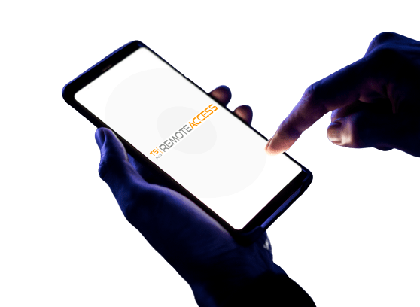

Publish Your Apps on
The Web in a Snap
3
Enable users to connect and work from anywhere
13
Remote Desktop Access
Application Delivery
Web Application Portal
Universal Printer
Lite Mode or Expert Mode

Slide 4
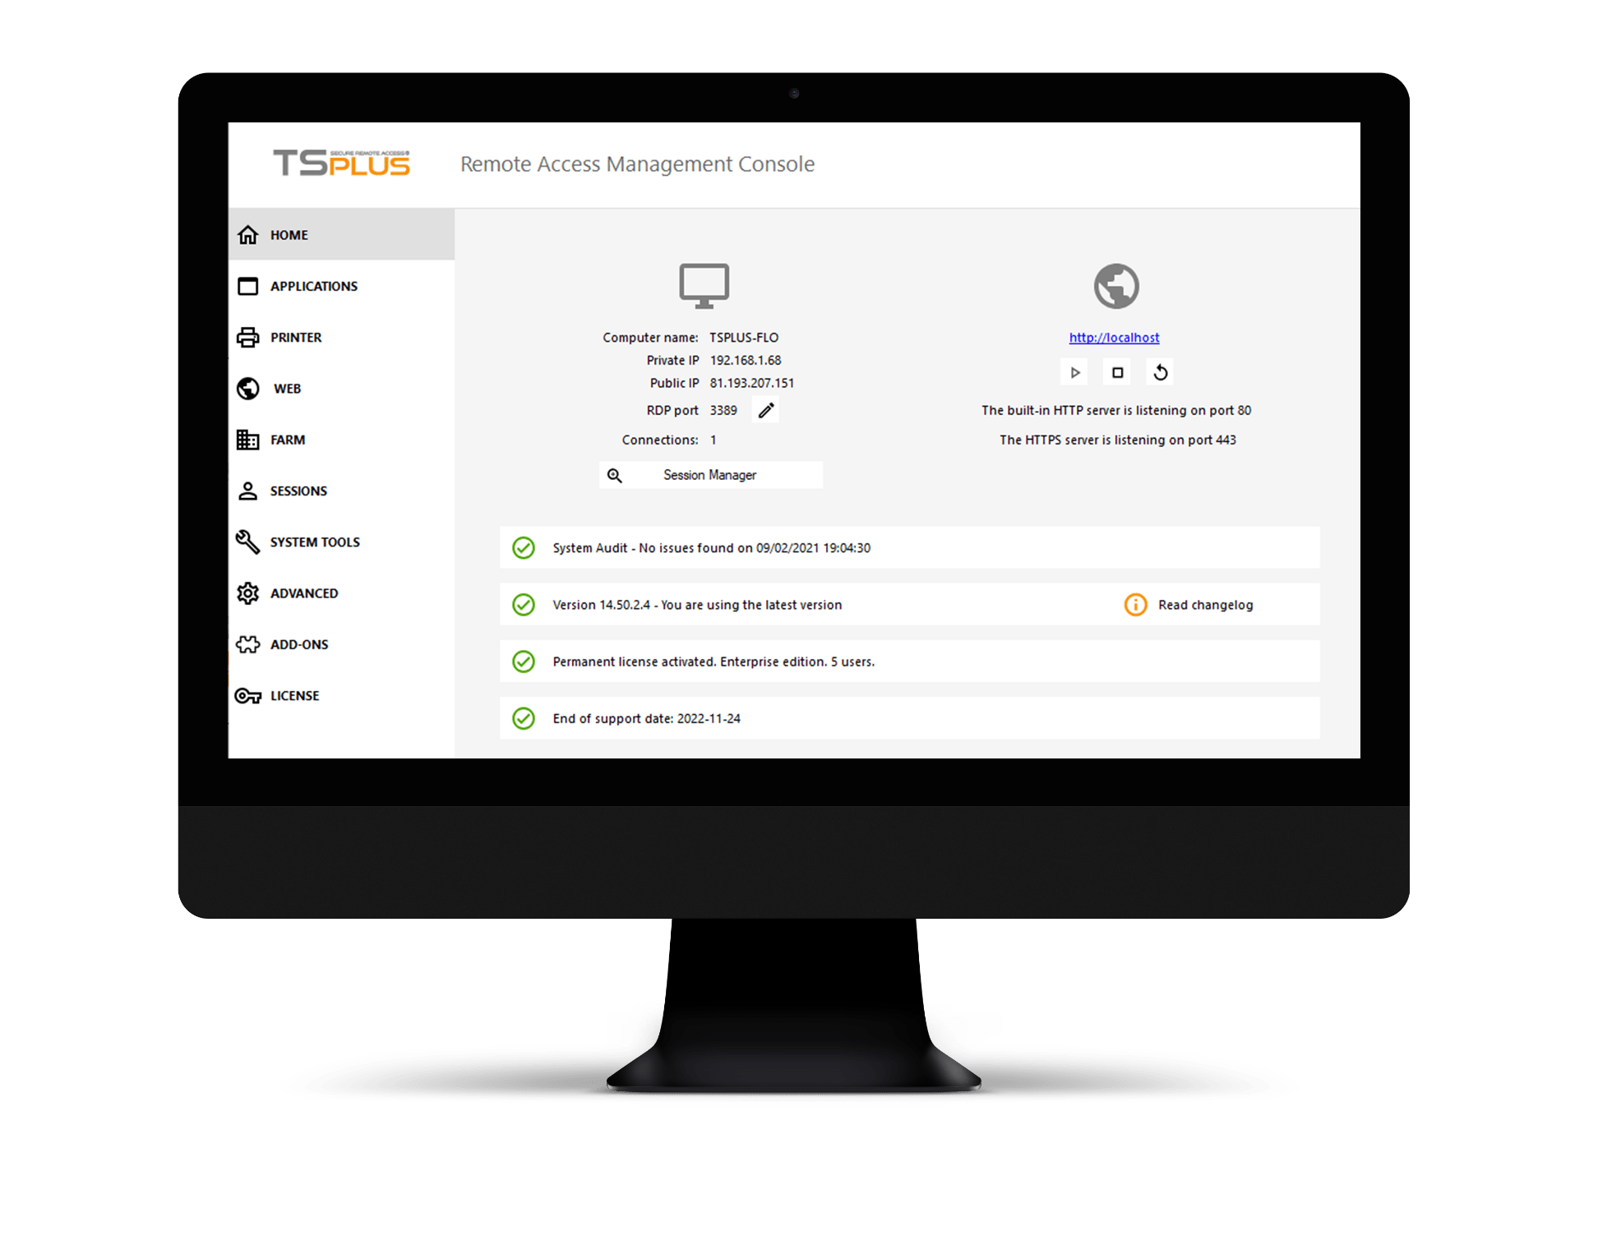
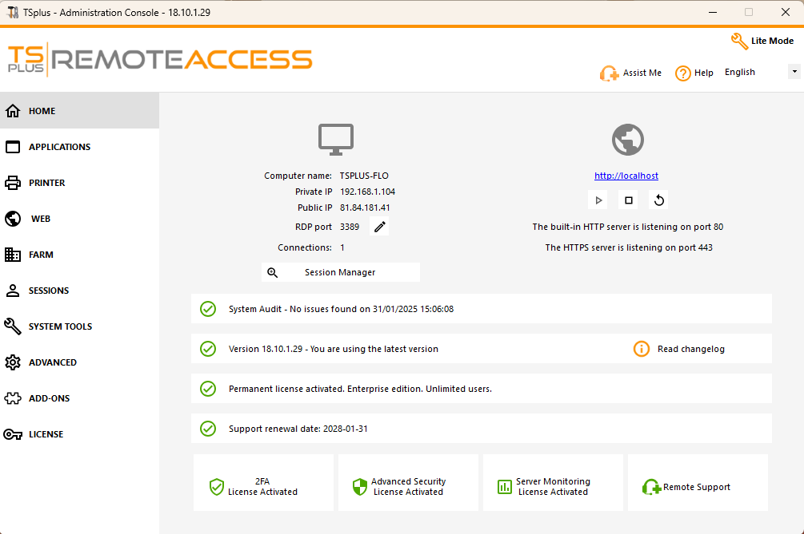
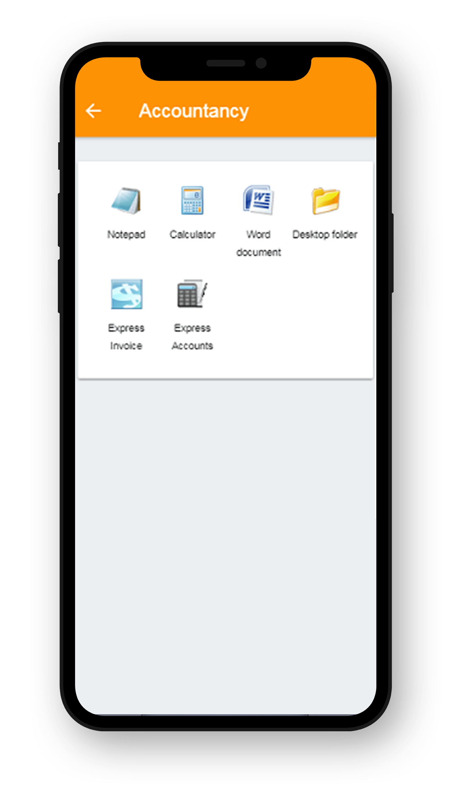
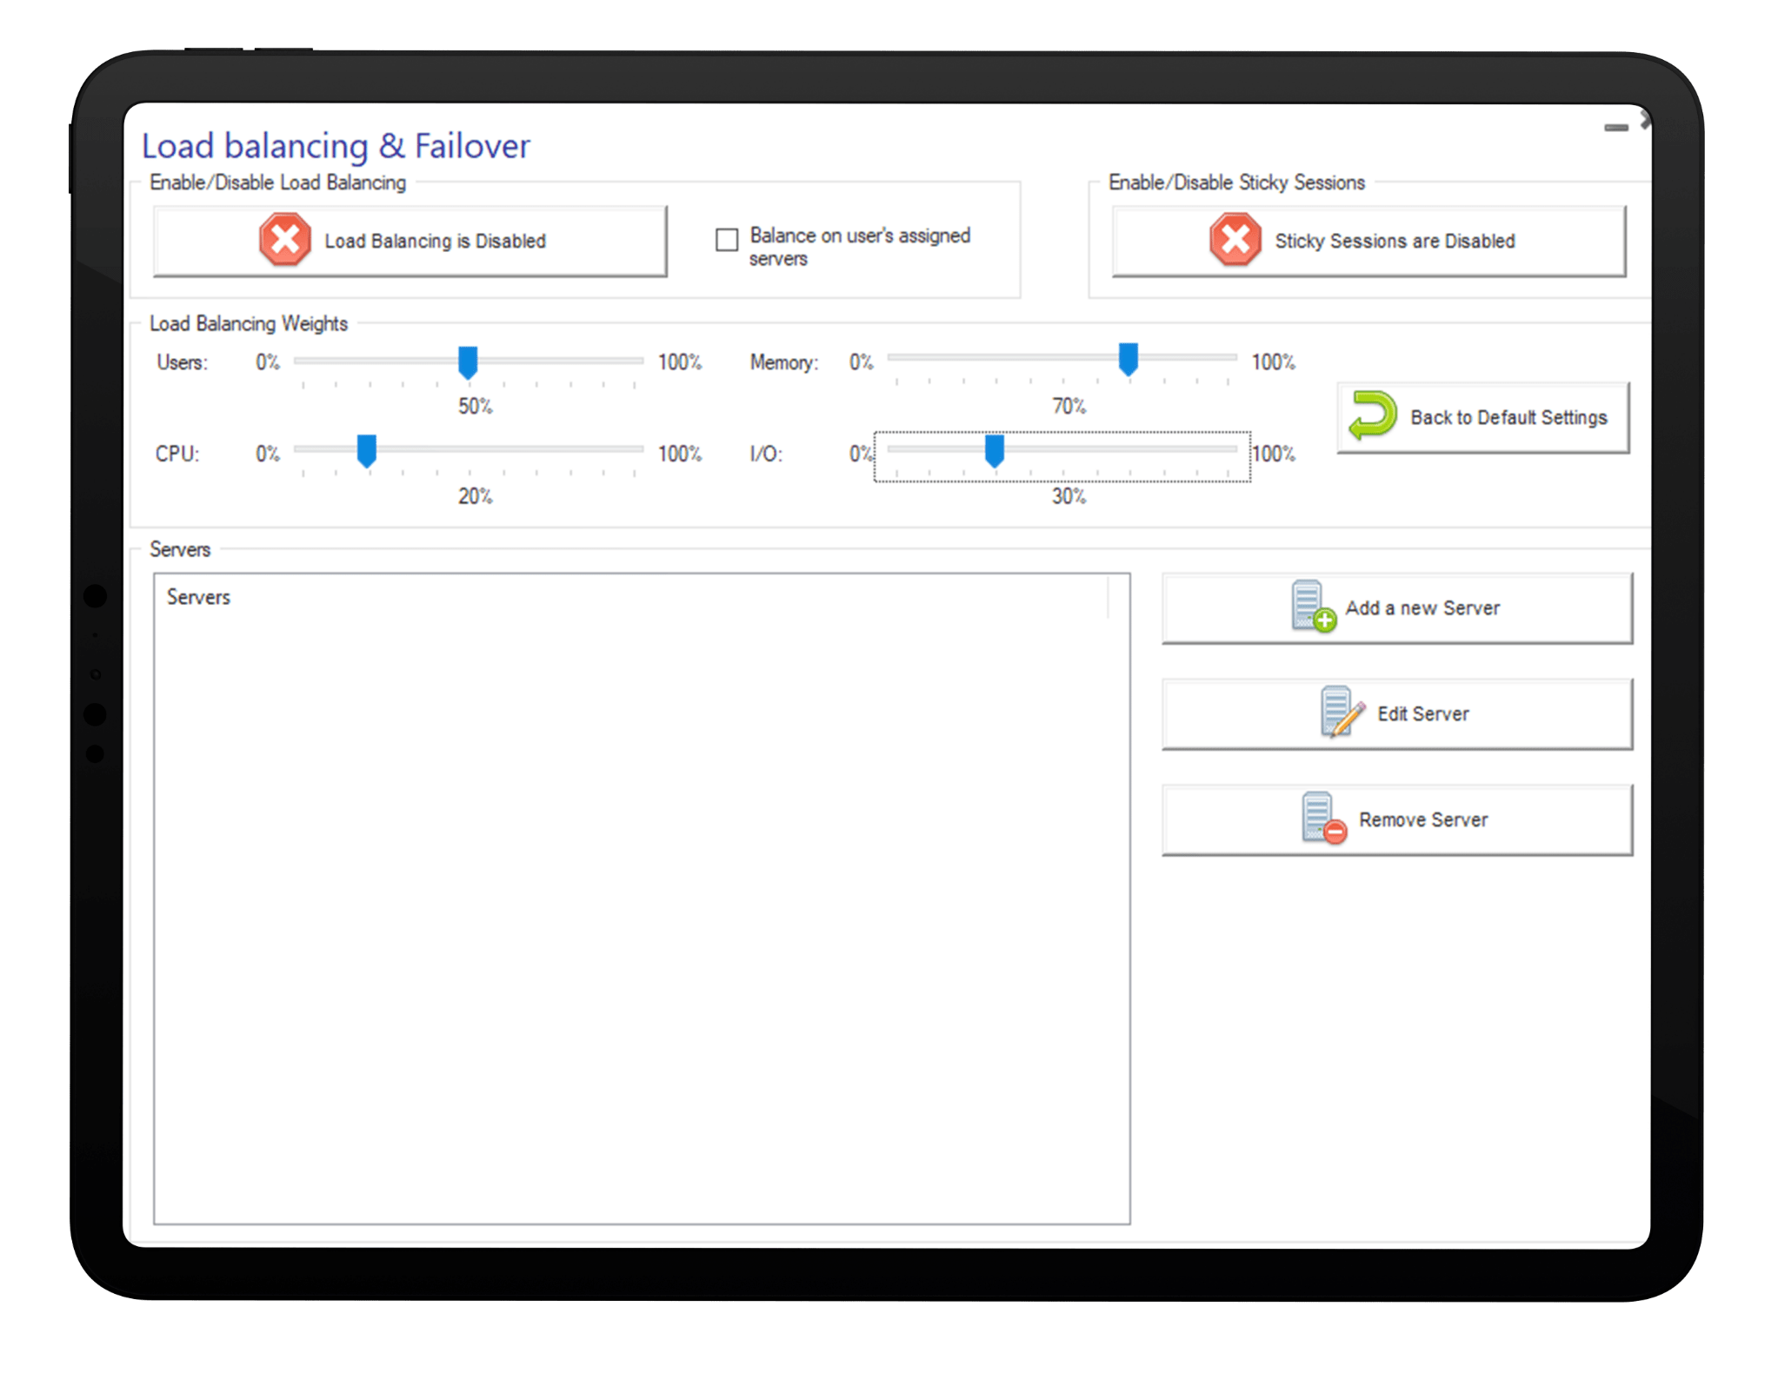

Get Setup Quickly with our Simple and Powerful Remote Access Solution
Configure and manage your network from one place
4
13
Quick installation
Easy setup
Portable Client Generator
Flexible Network Configuration

Slide 5
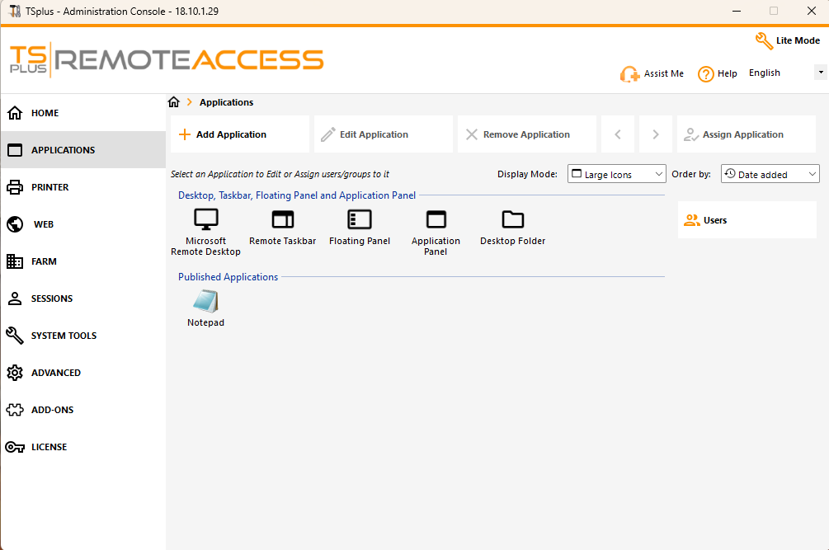
Get Setup Quickly with our Simple and Powerful Remote Access Solution
Configure and manage your network from one place
5
13
SMART MANAGEMENT
Intuitive Admin Tool
Application Control per Group
Single Enterprise Portal

Slide 6
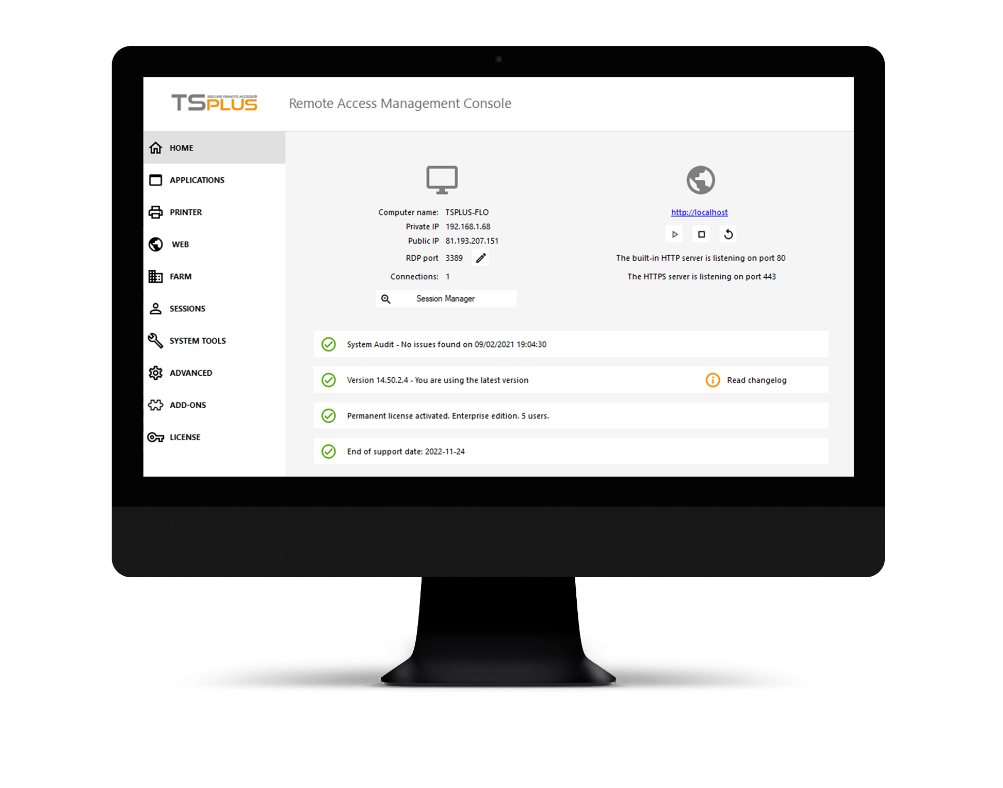
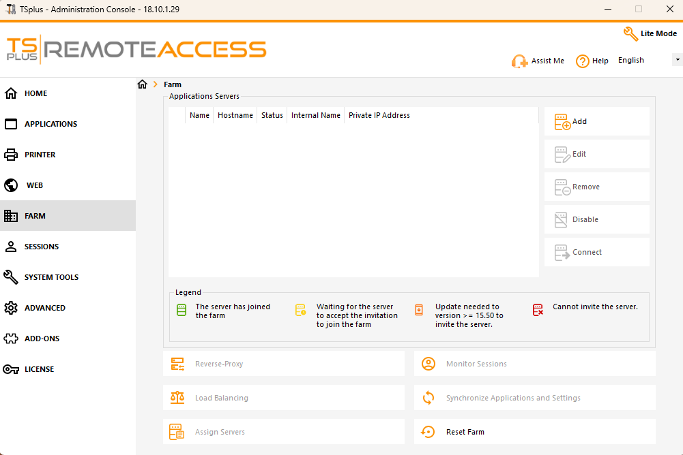
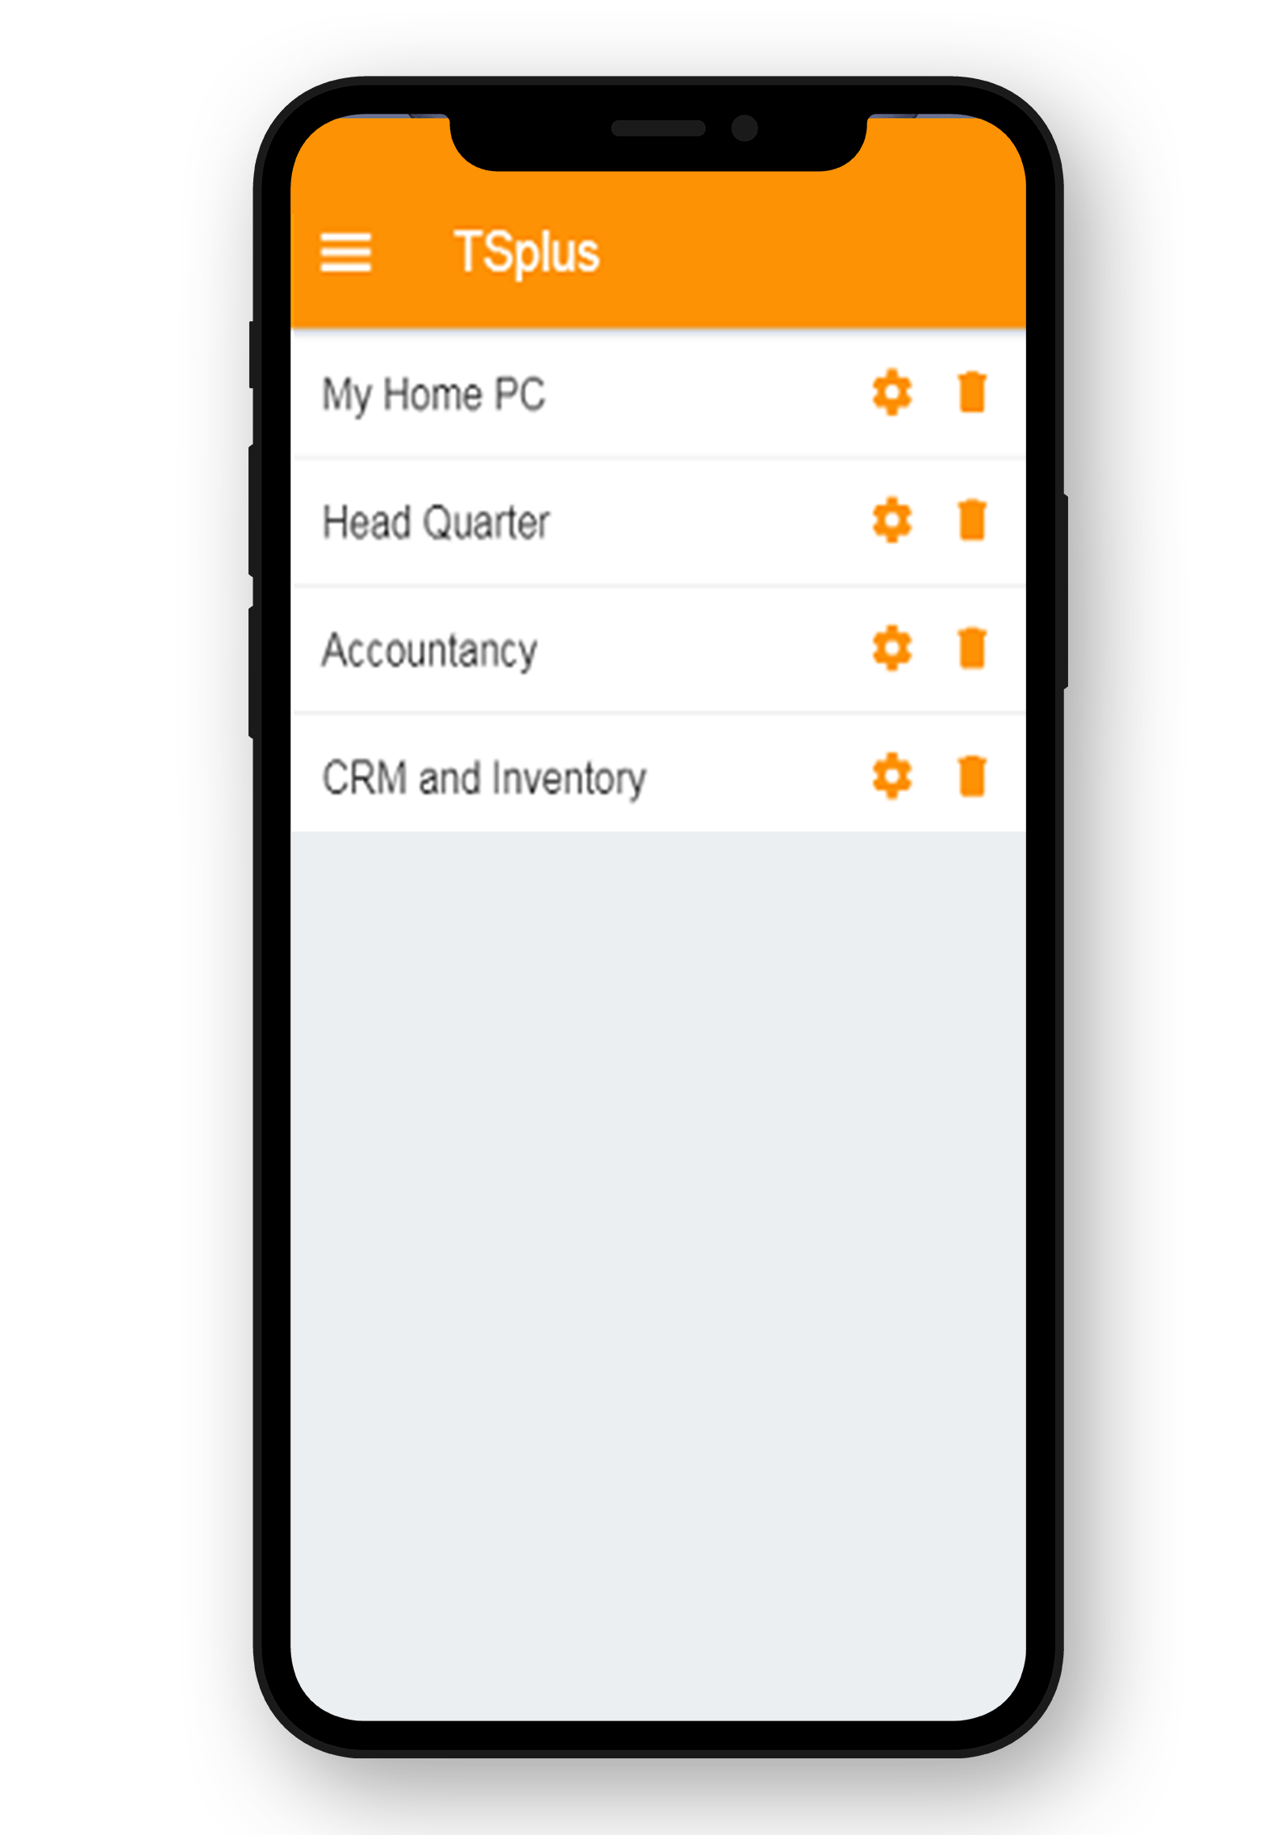
Get Setup Quickly with our Simple and Powerful Remote Access Solution
Configure and manage your network from one place
6
13
SCALABLE TO YOUR NEEDS
Load-balancing
Server Farm Management
Bundles: 3 editions & 4 add-ons

Slide 7
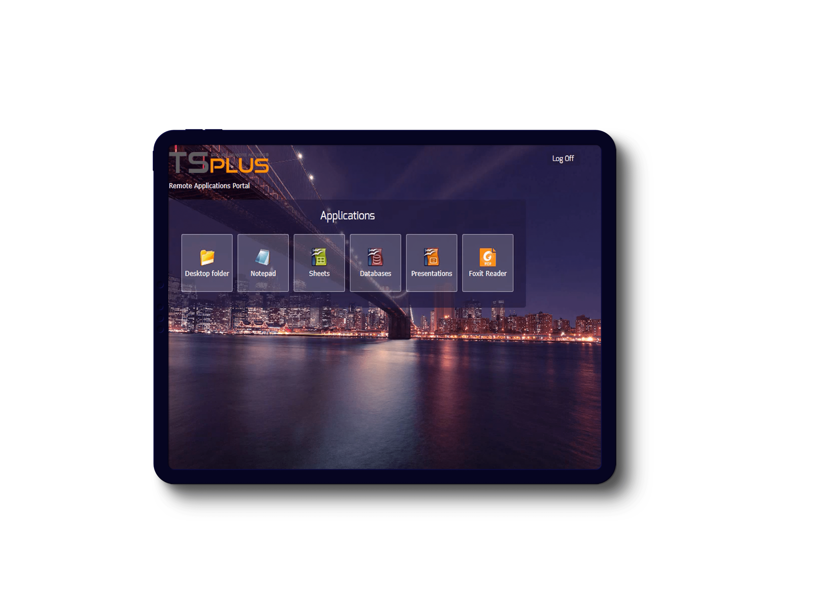
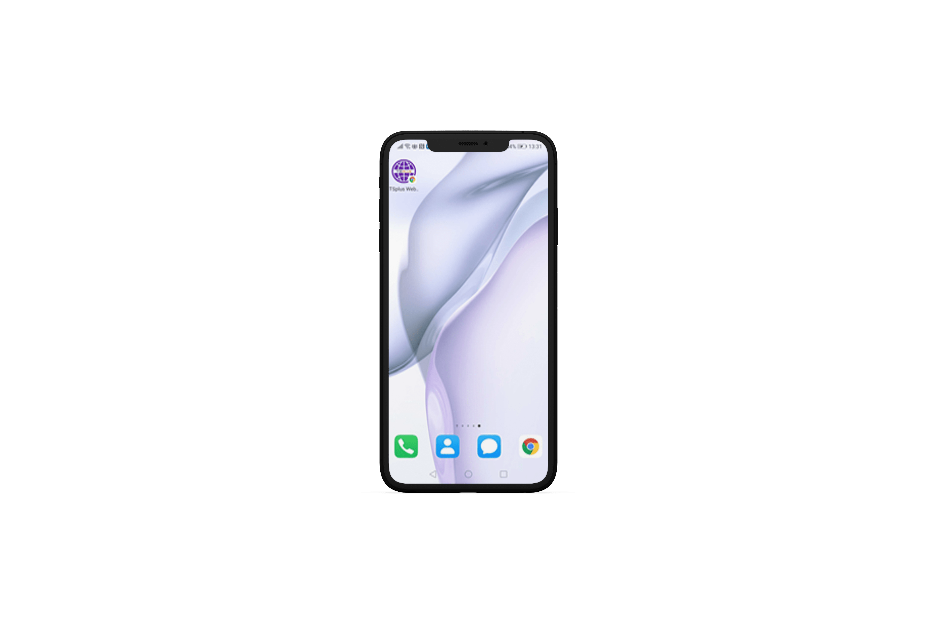
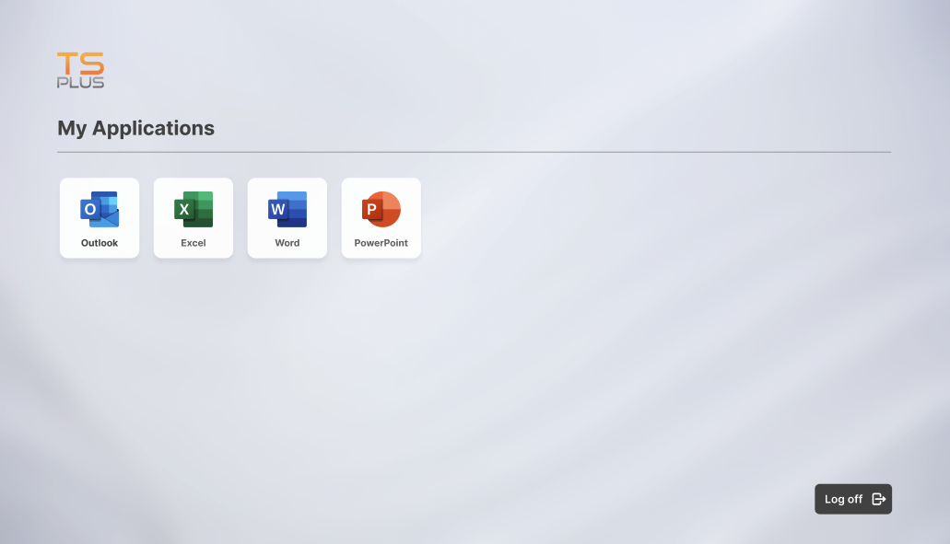
Easily Create The Optimal Remote Environment for Your Business
Give Your Users the Flexibility They Need
1
ACCESS OPTIONS
Use Remote Desktop or Seamless Clients
7
2
TOOLS
Display a full desktop or a single app
13
3
LOOK AND FEEL
Choose the Remote Taskbar, Floating Panel or Open-On-Client
4
MOBILITY
Install the web app on any browser, any device
5
CONNECTIVITY
Compatible with any Windows, Linux, or macOS computer

Slide 8
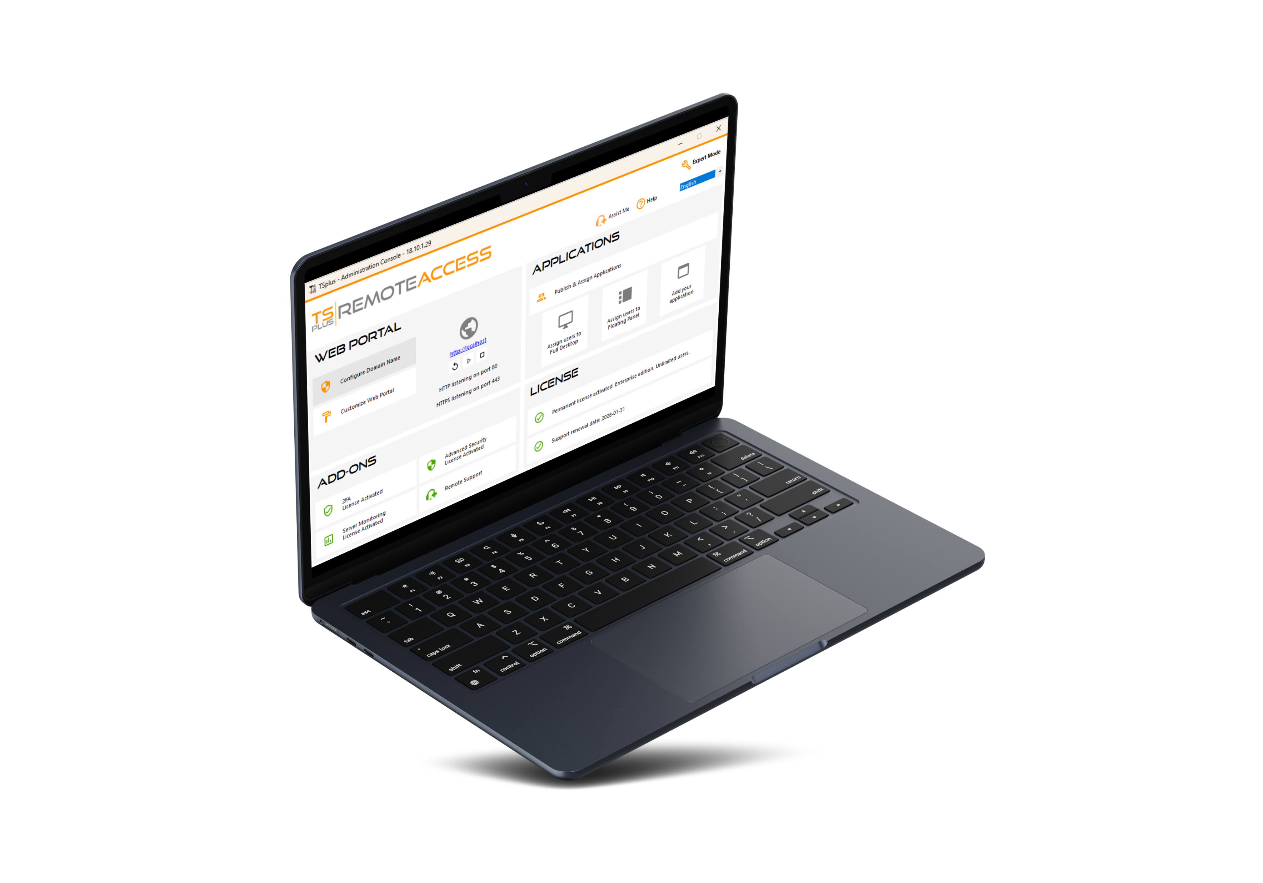
Remote Access is New For You? Get a Quick Start with Our Lite Mode
All our best features, right where you need them
8
1
CUSTOMIZE YOUR WEB PORTAL
Webmaster Toolkit and Real-time Preview
13
2
PUBLISH YOUR FAVORITE APPLICATIONS
Per User or Group
3
ELEVATE YOUR SECURITY
With our security add-ons
4
CHECK AND UPGRADE YOUR LICENSE
3 Editions to grow with your business

Slide 9


Make Remote Access
Safe for Everyone
No third-party servers. Keep control of your connections!
9
13
Built-in web server
SSL/TLS certificate generator
End-to-end encryption
Web credentials
Security add-ons

Slide 10


Corporate data center
or cloud server
The TSplus Difference:
A Built-In Web Server with HTML5 Client
10
Your business applications
installed on the central server
RDP and html5 clients
13
Host your apps on your own servers or in a private cloud for top security
Secure access for multiple users and devices

Slide 11
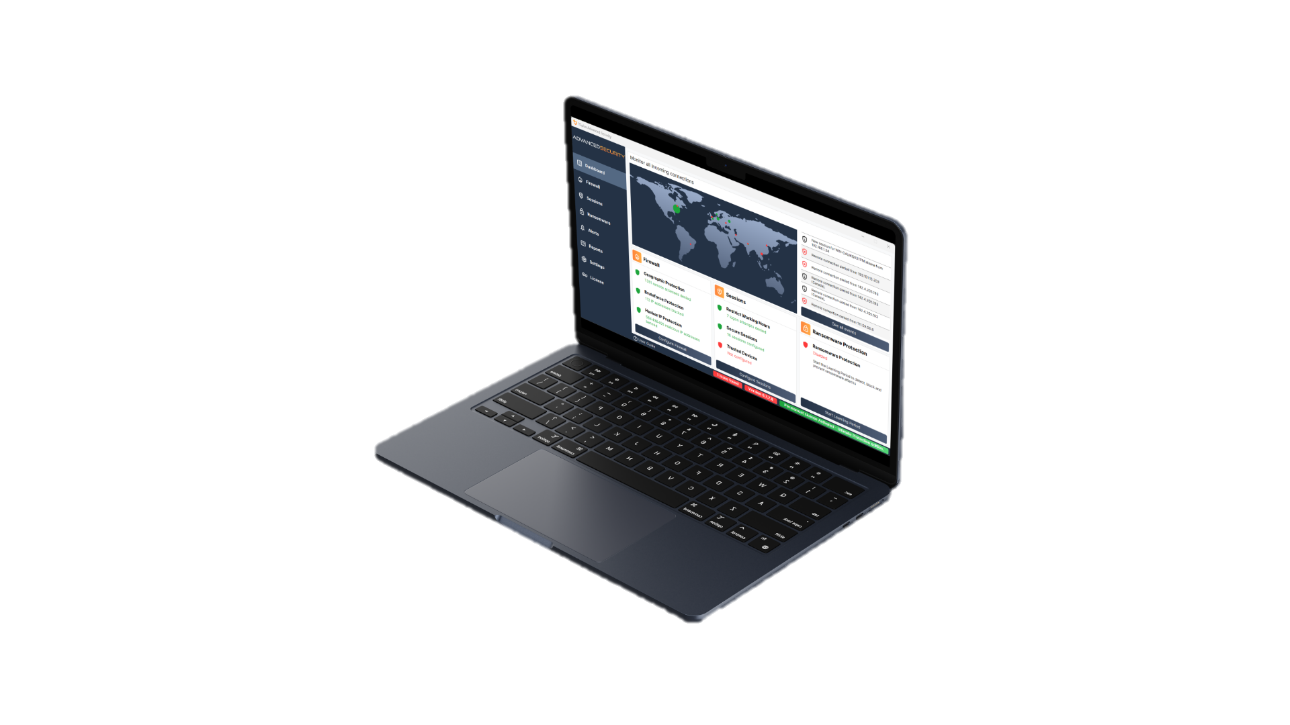
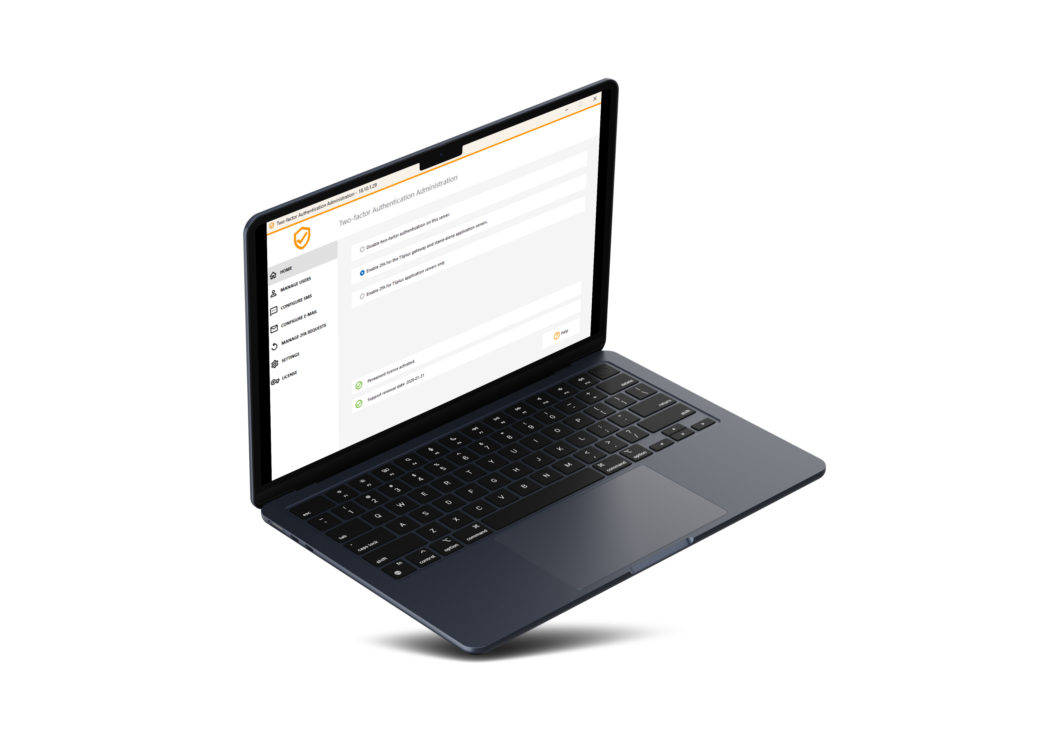

Fortify Your Network Security
TSplus Offers Robust Security Tools for Your Remote Access Network
11
13
An Extra Layer of Security for Your Web Portal
The Remote Desktop CYBER SECURITY Multi-tool
DISCOVER
DISCOVER

Slide 12

A Great Product Should not Come at a Great Cost. Be Smart and Take the Leap!
12
Our very attractive licensing model starts at:
PERPETUAL LICENSES
PER USER PRICING
FREE TRIAL DOWNLOAD
13
$180
for 3 users
Pay only once
Unlimited devices per user
15 Days
Own the licenses forever!
1 year of Updates/Support included
Test it today!
Visit our website

