Slide 1


Monitor your Entire Network
from One Place
DISCOVER
2022

Slide 2


QUICK
TO CONFIGURE
Monitoring and Reporting
for Remote Desktop Servers.
2
8
USER FRIENDLY
Understand your Remote Access infrastructure
in detail To Optimize your Production and save
on it costs!
COST-SAVING

Slide 3
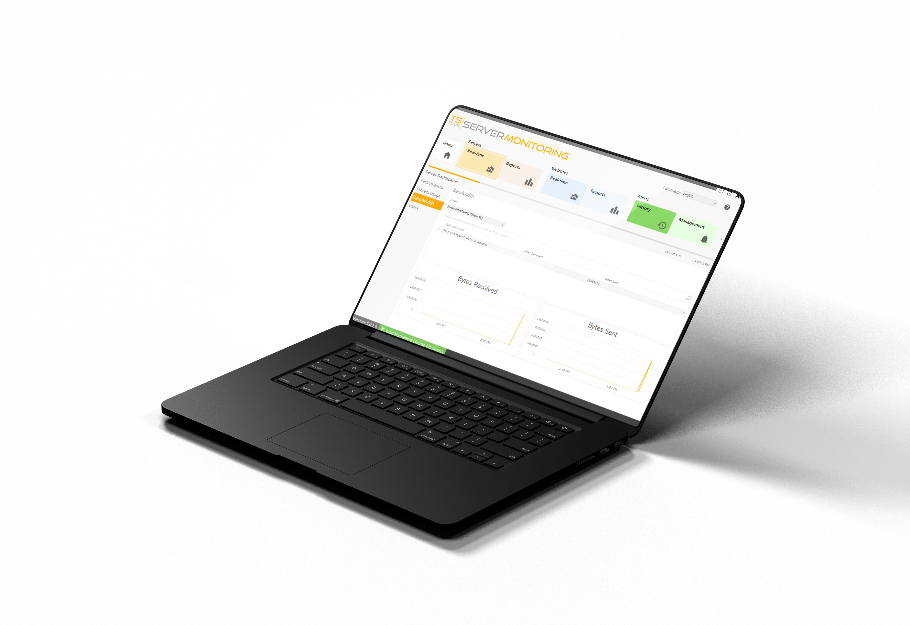
Track Your Server Health in Real-Time
PROCESS & BANDWIDTH
3
Application Usage (Bytes/sec)
Network Usage (Bytes/sec)
8

Slide 4
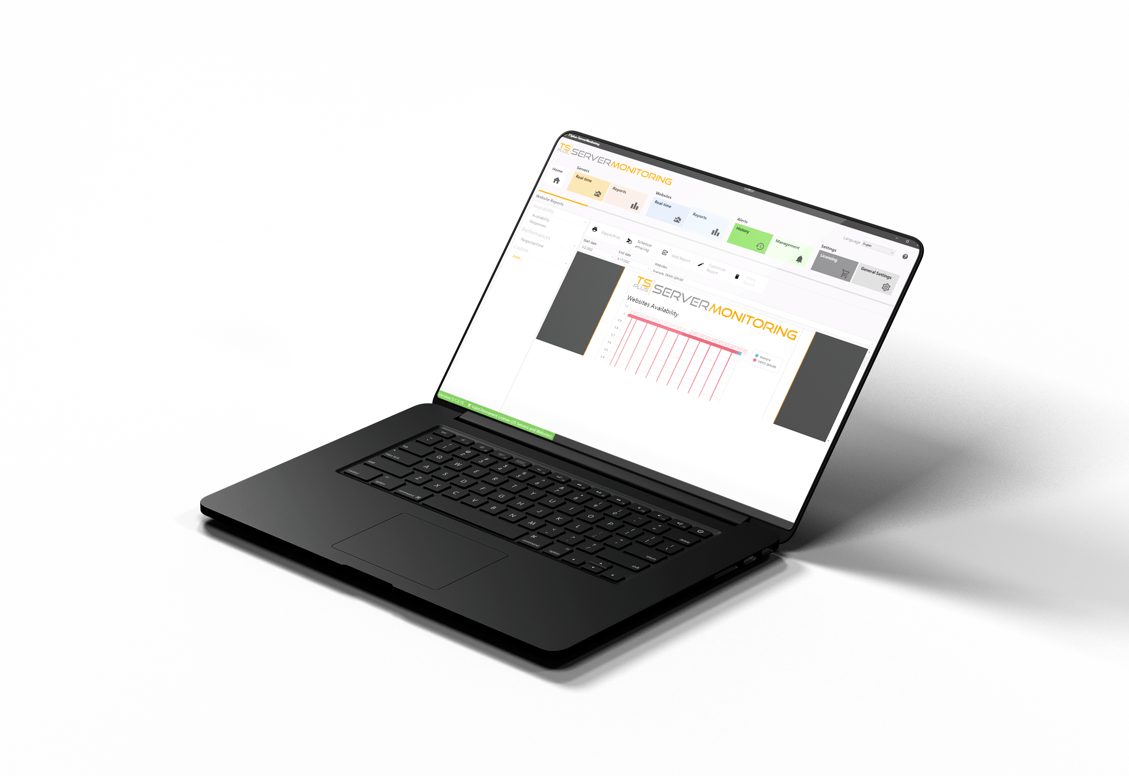
Track Your Server Health in Real-Time
Performance
3
CPU & Memory
Disk Write and Read
8

Slide 5
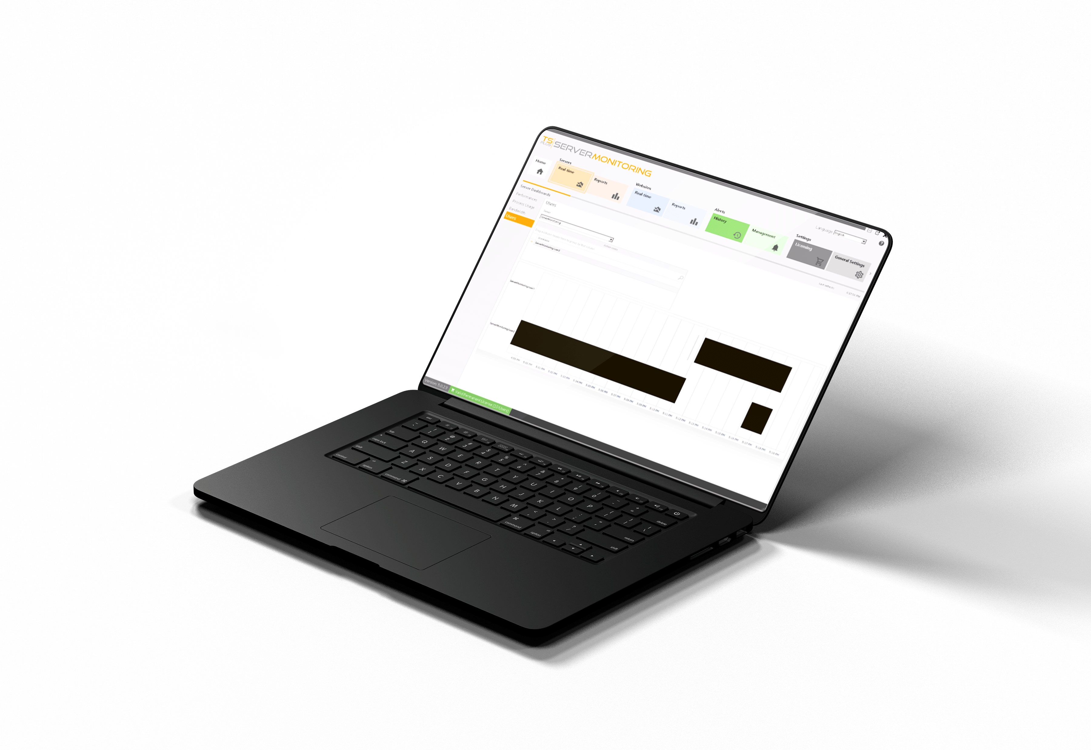
Track Your Server Health in Real-Time
USER BEHAVIOR
3
Active Users/Servers
Session Duration
8

Slide 6
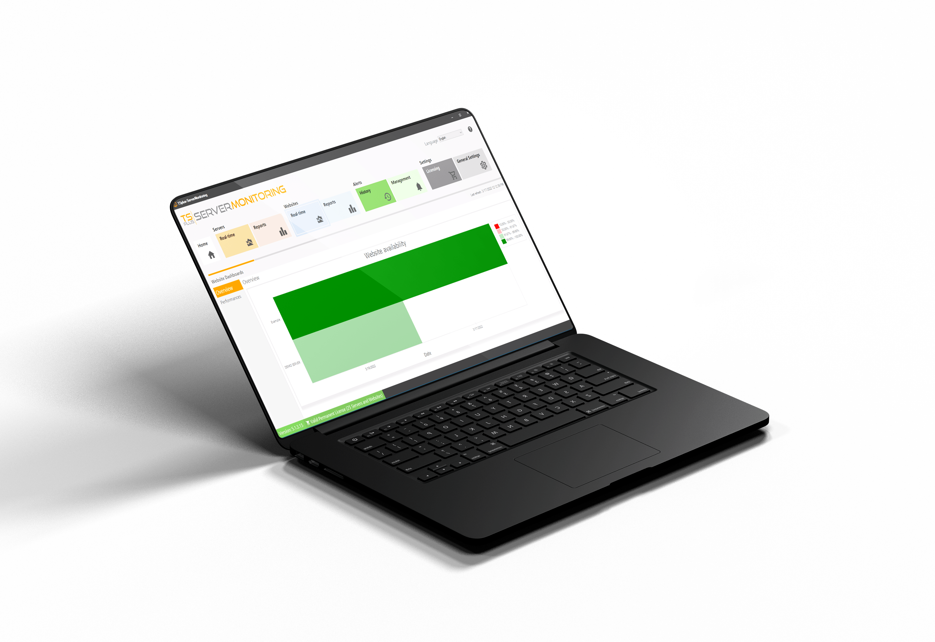
Monitor your Website Activity 24/7
Stay Informed About Your
Website status and Activity
4
AVAILABILITY
8
Up & Down time (%/Day)
Response codes

Slide 7
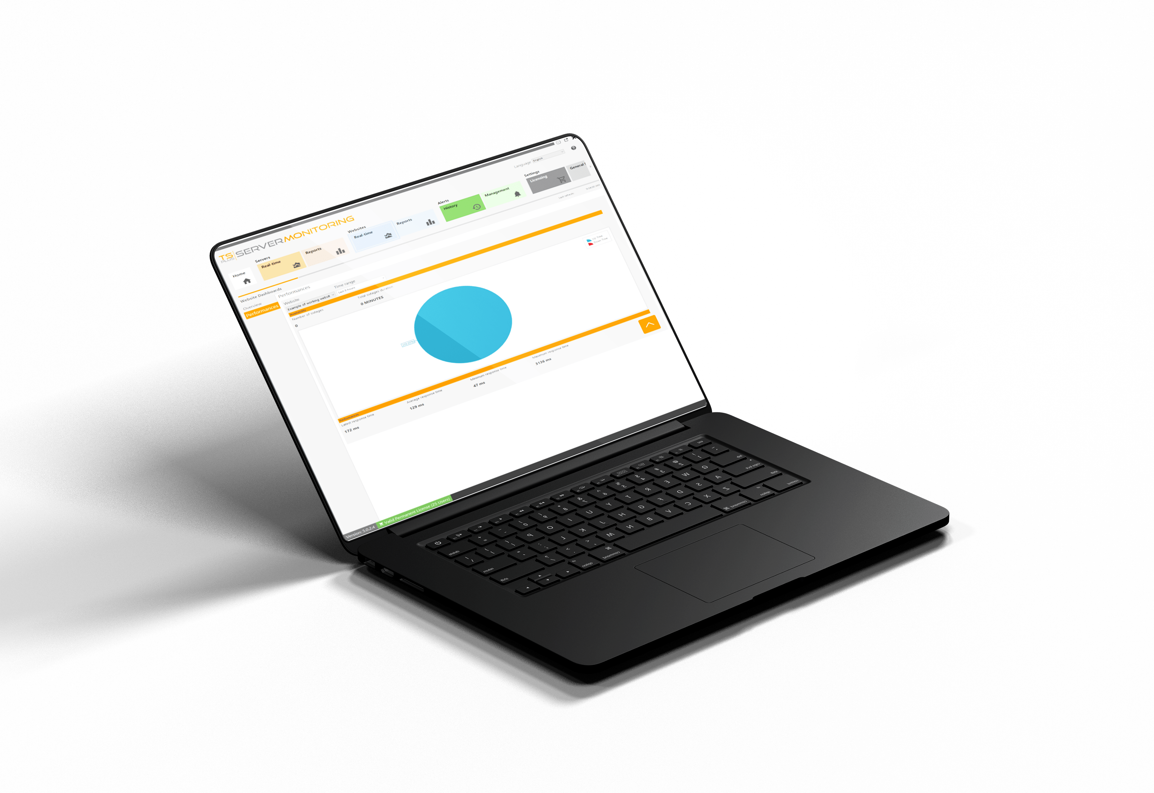
Monitor your Website Activity 24/7
Stay Informed About Your
Website status and Activity
4
PERFORMANCE
8
Number of outages (/Time range)
Total Outage duration

Slide 8
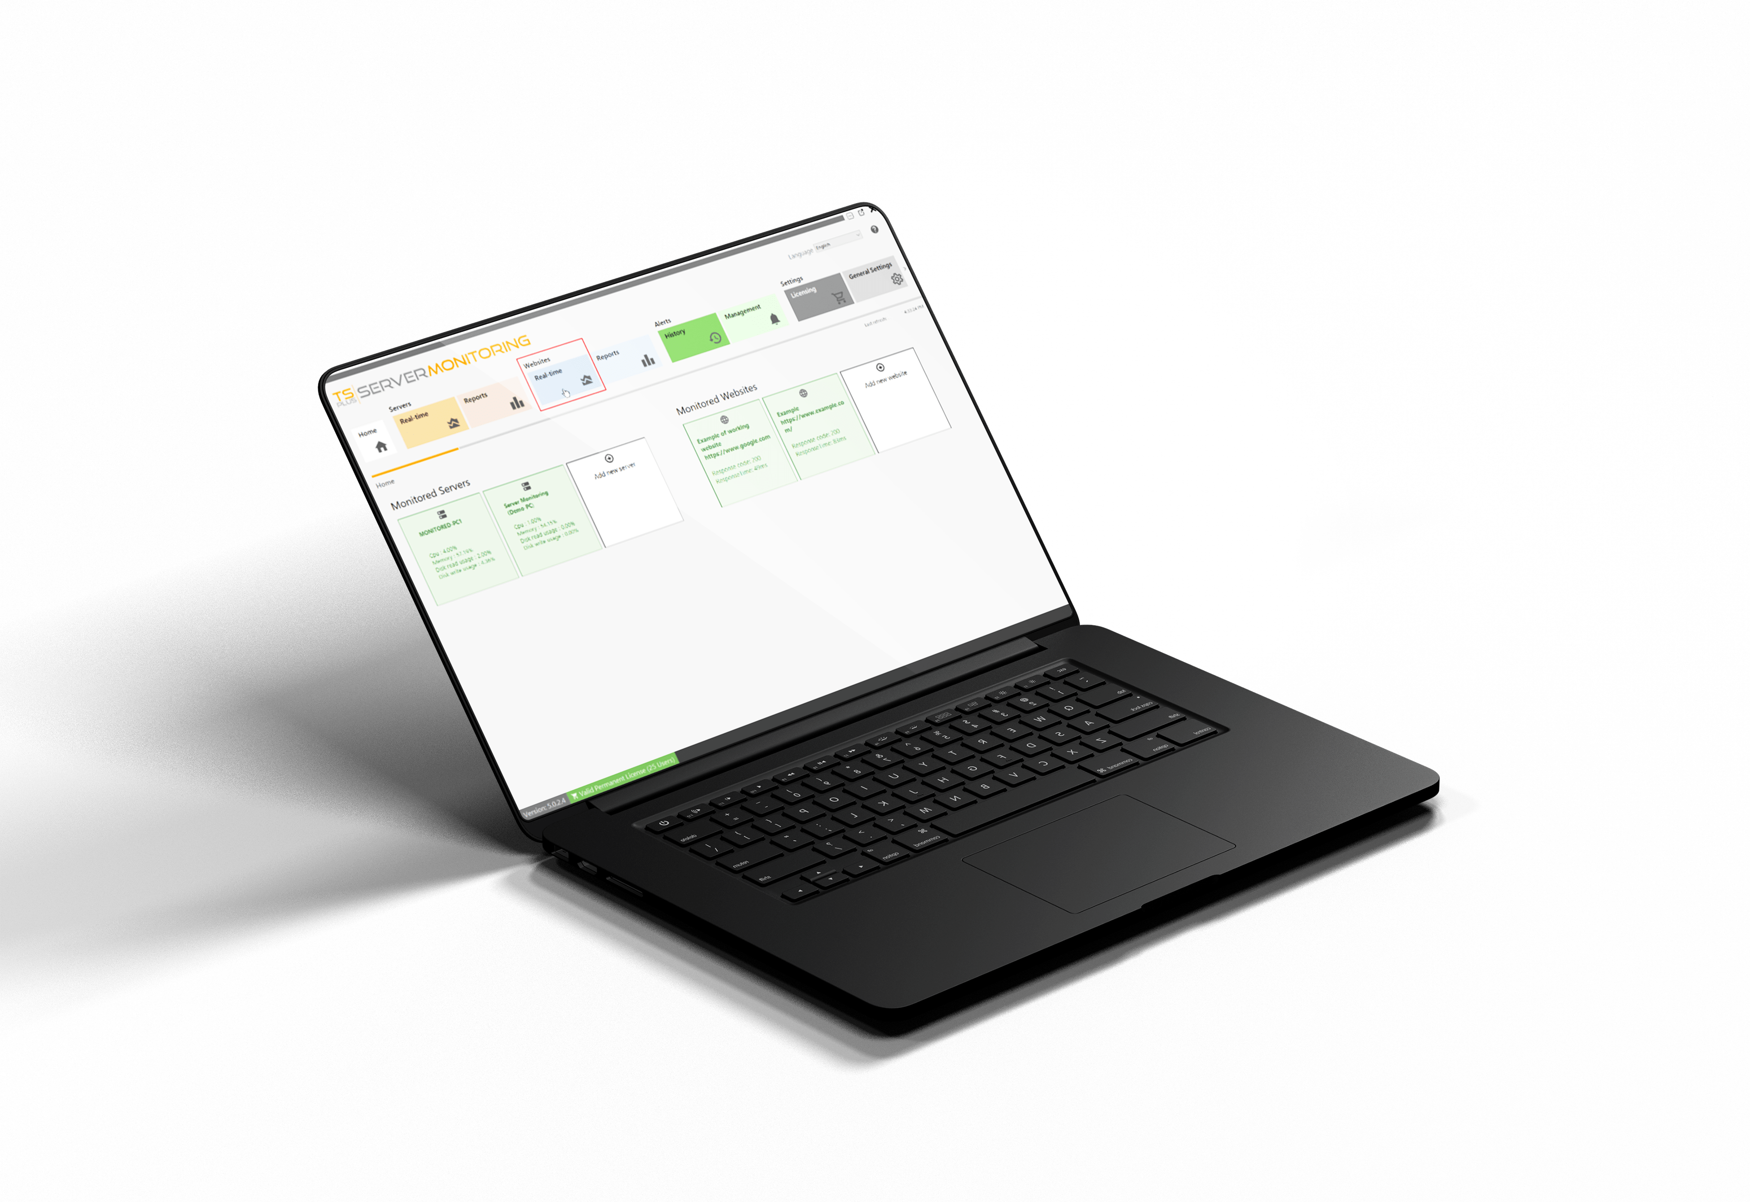
Monitor your Website Activity 24/7
Stay Informed About Your
Website status and Activity
4
RESPONSE TIME
8
Minimum & Maximum
Average Response Time

Slide 9

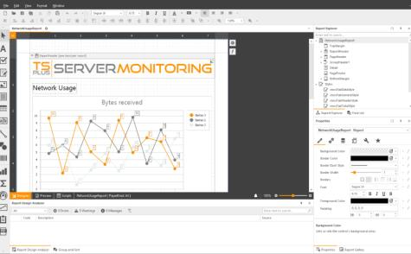

Setup Regular Reporting to Better Manage
your Servers
Easily Create Professional Reports with the Most Relevant Information
5
8
10+ Ready-to-use Reports
Intuitive Custom Reports Tool
Use Real-Time & Historical data
Export and Print Report
Schedule Report Emailing

Slide 10




Receive Real-Time Alerts
on your Network Health
Predict risky situations and troubleshoot issues faster!
6
8
Alert Management Tool
Unlimited Number of Alerts
For Websites and Servers
Customizable Thresholds

Slide 11






Server
Performance
User
Activity
Application
Usage
Website
Status
The TSplus Difference: Easy to Setup and Even Easier to Use
7
8
A small agent installed
on each server
Take Full Control of your Remote Servers
Your farm of servers
server administrators
Real-time alerts

Slide 12

A Great Product Should not Come at a Great Cost. Be Smart and Take the Leap!
8
Our Very Attractive Licensing Model Starts at
PERPETUAL LICENSES
PER SERVER PRICING
FREE TRIAL DOWNLOAD
8
$90
for 1 server and 1 website.
Pay only once
Straightforward Cost
15 days
Own the Licenses Forever
Structure – Simplicity
1 server
Test it today!
Visit our website

