Slide 1
Monitor your Entire Network from One Place
DISCOVER
2025

Slide 2
QUICK TO CONFIGURE
Monitoring and Reporting for Remote Desktop Servers.
2
13
USER FRIENDLY
Understand your Remote Access infrastructure in detail to optimize your production and save time and money!
COST-SAVING

Slide 3
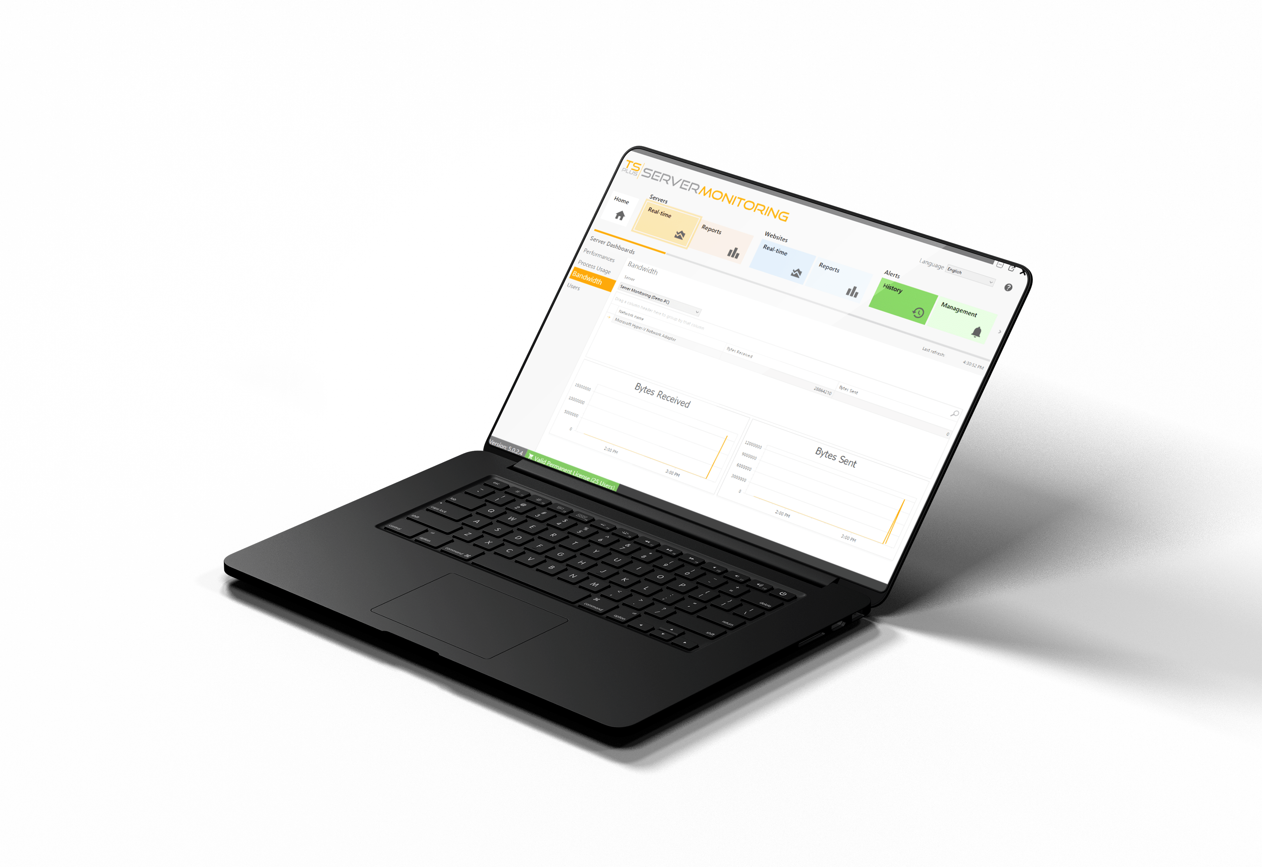
Track Your Server Health in Real-Time
PROCESS & BANDWIDTH
3
Application usage (memory, CPU, bytes/sec)
Network usage (bytes/sec)
13

Slide 4
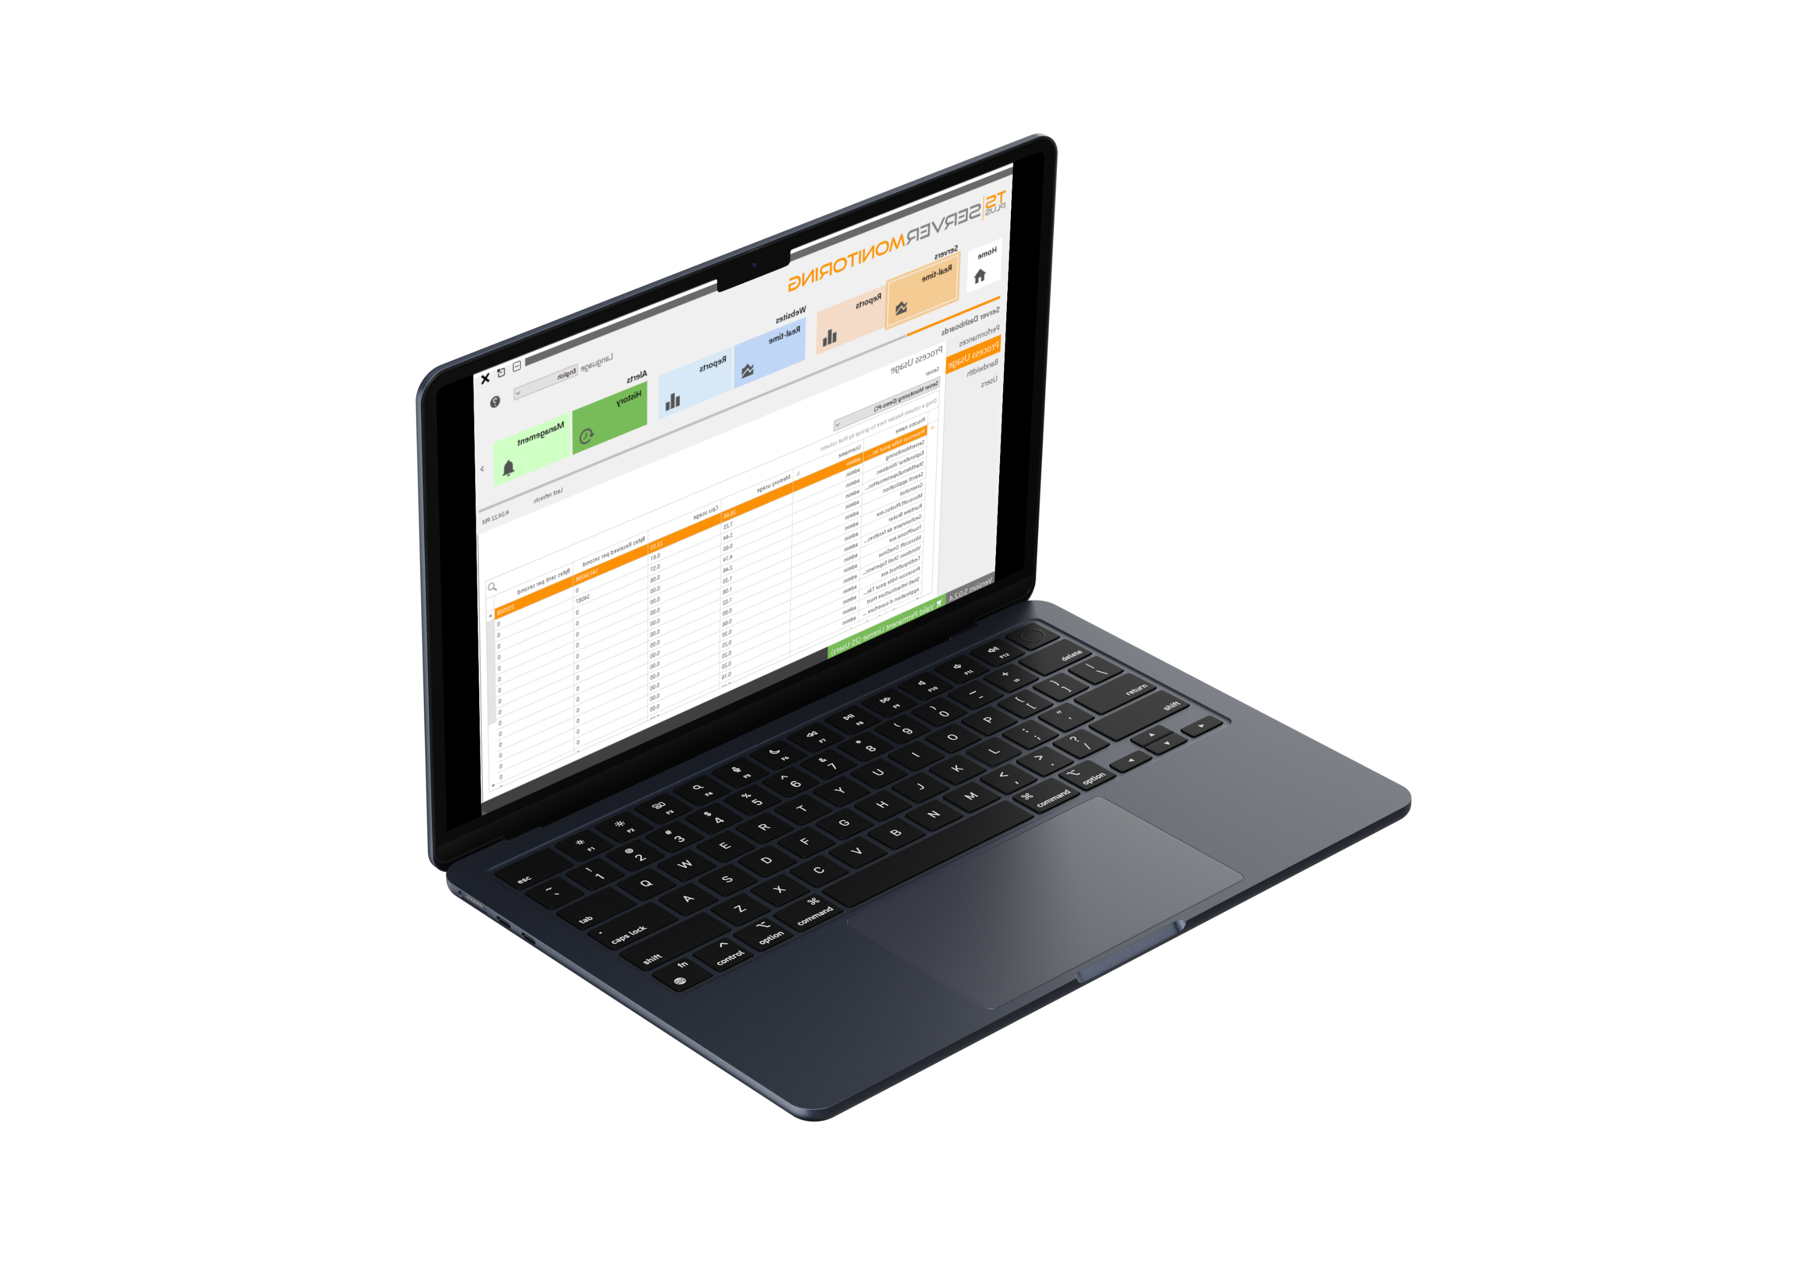
Track Your Server Health in Real-Time
Performance
4
CPU & memory
Disk read & write statistics
13

Slide 5
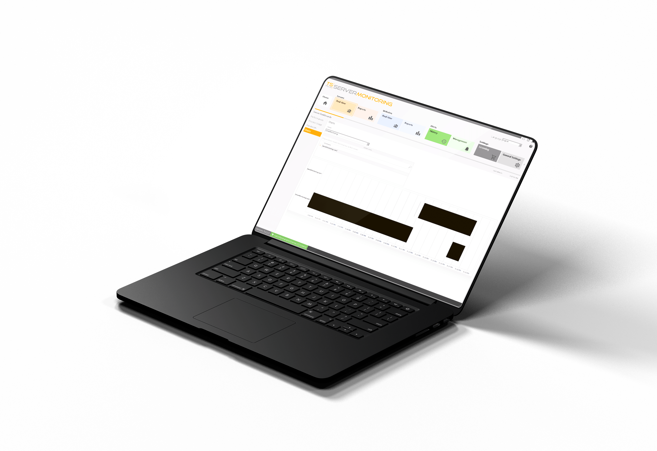
Track Your Server Health in Real-Time
USER BEHAVIOR
5
Active users and servers
Session duration
13

Slide 6
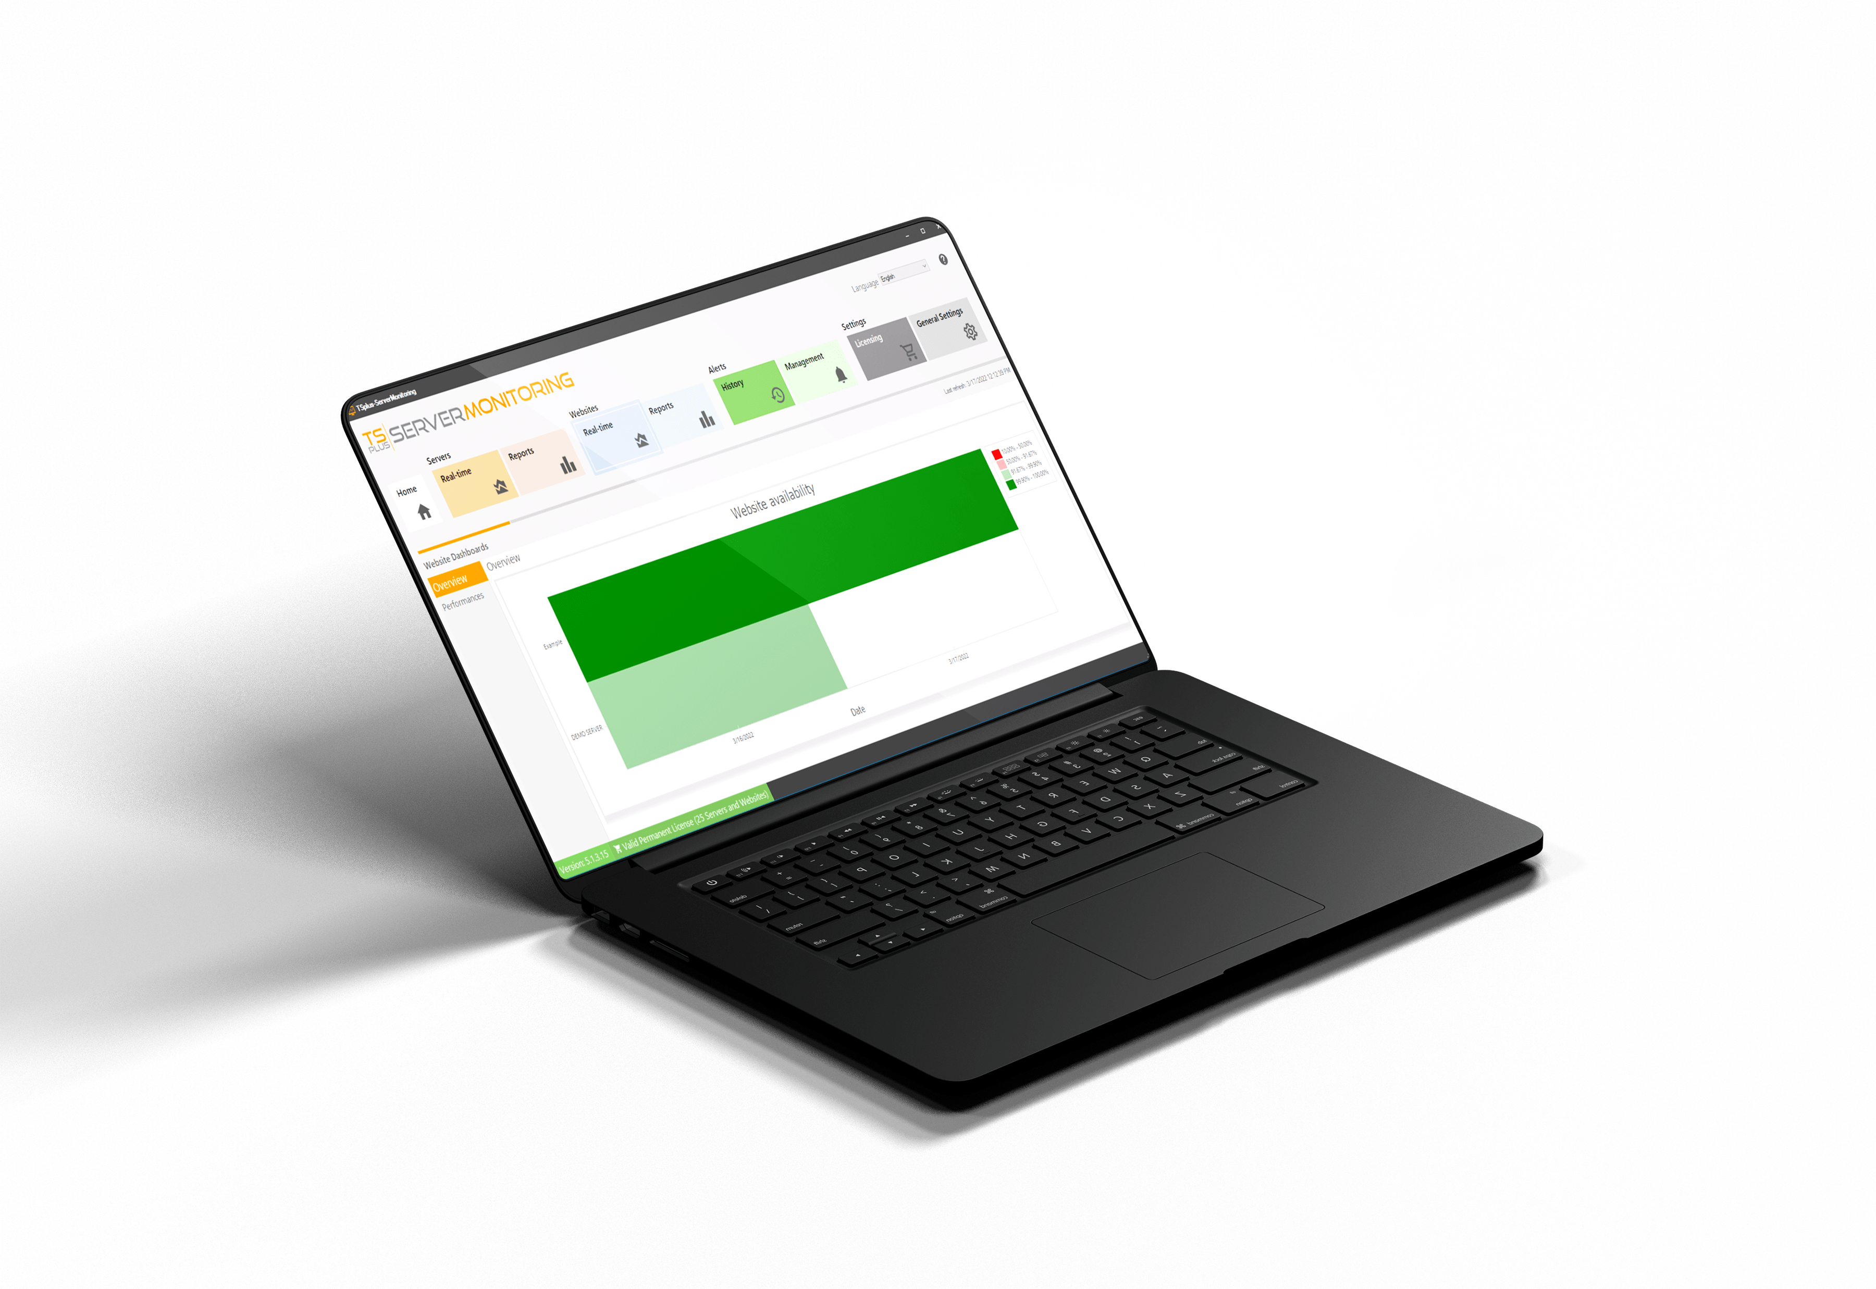
Monitor your Website Activity 24/7
Stay informed about your website status and activity
6
AVAILABILITY
13
Track up and down time
Monitor website response codes

Slide 7
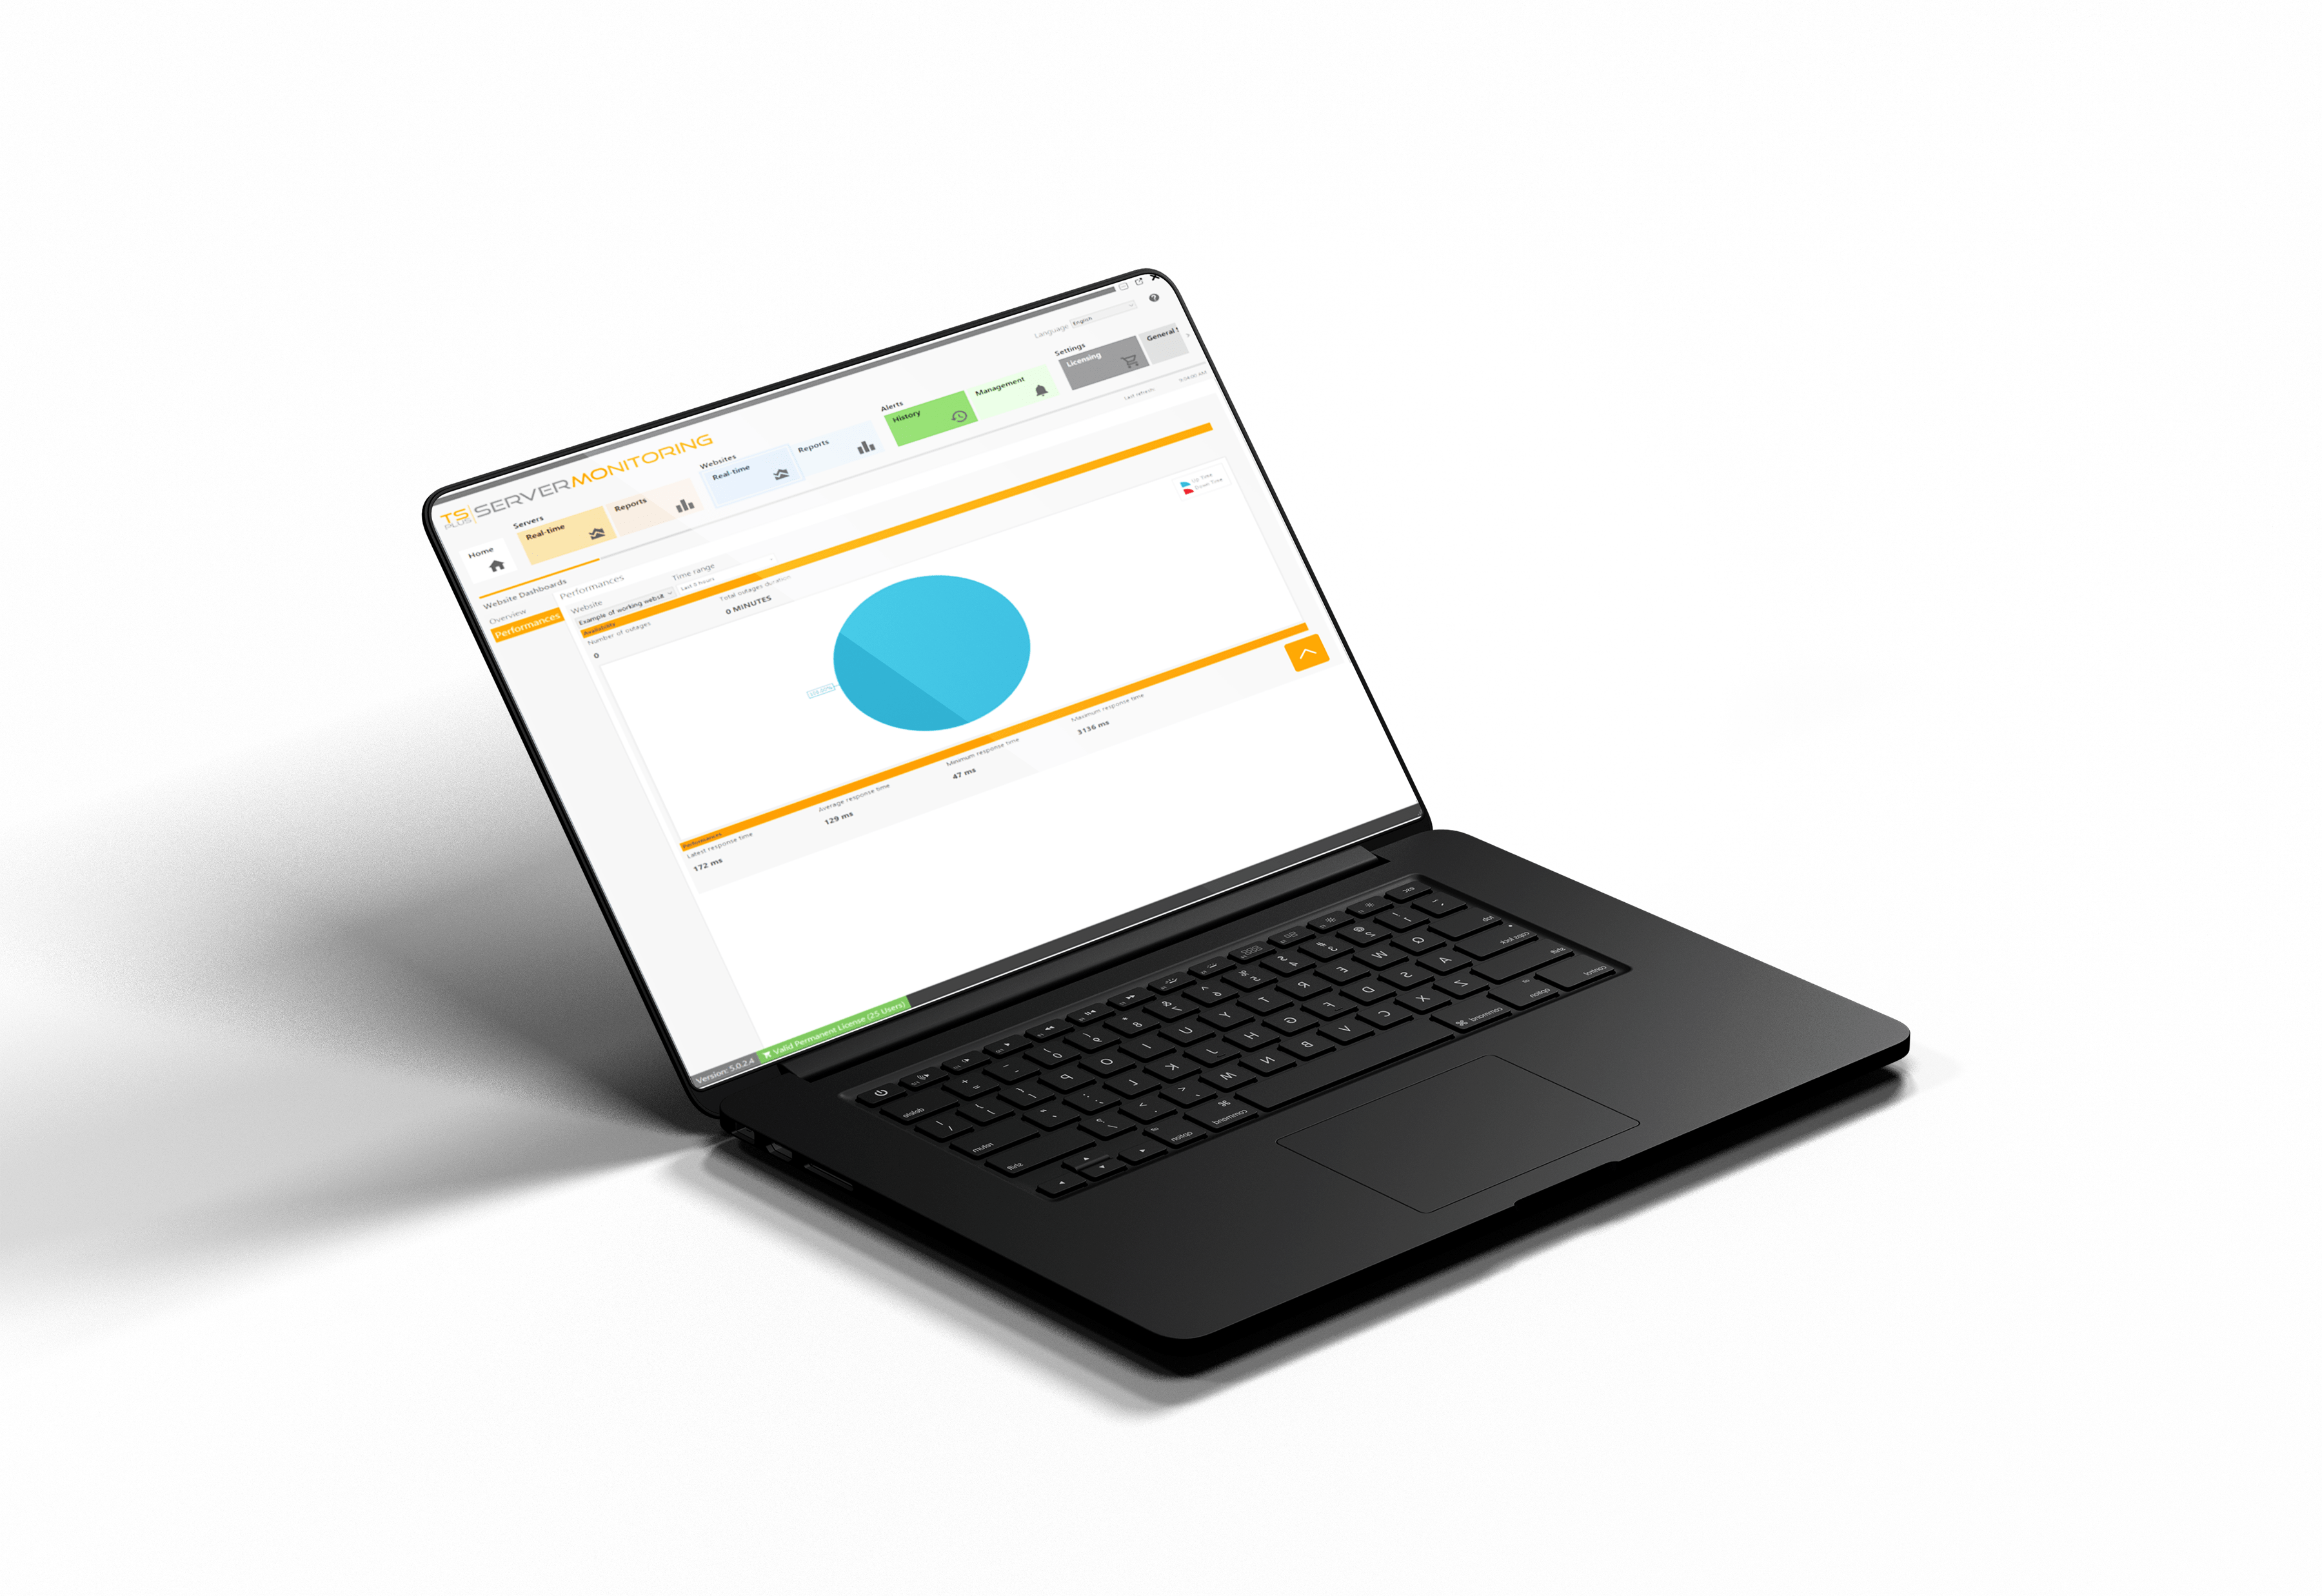
Monitor your Website Activity 24/7
Stay informed about your website status and activity
7
PERFORMANCE
13
Number of outages (selected time range)
Total outage duration

Slide 8
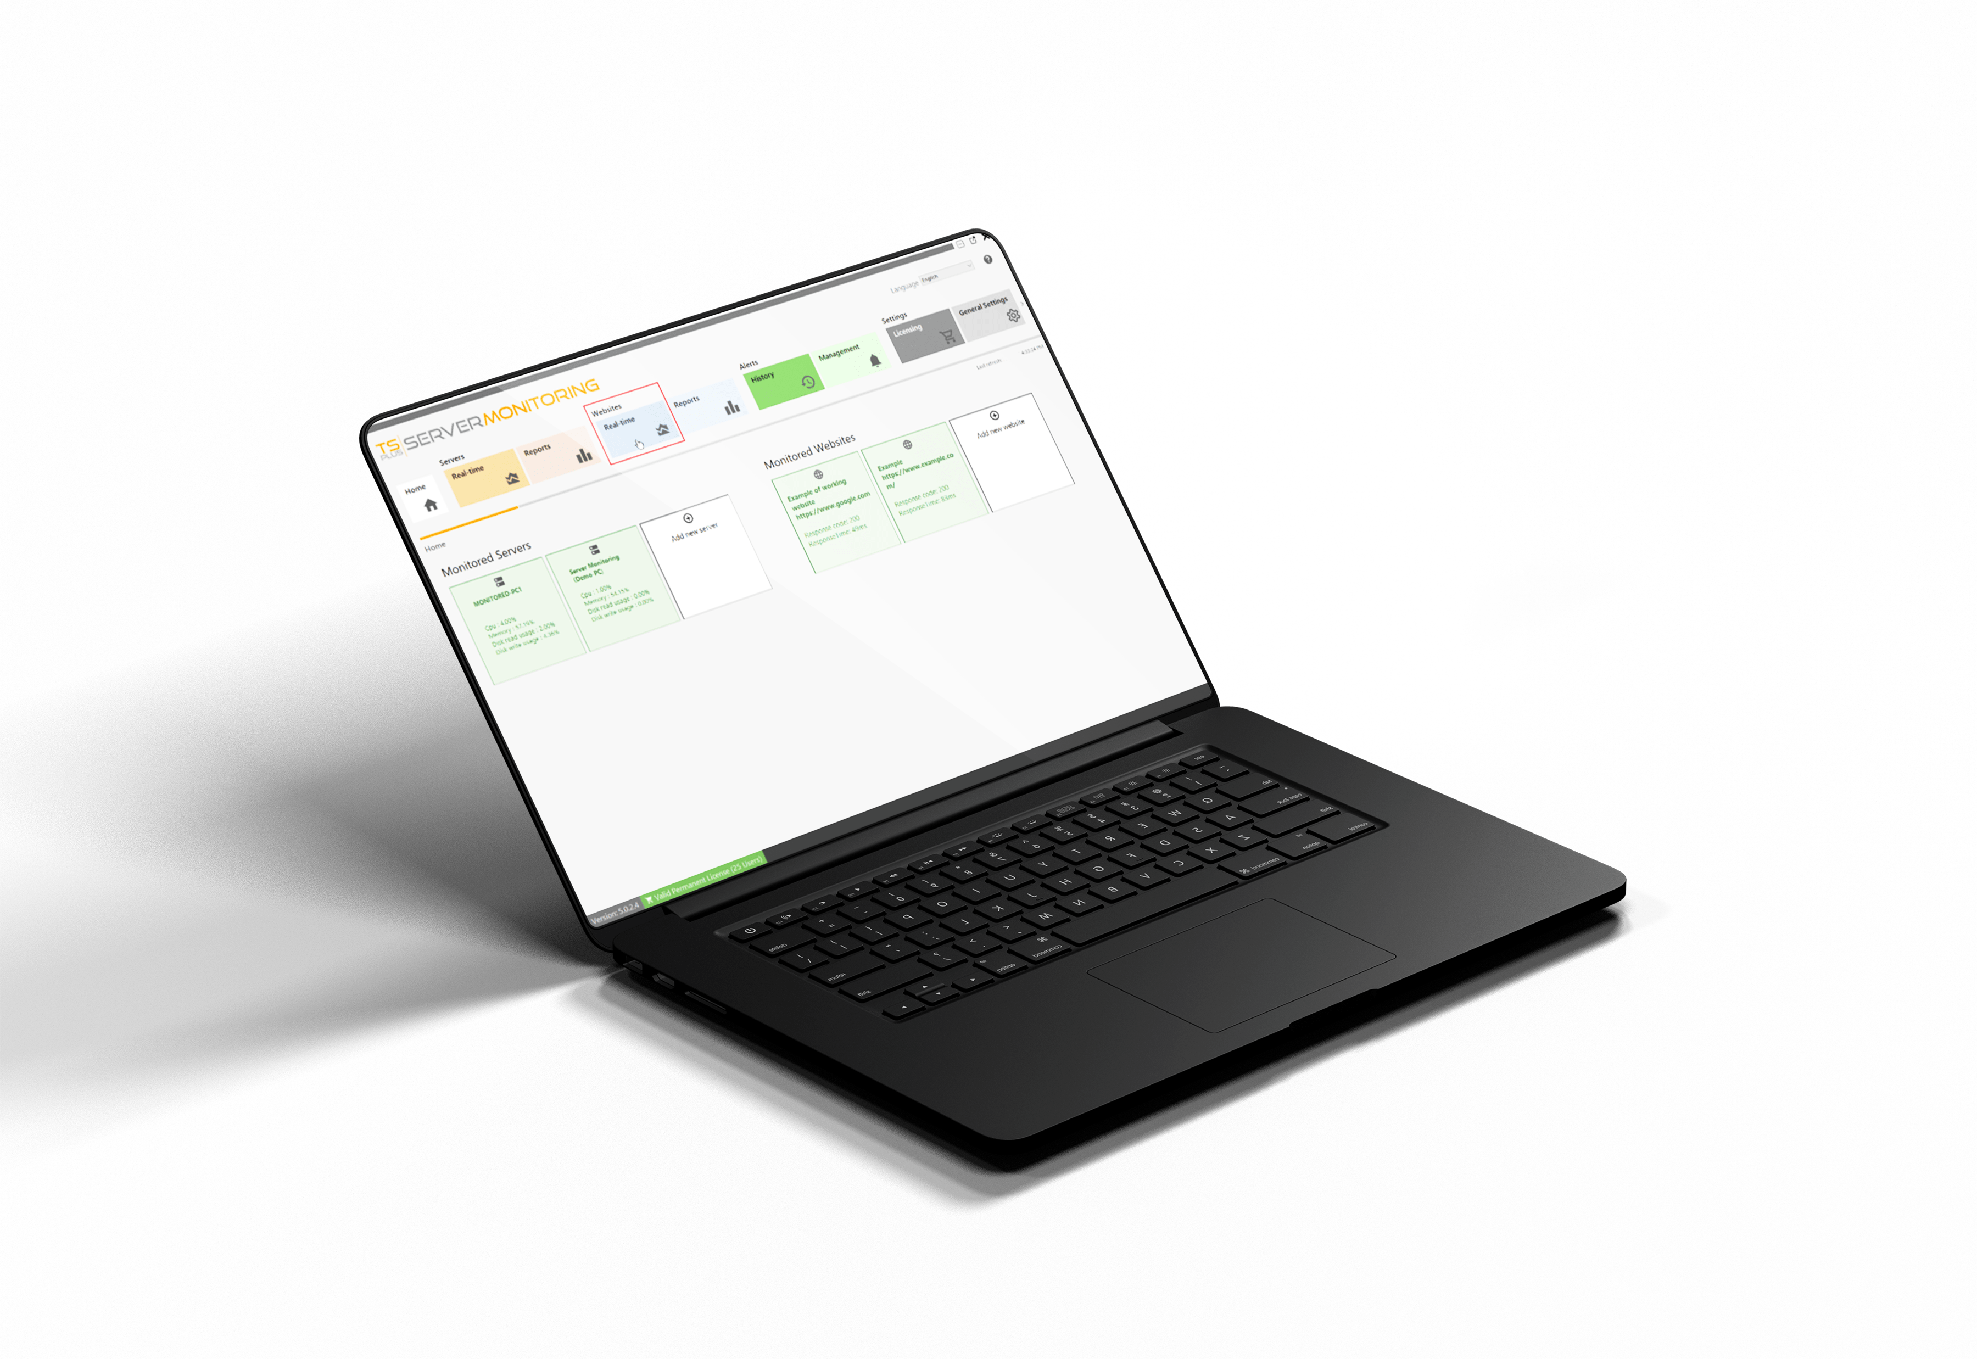
Monitor your Website Activity 24/7
Stay informed about your website status and activity
8
RESPONSE TIME
13
Minimum & maximum
Average response time

Slide 9
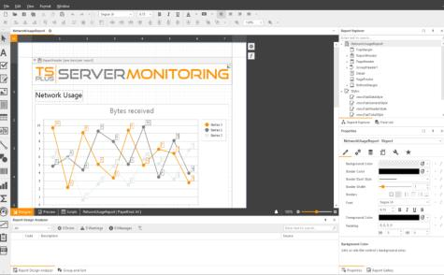
Set up Regular Reporting to Better Manage your Servers
Easily create professional reports with the most relevant information
9
13
10+ ready-to-use reports
Intuitive customization tool (logo, brand colors, etc.)
Use real-time & historical data
Search, save, export and print reports
Schedule report emailing

Slide 10
Receive Real-Time Alerts on your Network Health
Predict risky situations and troubleshoot issues faster!
10
13
Alert management tool
Unlimited number of alerts
For websites, servers and users
Customizable thresholds
Automatic notifications by email

Slide 11
Server
Performance
User Activity
Application
Usage
Website
Status
The TSplus Difference: Easy to Set up and Even Easier to Use
11
13
A small agent installed on each server
Take full control of your remote access infrastructure
Your farm of servers
server administrators
Real-time alerts

Slide 12
A Great Product Should not Come at a Great Cost. Be Smart and Take the Leap!
12
Our very attractive licensing model starts at
PERPETUAL LICENSES
PER SERVER PRICING
FREE TRIAL DOWNLOAD
13
$110
for 1 server and 1 website.
Pay only once
Straightforward pricing
15 Days
Own the licenses forever
1 Year Updates/Support included
1 Server
Test it Today!
Visit our website

